Slide 1
Social Preference
International Workshop on Behavioural Sciences and Urban-Rural Development in Developing Countries, 24 – 26 July 2023, Newnham College, University of Cambridge

Slide 2
Social Preference
Social preference refers to the tendency of individuals to prioritize and make decisions based on the interests and well-being of others in their social environment.
Examples:
Prosocial Behavior: Social preference fosters prosocial behavior, such as helping, comforting, or cooperating with others, driven by genuine concern for their welfare.
Altruism: Socially preferential people display altruistic acts, performing selfless deeds to benefit others without expecting anything in return.
Sharing Resources: People with social preference willingly share their resources, such as food, money, or time, with others in need, even if it means sacrificing some of their own well-being.
… …

Slide 3
Social Preference Nudges
Social Norms Messaging: Highlighting the behaviour that is most commonly practiced by others can influence individuals to follow suit. "80% of your neighbours have reduced their energy usage. Join them!"
Peer Comparisons: Show how an individual's behaviour compares to that of their peers in a positive or constructive way. "Your contribution is greater than 90% of donors!"
Social Rewards: Emphasize the social benefits or recognition that come with desired behaviours. "Be part of a caring community. Join our team of volunteers!"
Public Commitments: Encourage individuals to make their commitments publicly, making them more likely to follow through due to a desire to maintain a consistent self-image. For example, when encouraging recycling, ask people to sign a pledge visible to others.
Social Gamification: Introduce elements of competition or cooperation with others to encourage desired behaviours. For instance, in promoting physical activity, create challenges or competitions within a social group.

Slide 4
Social Preference
Galizzi, M. M. and D. Navarro-Martinez (2019). "On the External Validity of Social Preference Games: A Systematic Lab-Field Study." Management Science 65(3): 976-1002.
Self-reported social behaviours performed in the past, decisions in seven experimental social preference games, and behaviours in five naturalistic field situations that we created.
Survey: Self-Report Altruism (SRA) scale, 20 items (questions)
Lab experiments: dictator game (2), ultimatum game (2), trust game (2), and public good game (1)
Field experiments: help moving boxes, lend mobile phones, and donate to children’s charity, environmental charity, and lab donation.
The extent to which the games can explain the self-report measures and the field behaviours
The overarching conclusion is that the games do a poor job explaining both the self-report measures and the field behaviours

Slide 5
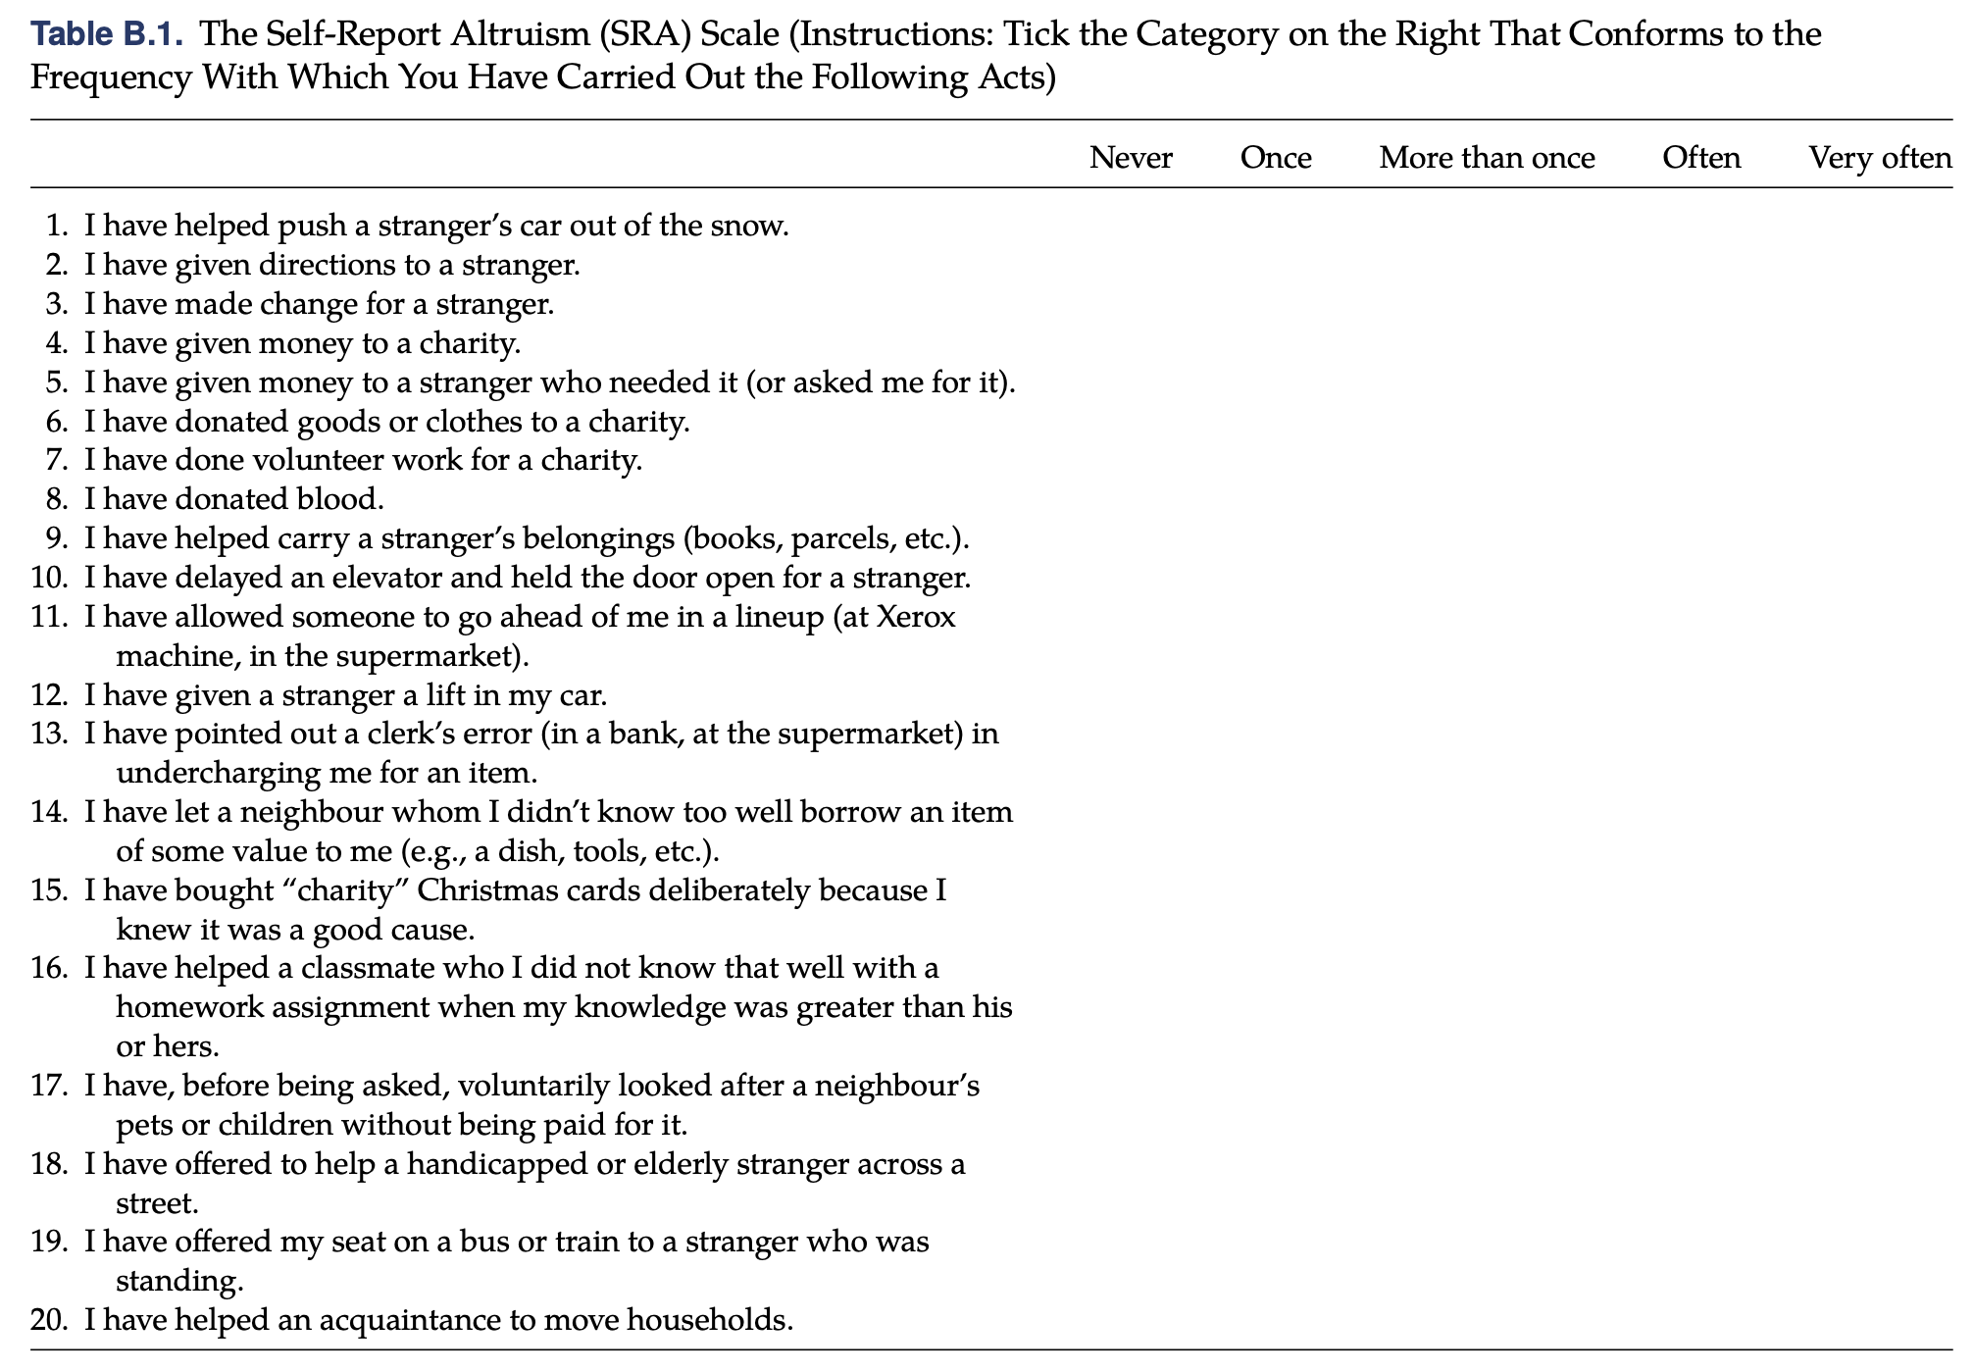
Survey Questions

Slide 6
Altruism Games
Dictator Game (DG1): Two-player game in which player 1 decides how to divide £10 between the self and player 2. Player 2 simply receives the allocation established by player 1. Half of the participants were player 1 and the other half player 2.
Dictator Game (DG2): Like Dictator Game 1, but switching the roles (and matching people with different partners).
Ultimatum Game (UG1): Two-player game in which player 1 decides how to divide £10 between him/her and player 2. player 2 decides whether to accept the allocation or not. If the allocation is rejected, both players get nothing. Half of the participants were player 1 and the other half player 2.
Ultimatum Game (UG2): Like Ultimatum Game 1, but all of the participants were player 2 and had to respond to the same allocation of £3 for player 2, which was determined by a participant who was player 1 in a preliminary pilot session.
Trust Game (TG1): Two-player game in which player 1 has an endowment of £10 and decides how much of it to send over to player 2. The amount sent over is multiplied by three and given to player 2, who has to decide how much of it to send back to player 1. Half of the participants were player 1 and the other half player 2.
Trust Game (TG2): Like Trust Game 1, but all of the participants were player 2 and all of them had to respond to the same amount of £4 sent over by player 1, which was determined by a participant who was player 1 in a preliminary pilot session.
Public Good Game (PGG): Four-player game in which all of the players have an endowment of £10 and have to decide simultaneously how much of it to contribute to a common group fund. The overall money in the group fund is then multiplied by two and split between the four players.

Slide 7
Field Experiments
Boxes: A research assistant stood in an area out- side of the lab and told the participants that he needed help carrying two voluminous (but light) boxes to the basement of the university building where the lab was located. He explicitly asked the participants one by one after they exited the lab if they could help. If the participants said yes, they actually helped him carry the boxes downstairs.
Phone: A research assistant stood outside of the lab and said to the participants that he needed to make a quick phone call but that his phone was out of battery. He explicitly asked the participants if they could lend him their phone for a minute to make the call. If the participants lent him the phone, he simply made a call, hung up, and said that there was no answer.
Children’s Charity: A research assistant stood outside of the lab collecting money for a leading charity dedicated to helping children in developing countries. He explicitly asked the participants if they wanted to contribute money to the charity. The research assistant was wearing an official university T-shirt and a professional (sealed) charity bucket of the type commonly used to collect donations, with a large sticker with the logo of the charity. He also had color-printed leaflets with a brief description of the charity and its activities. The money given by people was then actually sent to the charity.
Environmental Charity: This situation was exactly like the previous one, but with a different charity. This organization was a leading charity dedicated to protecting the environment. The money donated was actually sent to the charity.
Lab Donation: This situation was analogous to situations 3 and 4, but this time the research assistant was asking for money to support research projects conducted in our lab. The money given by people was actually added to the research funds of the lab.

Slide 8
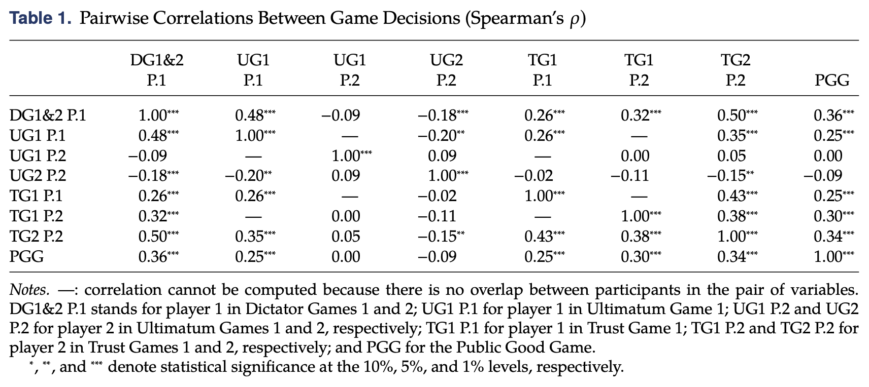
Social Preference
Galizzi, M. M. and D. Navarro-Martinez (2019). "On the External Validity of Social Preference Games: A Systematic Lab-Field Study." Management Science 65(3): 976-1002.

Slide 9
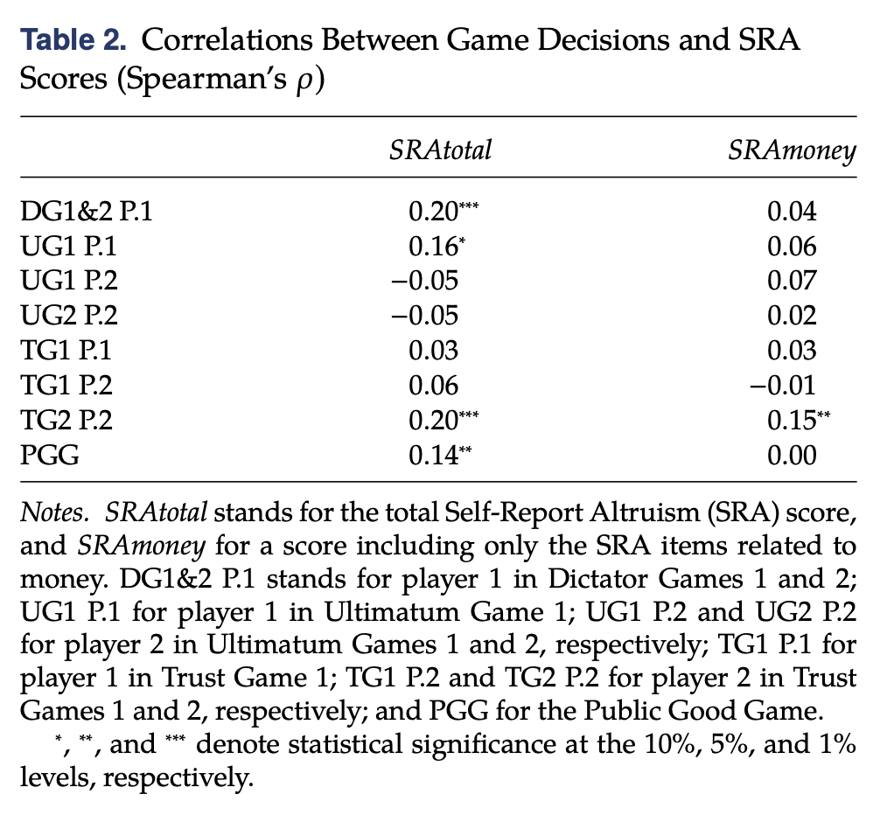
Social Preference
Galizzi, M. M. and D. Navarro-Martinez (2019). "On the External Validity of Social Preference Games: A Systematic Lab-Field Study." Management Science 65(3): 976-1002.

Slide 10
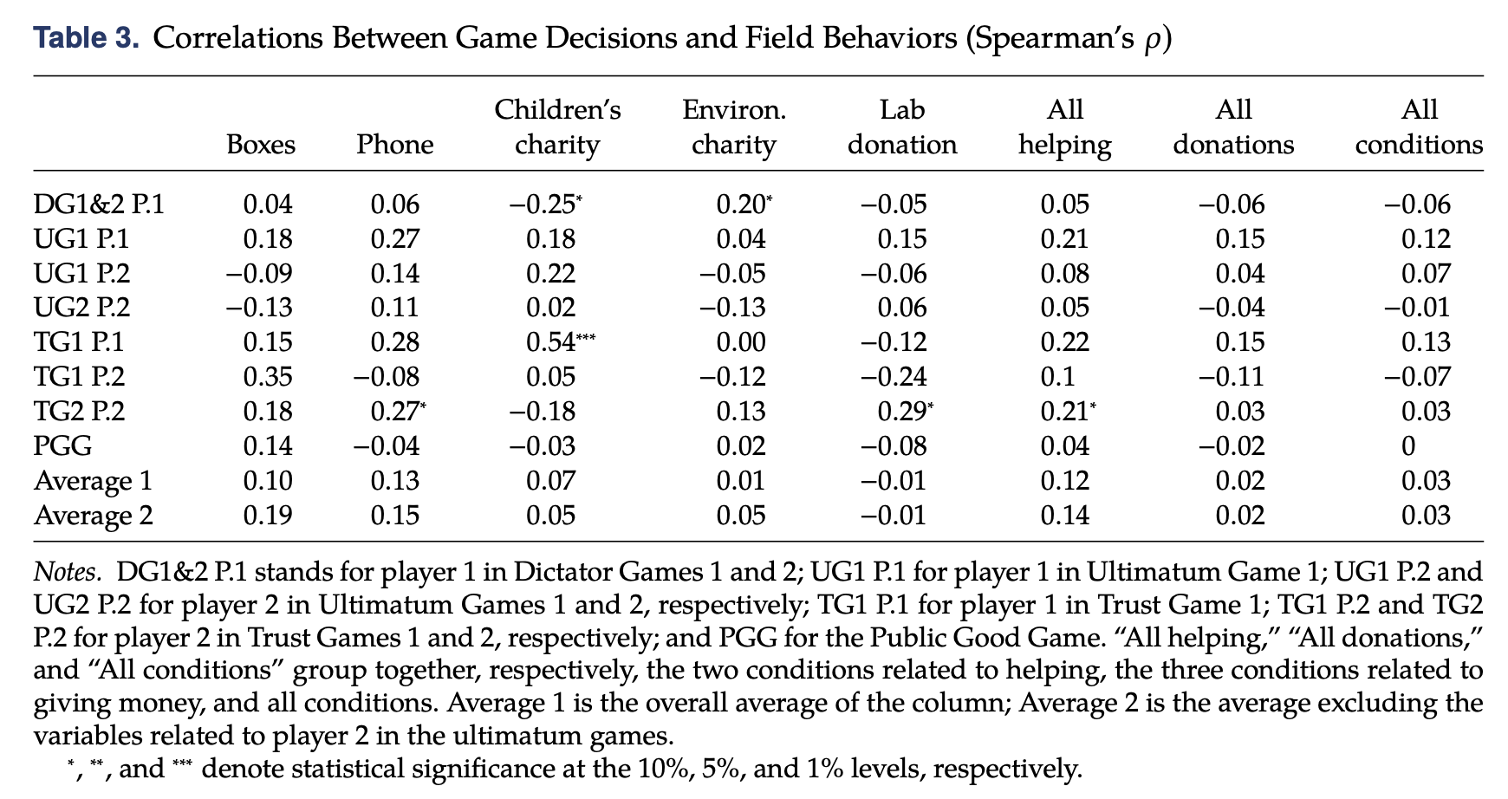
Social Preference
Galizzi, M. M. and D. Navarro-Martinez (2019). "On the External Validity of Social Preference Games: A Systematic Lab-Field Study." Management Science 65(3): 976-1002.

Slide 11
Example: BIT & Organ Donation
Working with National Health Services (NHS) Blood and Transplant, Government Digital Services, the Department of Health and the Driver and Vehicle Licensing Agency (DVLA) to increase the number of people on the NHS Organ Donor Register.
They used the point at when people had just completed registering for a driving licence or renewing their vehicle tax to trial 8 different prompts on over 1 million people.
Prediction: ‘Over the course of a year, this would lead to approximately 96,000 additional completed registrations compared with the control (assuming all other factors are equal)’.
Outcome: ‘Prompting people to join the Organ Donor Register using reciprocity messages (‘if you needed an organ, would you have one?’) adds 100,000 people to the register in one year’.

Slide 12
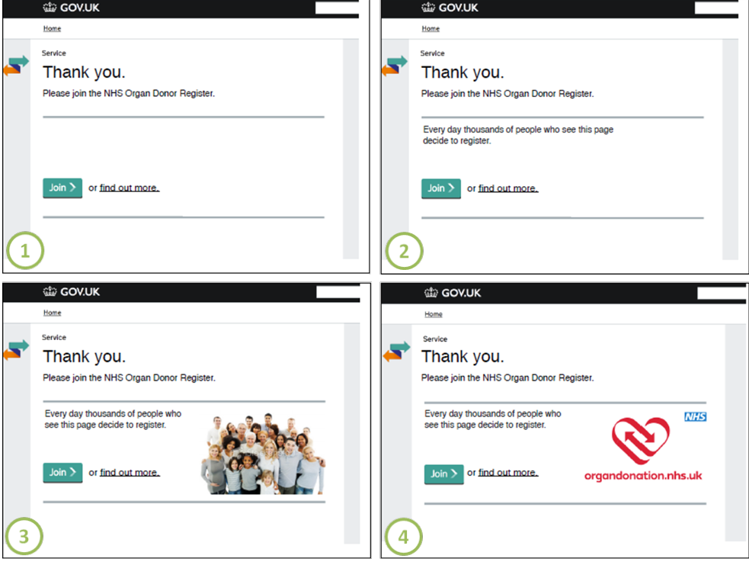
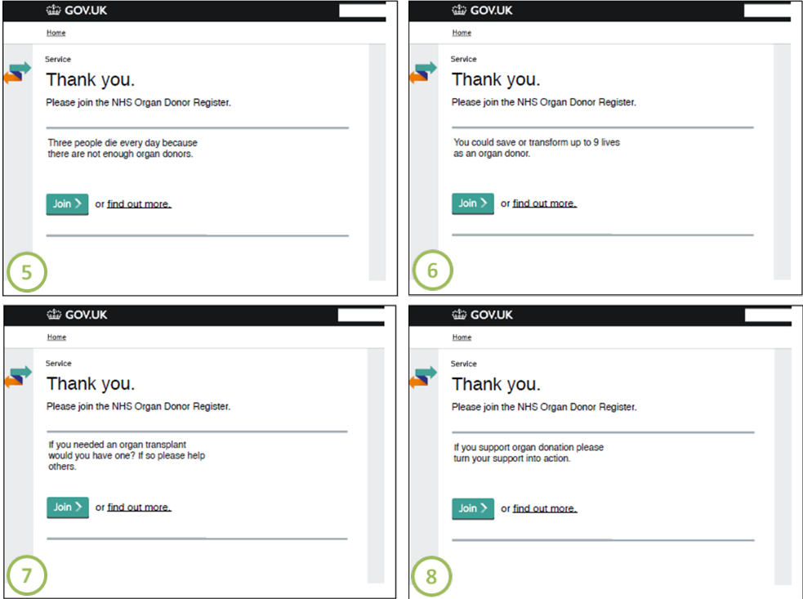
Example: BIT & Organ Donation
Control page
Social norm
Loss frame
Gain frame
Salience 1
Salience 2
Fairness & reciprocate
Intention & action

Slide 13
Example: BIT & Organ Donation

Slide 14
Social comparison
Theoretical framework:
Festinger, L. (1954). "A Theory of Social Comparison Processes." Human Relations 7(2): 117-140.
People compare themselves with those of similar abilities and views, in order to have an accurate self-evaluation
We are self-motivated to obtain an accurate self-evaluation in order to define ourselves and to eliminate uncertainty in self-knowledge.
We prefer objective standards in evaluations.
When objective information is unavailable, we turn to social comparison.
This is similar to the way that herd behaviours work – when our own information is insufficient, either in quality of quantity or both, we rely on other people’s information to make decisions.
14

Slide 15
Social comparison
Upward comparison vs. downward comparison:
Wood, J. V. (1989). "Theory and Research Concerning Social Comparisons of Personal Attributes." Psychological Bulletin 106(2): 231-248.
Downward/upward comparison: enhances/reduces self-esteem by comparing with others who are worse/better off.
Both processes are largely subjective, tinted with biased self-perceptions.
When social comparison is conducted via social media, it is predominantly upwards comparison.
Verduyn, P., et al. (2017). "Do Social Network Sites Enhance or Undermine Subjective Well-Being? A Critical Review." Social Issues and Policy Review 11(1): 274-302.
Clark, J. L., et al. (2018). "Social Network Sites and Well-Being: The Role of Social Connection." Current Directions in Psychological Science 27(1): 32-37.
15

Slide 16
Social comparison
How to measure social comparison?
Who to compare? What to compare?
Income of neighbours: Wang, D. G., et al. (2019). "Does exposure to richer and poorer neighborhoods influence wellbeing?" Cities 95.
Happiness of friends: Olivos, F., et al. (2021). "Asymmetric Social Comparison and Life Satisfaction in Social Networks." Journal of Happiness Studies 22(1): 363-384.
Access to transport: van Wee, B. (2021). "Accessibility and mobility: Positional goods? A discussion paper." Journal of Transport Geography 92.
16

Slide 17
Social comparison
Olivos, F., et al. (2021). "Asymmetric Social Comparison and Life Satisfaction in Social Networks." Journal of Happiness Studies 22(1): 363-384.
2267 Chileans over the age of 18 who were interviewed face- to-face between November 2014 and January 2015. The final sample size is 1596
Life satisfaction is a summation of scores in five questions, including satisfaction with health, friendship, family and work
The positive effect of downward comparison and the negative effect of upward comparison are confirmed.
Upward comparison seems to be more substantial than downward comparison.
17

Slide 18
Social comparison
Olivos, F., et al. (2021). "Asymmetric Social Comparison and Life Satisfaction in Social Networks." Journal of Happiness Studies 22(1): 363-384.
Measurement of social comparison
List up to five persons (comparison targets) you had spoken to most during the previous 6 months
Nine questions about the comparison targets, including age, education, and gender
One question about comparison target’s life satisfaction: “Overall, how happy do you think [name] is?”. Answers range from 1 (very happy) to 4 (nothing happy)
The average of the five comparison targets’ happiness scores is calculated.
Define downward/upward comparison as follows.
18

Slide 19
Social comparison
Olivos, F., et al. (2021). "Asymmetric Social Comparison and Life Satisfaction in Social Networks." Journal of Happiness Studies 22(1): 363-384.
Measurement of reciprocity
List up to five persons (comparison targets) they had spoken to most during the previous 6 months
“If [name] would have a problem, how much would you be willing to support them?”. Answers range from 1 (very willing) to 4 (unwilling).
“If you have a problem, could you count on [name] to solve it?”. Answers range from 1 (Yes, of course) to 3 (I don’t think so).
Rec_{i} = 1 if answer to both question is 1 (i.e., complete reciprocal exchange) for all five comparison targets
19

Slide 20
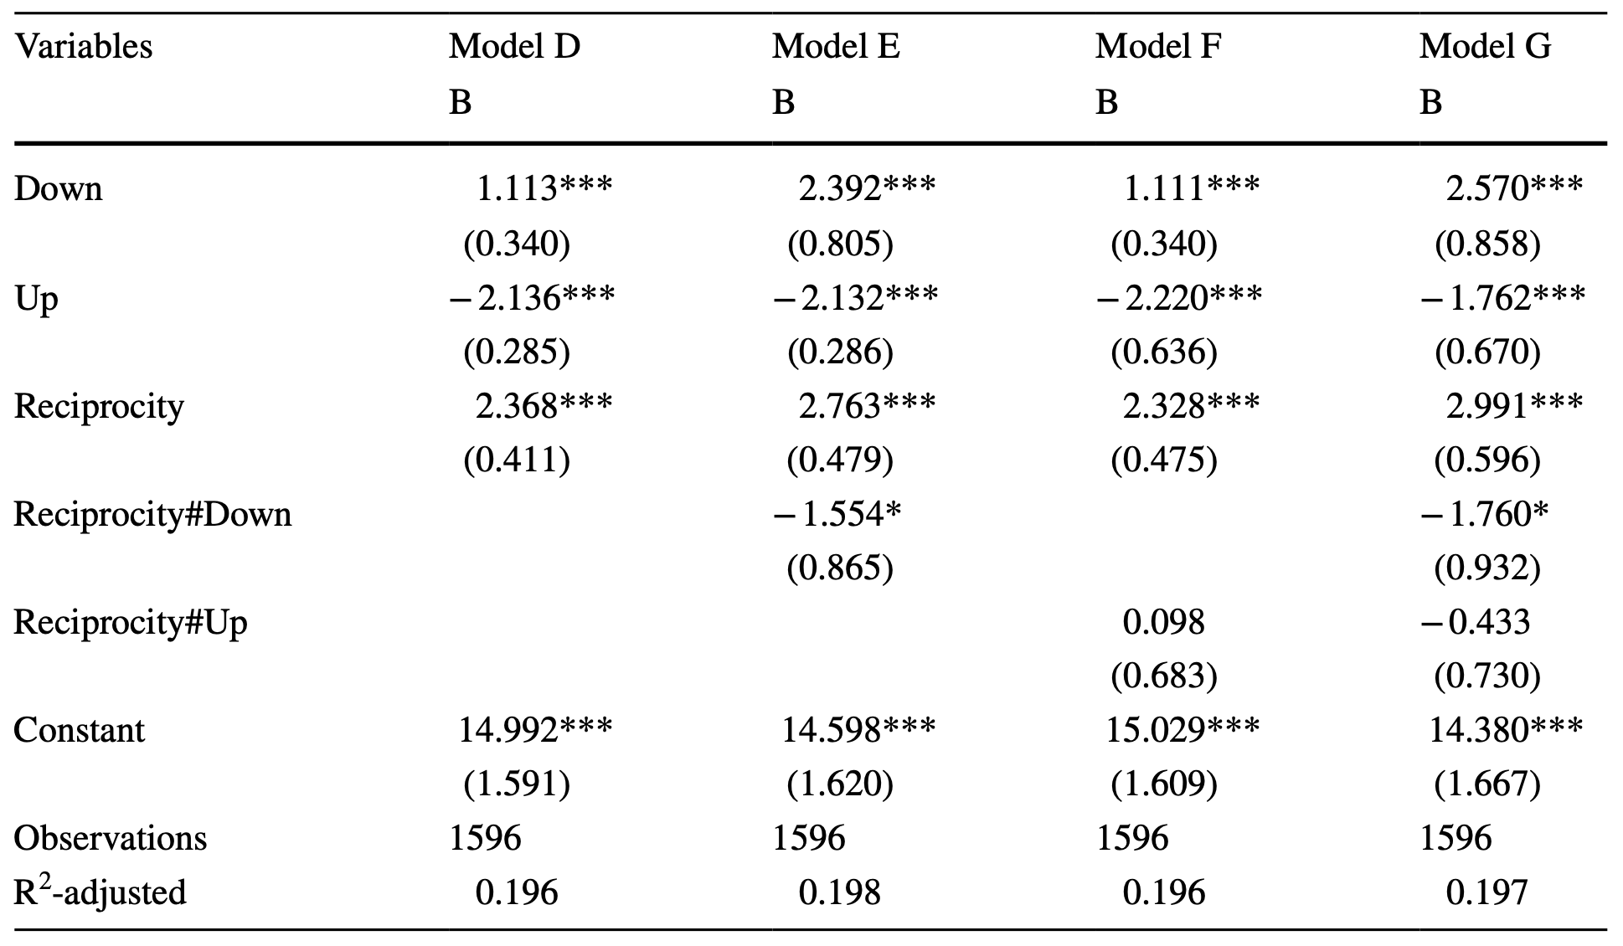
Social comparison
Olivos, F., et al. (2021). "Asymmetric Social Comparison and Life Satisfaction in Social Networks." Journal of Happiness Studies 22(1): 363-384.
20

Slide 21
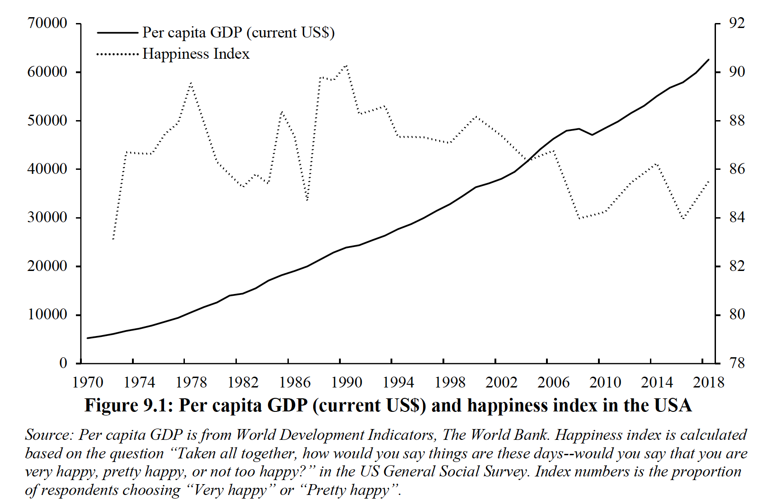
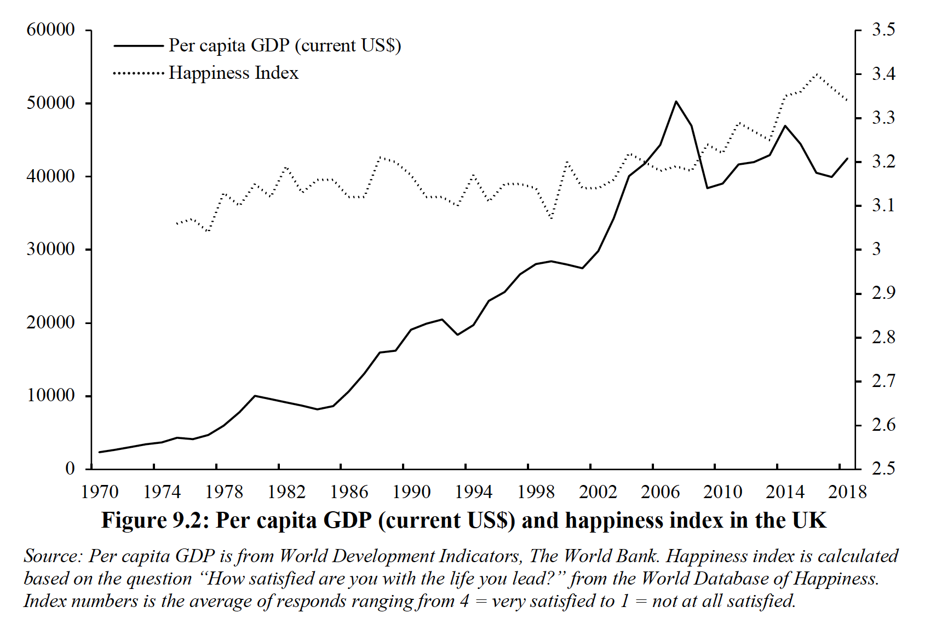
The happiness literature
Despite significant increases in real income in western countries over fifty years, reported happiness levels have not risen correspondingly – the Easterlin Paradox.
Easterlin, R. A. (1973). "Does Money Buy Happiness?" Public Interest (30): 3-10.
21

Slide 22
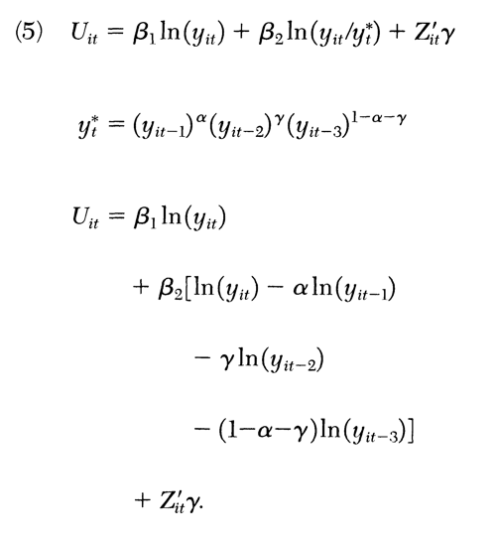
The happiness literature
Clark, A. E., et al. (2008). "Relative income, happiness, and utility: An explanation for the Easterlin paradox and other puzzles." Journal of Economic Literature 46(1): 95-144.
Two explanations of the Easterlin’s Paradox
Both absolute and relative income affect happiness
Adaptation also at work – happiness treadmill
The relative income explanation has been tested and confirmed in the literature many times
The adaptation explanation has relatively weaker empirical support
22

Slide 23
Social comparison & Prospect Theory
According to prospect theory, people derive value 𝑉(𝐶_{i} ) from the consumption of housing good 𝐶_{i} as described by the following function
The distinction between Clark et al (2008)’s model and the PT model is loss aversion.
Clark et al (2008) does not consider asymmetric social comparison, whilst PT model allows social comparison effects differ between the worse-off and better-off groups.
23

Slide 24
Social comparison & Prospect Theory
An illustrative example to demonstrate how PT model works
Let $α= β=1$, and $λ$ =2.5. 𝐶_{i} is the number of bedrooms in your house. The value function is now
Assume that you are living in a two-bedroom house now. The reference point is a two-bedroom house as well (which means you are right on target). 𝑉(𝐶_{i} ) = 0.
If you move into a three-bedroom house, 𝑉(𝐶_{i} ) = 1
If you move into a one-bedroom house, 𝑉(𝐶_{i} ) = - 2.5
Same change in different direction, but losses loom larger than gains!
24

Slide 25
Social comparison & Prospect Theory
It is an extension of the relative income model in the happiness literature
When applied to residential satisfaction, there are significant policy implications
If we find out what the reference groups are, it is possible to improve residential satisfaction by altering the reference groups without changing the housing condition significantly - should we mix public and private housing residents?
The housing condition of individuals in their loss domain, or individuals with housing conditions that fall short of their expectation, needs more attention
Increasing the housing conditions of the poor without changing the housing conditions of the wealthy individuals could possibly improve the overall satisfaction. Thus, reducing inequality can be the key to solving dissatisfaction which increases social stability and overall life satisfaction.
25

Slide 26
Social comparison and social media
Example: Bailey, M., et al. (2018). "The Economic Effects of Social Networks: Evidence from the Housing Market." Journal of Political Economy 126(6): 2224-2276.
Online social networking data (Facebook)
Sample size: 1.4 million individuals from 71 countries, and 525,000 housing transactions between 2015 and 2017.
Control variables: a wide range of demographic, social, and economic factors
Individuals whose geographically distant friends experienced larger recent house price increases are more likely to transition from renting to owning. They also buy larger houses and pay more for a given house. Survey data show that these relationships are driven by the effects of social interactions on individuals' housing market expectations.

Slide 27
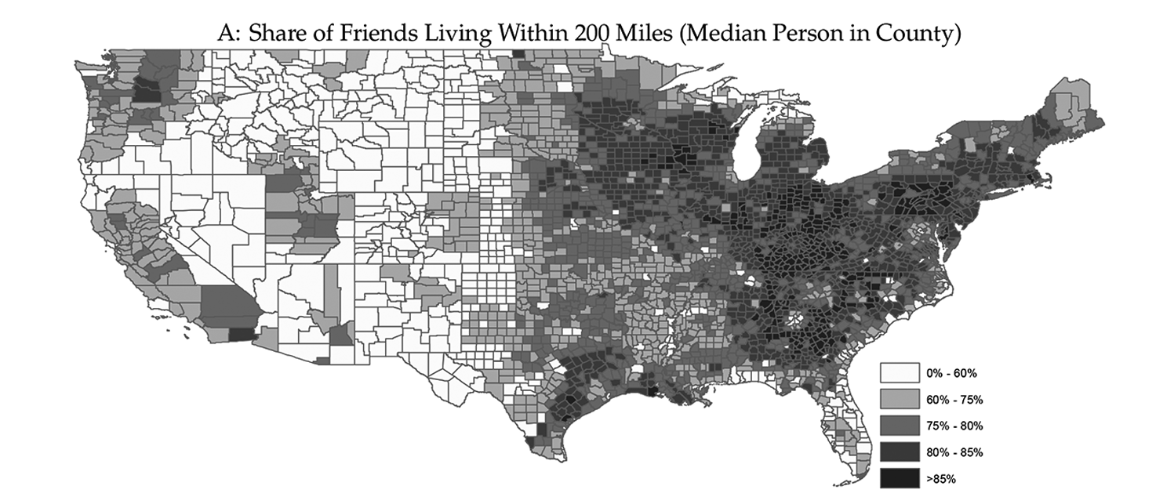
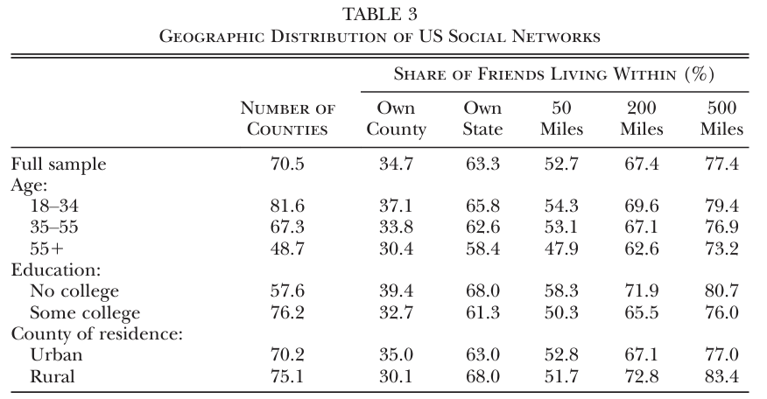
Social comparison and social media

Slide 28
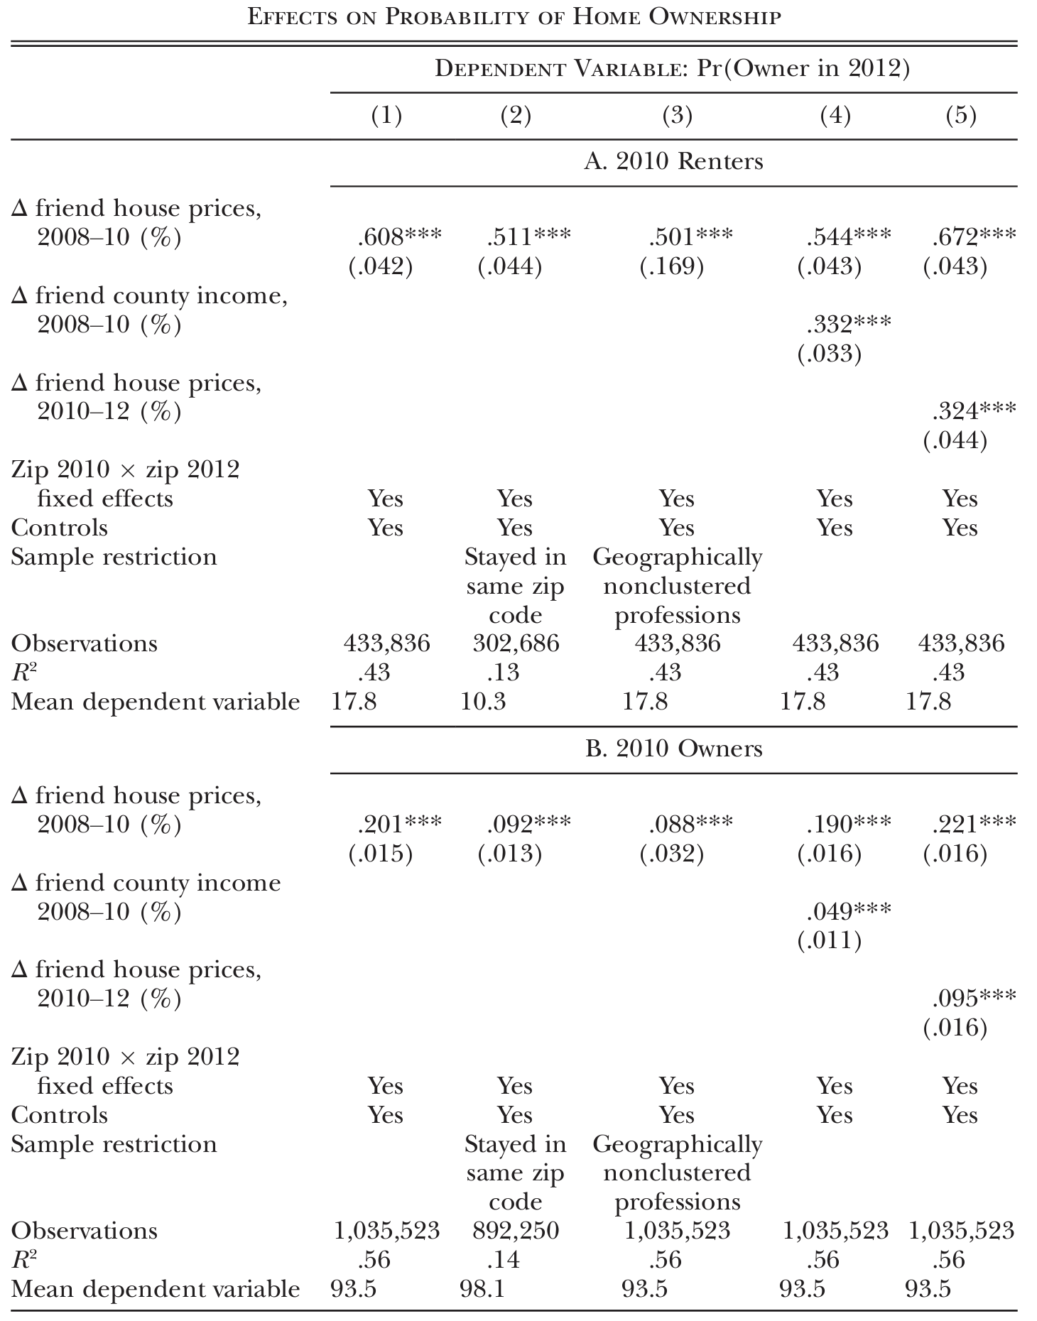
Social comparison and social media

Slide 29
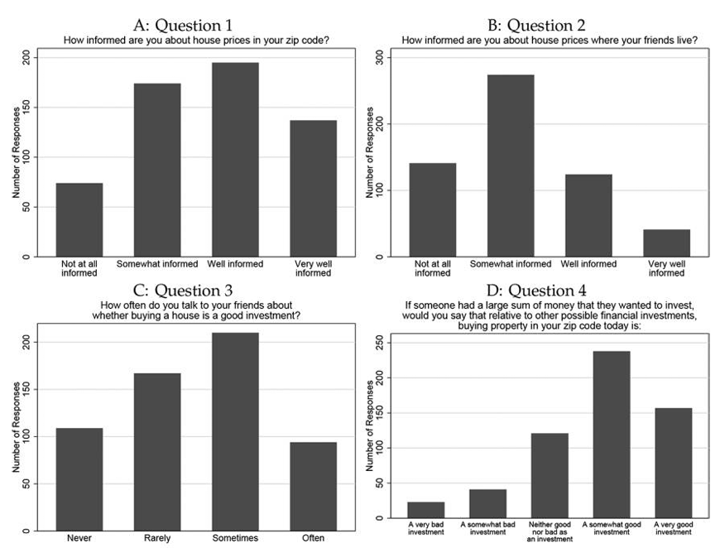
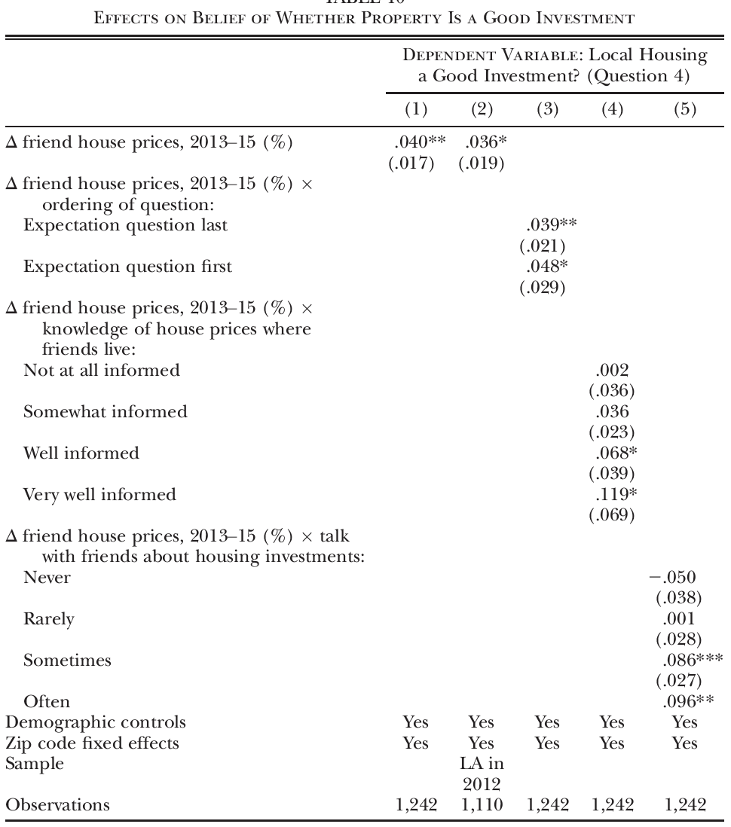
Social comparison and social media

Slide 30
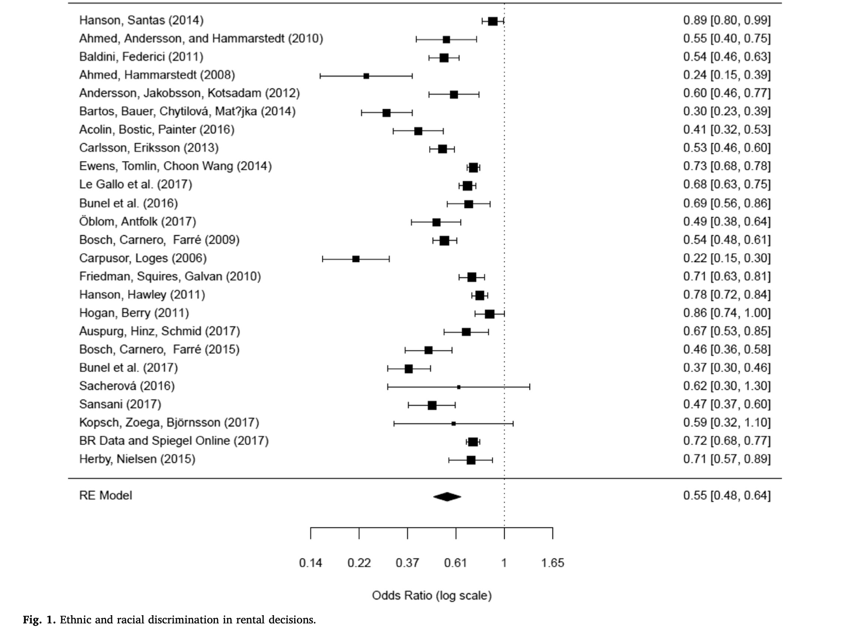
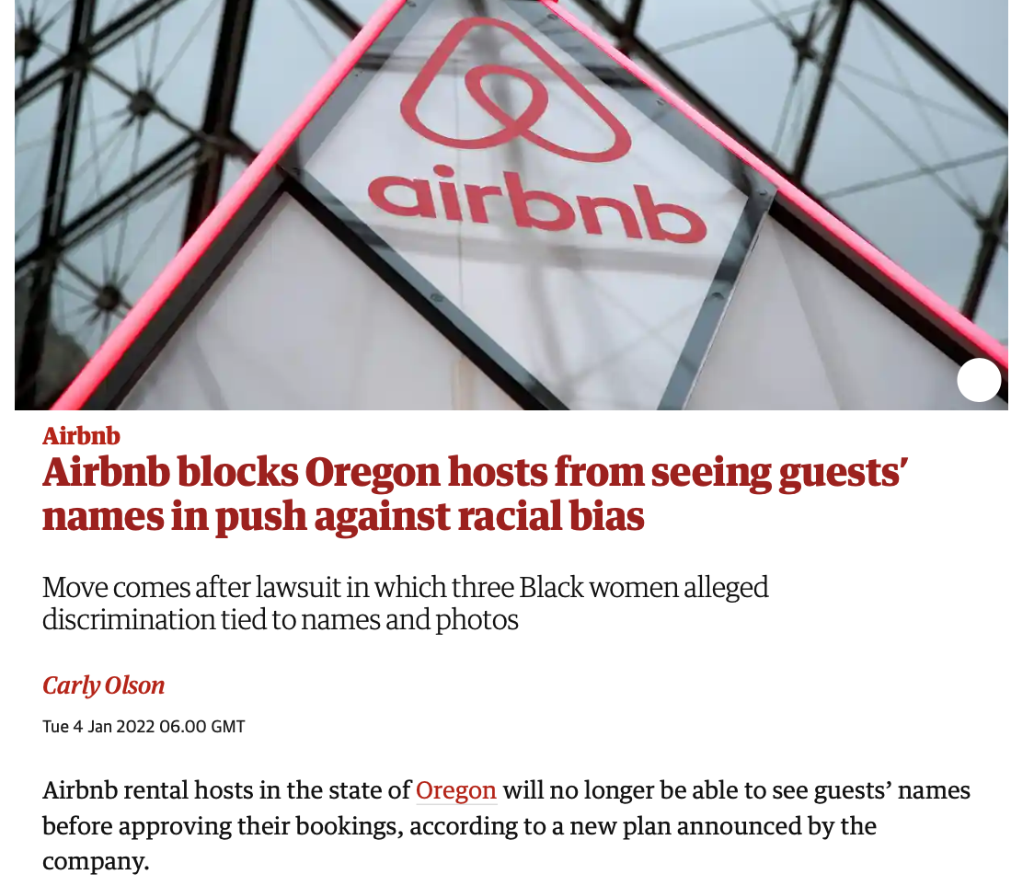
Case Study – Housing Discrimination
Source: Flage, A. (2018). "Ethnic and gender discrimination in the rental housing market: Evidence from a meta-analysis of correspondence tests, 2006-2017." Journal of Housing Economics 41: 251-273.
Source: https://www.theguardian.com/technology/2022/jan/03/airbnb-race-oregon-names-discrimination

Slide 31
Case Study – Housing Discrimination
Experiment design
Hi there, Is this property still available? If yes, may I arrange a viewing with you? I am running a medical practice and won't be able to answer personal phone calls at work. An email response will be much appreciated! Warmest regards,
Amara Okeke
#BlackLivesMatter
Note: Correspondence test on 360 rental listings (letting agents only) from the Greater London Area between December 2021 and April 2022. N = 1,800. Five ethnic groups (White British, Chinese, Indian, Polish, Nigerian). Three treatment groups (Boost, Nudge, and Boost&nudge).

Slide 32
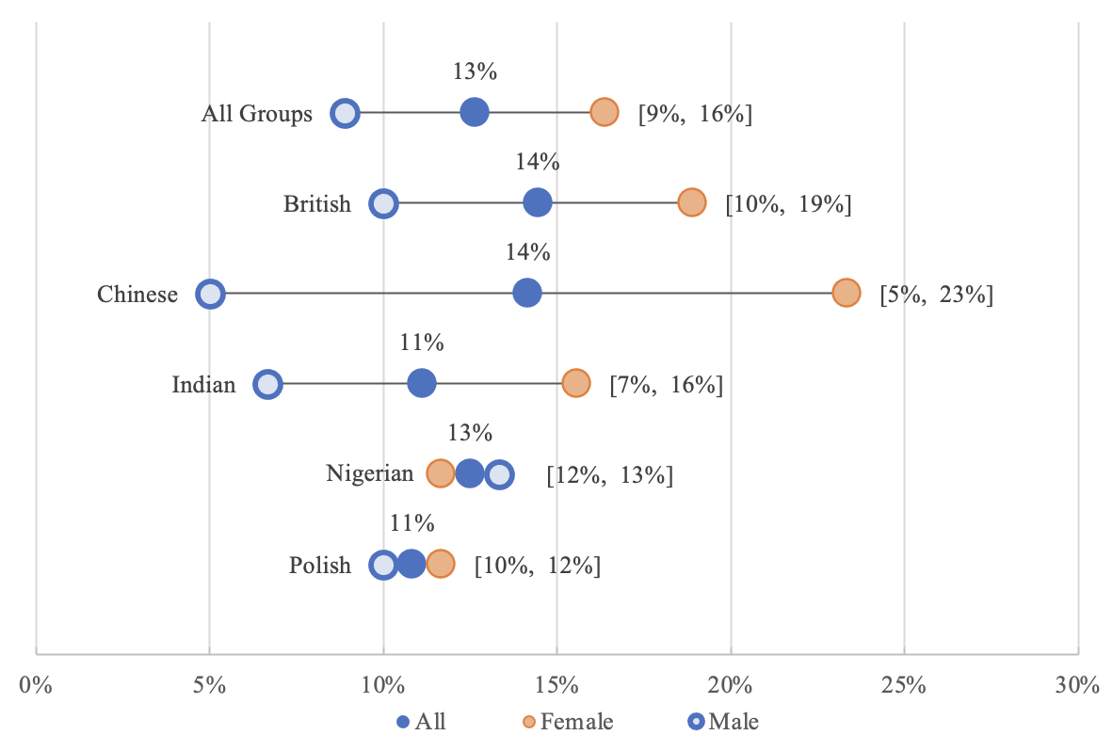
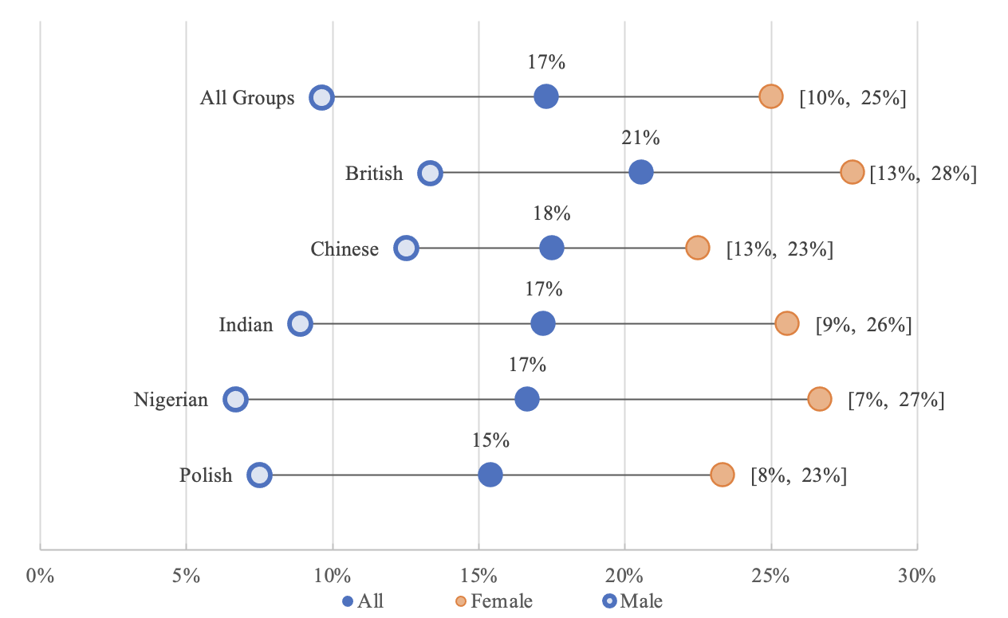
Case Study – Housing Discrimination
Racial and gender discrimination are persistent in the housing market.
Behavioural interventions are powerful tools.
Control Group
The effectiveness of behavioural interventions various among ethnic and gender groups.
Hiding first names can reduce gender discrimination, but at the expense of female renters.
Treatment Groups

Slide 33
Case Study – Housing Discrimination
The findings were presented at the ASSA 2023 annual conference
The methodology design won the “Housing Discrimination Methodology Research Competition” in 2023
The paper is currently under review with Urban Studies
Next steps:
Paired testing (Annual housing discrimination survey by the US Department of Housing and Urban Development)
The new geography of housing discrimination – a global perspective

