Slide 1
Herding, Sentiment, and Emotion
International Workshop on Behavioural Sciences and Urban-Rural Development in Developing Countries, 24 – 26 July 2023, Newnham College, University of Cambridge

Slide 2
Decision-making Under Uncertainty
How do we decide on an action when outcomes are not known?
How do we assess the probability of an event occurring?
How do we assess the probability of an event occurring when it is conditional on another event occurring?
Probability and Subjective Probability
Updating Probabilities Given New Information
Information Sources, Noise and Social Factors …

Slide 3
Subjective Probability: Rational Decision-Making?
Probability of an event occurring: P(X |φ) where φ is information set held
Information set comes from experience, research, others’ views etc. etc.
Weight of P depends on our confidence in φ
Weight of P amounts to a bet we would place on X occurring (rather than not occurring)
Rational utility suggests that the bet should be “fair”
This is basis both of rational utility models in economics and game theory (von Neumann and Morgenstern, Nash etc.) but comes from 1920s work of Frank Ramsey
Can extend this to causal relationships P(Y|X) where both X and Y are uncertain – e.g. Bayesian statistics

Slide 4
Updating Your Probabilities
Start with an initial “belief” or probability – your “prior”
New information arrives – update your probability
Under rational utility, fully process new information and adjust probability such that “bets” remain fair given new information set
Your friends are organising an event –a picnic: will it go ahead or not? P(E)
The picnic going ahead depends on the weather: priors are P(E|W)
Your Priors depend on beliefs about friends’ reliability and the weather
These are based on past experience etc. => φ₁
Nearer the time, you check the weather forecast and update P(E|W)
The extent of the update depends on your confidence in accuracy of the weather forecast …

Slide 5
Uncertainty, Information and Noise
Information Set is “Noisy”
Incomplete, partial
False signals (errors, outliers, randomness)
Hard to interpret?
Historic, dated
What is Source of Information?
How reliable or partial is the source of information?
Information is Social
Others are making decisions too
We can observe their decisions/actions and/or hear their views

Slide 6
An Example: Valuing Housing
Quan & Quigley (1991) Price Formation and the Appraisal Function in Real Estate Markets, J. Real Estate Finance & Economics, 4(2) 127-146.
Appraiser’s task is to estimate likely selling price of property in the market: she makes an initial valuation
She observes sales of other properties in that market, and should update her valuation
But sales information is incomplete and noisy: she does not have full information …
Rationally she does not fully adjust her initial valuation, but blends the new information with her prior valuation V_{t} = αV_{t-1} + (1- α)(V_{t}|φ) => “valuation smoothing”
However, this is not a “conscious” act and we do not know what α should be.
Appraisers (and buyers/sellers) may fail to “rationally” update their priors

Slide 7
Herding and Information
The actions of others provide a signal to an individual
Herding: everyone doing what everyone else is doing, even when their private information may suggest doing something quite different
Banerjee, A. V. (1992). "A Simple Model of Herd Behavior." Quarterly Journal of Economics 107(3): 797-817.
Bikhchandani, S., et al. (1998). "Learning from the behavior of others: Conformity, fads, and informational cascades." Journal of Economic Perspectives 12(3): 151-170.
7

Slide 8
Herding
Information Cascades
Bikhchandani, S., et al. (1998). "Learning from the behavior of others: Conformity, fads, and informational cascades." Journal of Economic Perspectives 12(3): 151-170.
Information Cascades happens when optimal action does not depend on private information, and no further information accumulate
Assumptions:
All previous actions can be observed (not just the immediate predecessor)
Public information pool is updated by adding private information in each step
Signal is inferred from actions taken by all predecessors
When private information is absent or canceled out, flip a coin (instead of following the predecessor)
8

Slide 9
Information Cascade
If signal = A then adopt, if signal = B reject
An information cascade starts from Clarence when public information stops accumulating, or private information stops entering the public information pool
Decision maker | Private signal | Action | Public signal
Aaron | A | adopt | A
Barbara | B | Flip a coin and adopt | AA
Clarence | B | adopt | AAA
Donna | B | adopt | AAAA
…
9

Slide 10
The Restaurant Example
You are deciding where to go for dinner, with two adjacent restaurants
So are others … they will arrive sequentially
You have access to reviews which are relatively balanced between the two
You have a private signal (a recommendation from a friend), as do others
When you arrive, you can observe how many people are in each restaurant … this can be seen as a positive (or negative!) signal
Person 1 arrives: they will go with their private signal to restaurant A
Person 2 arrives: Person 1’s decision may influence them to go to A
Person 3, 4 … n go to Restaurant A (until there’s a capacity constraint).
This is NOT quality related and the private signals have been swamped.

Slide 11
Herding
Bikhchandani, S., et al. (1998). "Learning from the behavior of others: Conformity, fads, and informational cascades." Journal of Economic Perspectives 12(3): 151-170.
The ”Fashion Leaders” effect
If an expert (i.e., a fashion leader) is the first-decision maker, a cascade forms instantly
People imitate the actions of those who appear to have expertise
Ways to protect us: in U.S. Navy courts-martial, judges vote in inverse order of rank. In simultaneous balloting, voters decide without knowing how others have voted.
11

Slide 12
Herding
The wisdom of crowds
Surowiecki, J. (2004). The wisdom of crowds : why the many are smarter than the few and how collective wisdom shapes business, economies, societies, and nations. New York, Doubleday.
Galton’s Weight-judging competition in a country fair in Plymouth, UK
787 people participated, many non-experts [?]
The average estimate was 1197 pounds
The Ox was 1198 pounds after being slaughtered and dressed
The collective wisdom of the Plymouth crowd was essentially perfect
12

Slide 13
Herding
The wisdom of crowds
Surowiecki, J. (2004). The wisdom of crowds : why the many are smarter than the few and how collective wisdom shapes business, economies, societies, and nations. New York, Doubleday.
“Under the right circumstances, groups are remarkably intelligent, and are often smarter than the smartest people in them”
“diversity and independence are important because the best collective decisions are the product of disagreement and contest, not consensus or compromise”
The value of aggregating private information!
13

Slide 14
Herding
The wisdom of crowds
Golub, B. and M. O. Jackson (2010). "Naive Learning in Social Networks and the Wisdom of Crowds." American Economic Journal-Microeconomics 2(1): 112-149.
A theoretical model of the wisdom of crowds …
Assumption: people receive independent noisy signals about the true value of a variable and then communicate in a network. They naively update beliefs by repeatedly taking weighted averages of neighbors' opinions
Conclusions:
A society is wise if and only if the influence of the most influential agent (e.g., experts or fashion leaders) is vanishing as the society grows
Societies with balance (e.g., no experts or fashion leaders) and dispersion (e.g., all members pay attention to the rest of the network) in their communication structures will have (more) accurate learning
14

Slide 15
Herding
Herding in housing markets
A specialised market, and hence “experts” are important (and there are so many of them!)
Plentiful information sources, but partial, noisy (and possibly biased)
Inattention is widespread: complex marketplace and products, stressful decision, information overload, …
Products, transactions are “social”, and hence independent use of private information is difficult
As a result, housing market is probably not a good place to find the wisdom of crowds!
15

Slide 16
Herding in Asset Markets: Optimists and Pessimists
“Normal” markets: buyers and sellers in balance, no large divergence of views, information
Market where optimists > pessimists – average prices rise – drives pessimists out of market – prices jump to average valuations of optimists
Requires optimists to have access to credit and for there to be limits to supply of new products
Arbitrage and limits to arbitrate (Schleifer and Vishny, 1997, Limits to Arbitrate, J of Finance 52(1) 35-55)
Leverage magnifies problems when “bubble” bursts.

Slide 17
Seasonal Affective Disorder (SAD)
Seasonal Affective Disorder (SAD): winter blue!
Rosenthal, N. E., et al. (1984). "Seasonal Affective Disorder: A Description of the Syndrome and Preliminary Findings With Light Therapy." Archives of General Psychiatry 41(1): 72-80.
Goetzmann, W. N., et al. (2015). "Weather-Induced Mood, Institutional Investors, and Stock Returns." Review of Financial Studies 28(1): 73-111.
Kaplanski, G. and H. Levy (2012). "Real estate prices: An international study of seasonality's sentiment effect." Journal of Empirical Finance 19(1): 123-146.
17

Slide 18
The SAD effect
Kaplanski, G. and H. Levy (2012). "Real estate prices: An international study of seasonality's sentiment effect." Journal of Empirical Finance 19(1): 123-146.
CDH: changes in daylight hours across the various months of the year
Also considered the latitude of the area zone under consideration
Alternative explanations:
Matching Theory (MT): strategic herding – larger group gives higher chance to sell and/or better prices, so join the group
Bargaining Power Hypothesis (BPH): summer buyers have less bargaining power (parents of school-age children and newlyweds)
18

Slide 19
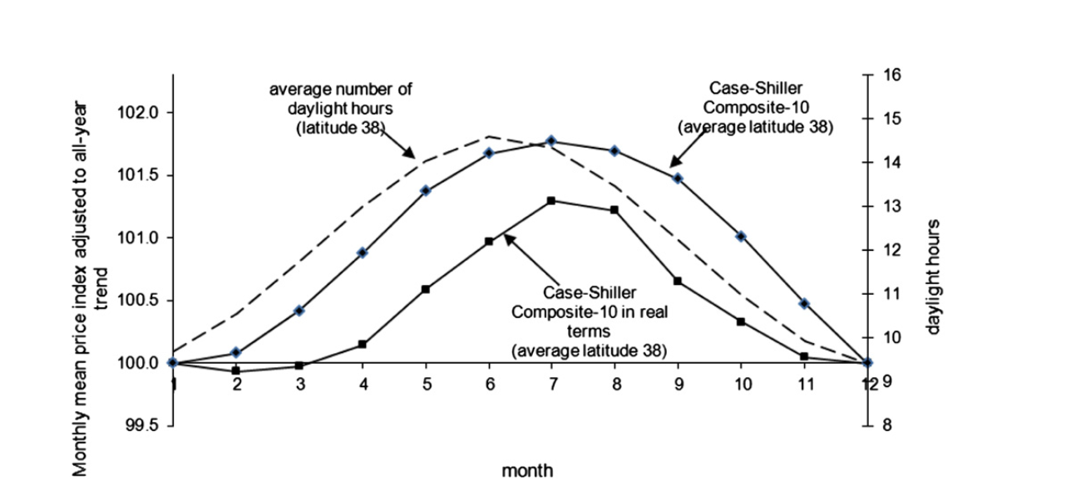
The SAD effect
Kaplanski, G. and H. Levy (2012). "Real estate prices: An international study of seasonality's sentiment effect." Journal of Empirical Finance 19(1): 123-146.
19

Slide 20
Measuring Market Sentiment
Direct measurement through surveys
Confidence indices by the Organisation for Economic Co-operation and Development (OECD)
Economic Sentiment Index (ESI) by Eurostat
University of Michigan Consumer Sentiment Index (monthly): a broad measurement (50+ questions about business climate, personal finance, and spending); telephonic household interviews
American Association of Individual Investors (AAII) survey; based on weekly online survey among members; ”Bull-Bear Spread Trend”.
The U.S. Housing Confidence Survey: Based on an annual household survey by Case and Shiller; 2014 – 2019.

Slide 21
Measuring Market Sentiment
Direct measurement through surveys
Case, K. E., et al. (2012). "What Have They Been Thinking? Homebuyer Behavior in Hot and Cold Markets." Brookings Papers on Economic Activity: 265-315.
Homebuyers’ expectations and reasons for buying
Stratified sampling: 500 random samples in each of the four cities selected, i.e., two hot (Los Angeles and San Francisco), one cold (Boston) and one stable market (Milwaukee)
The questionnaires were sent with a letter hand signed by both Case and Shiller, a postcard follow-up to non-respondents, a second mailing, and when response rates dropped off after 2005, they included a letter signed by a colleague in each state.

Slide 22
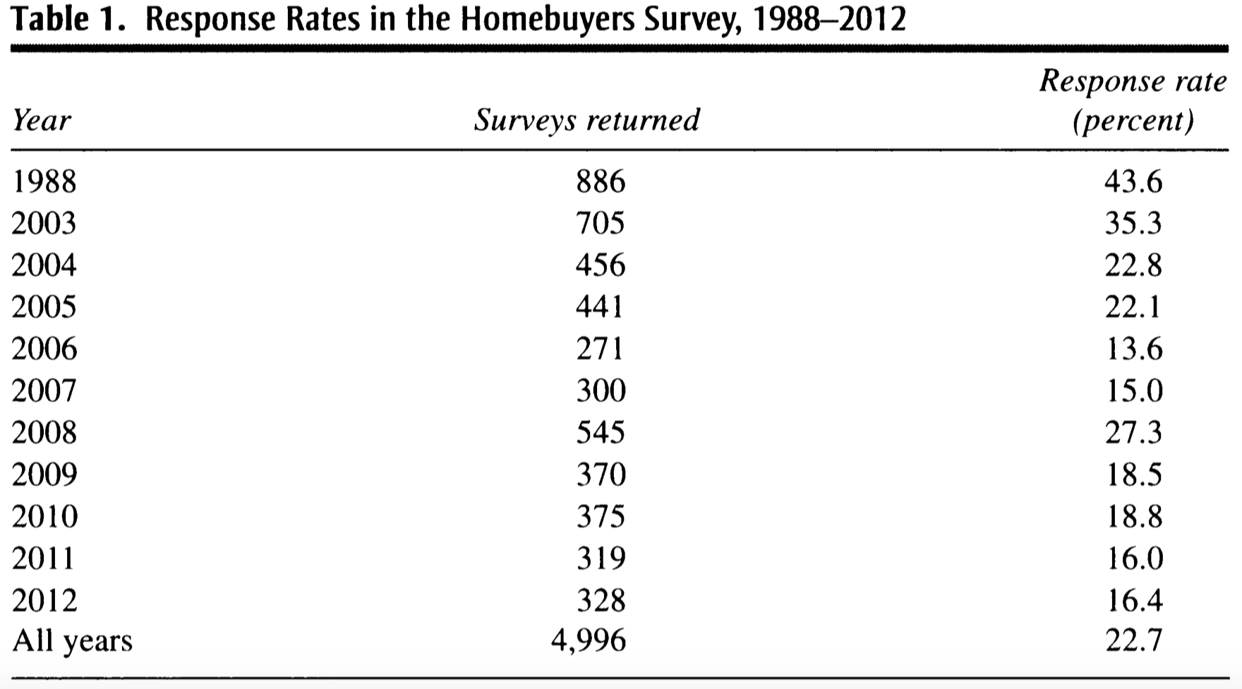
Measuring Market Sentiment
Case, K. E., et al. (2012). "What Have They Been Thinking? Homebuyer Behavior in Hot and Cold Markets." Brookings Papers on Economic Activity: 265-315.

Slide 23
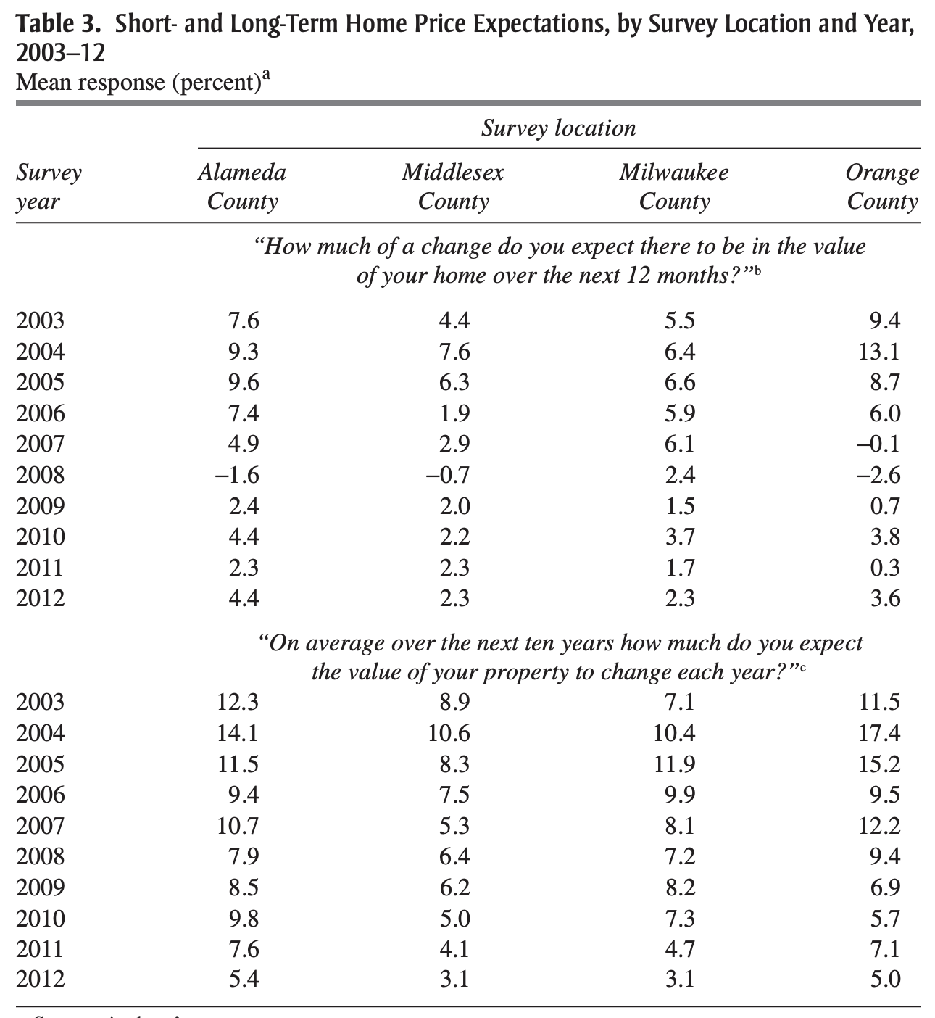
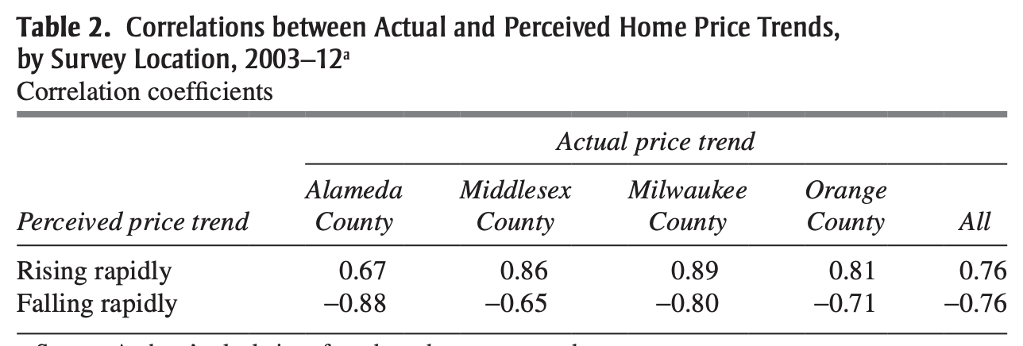
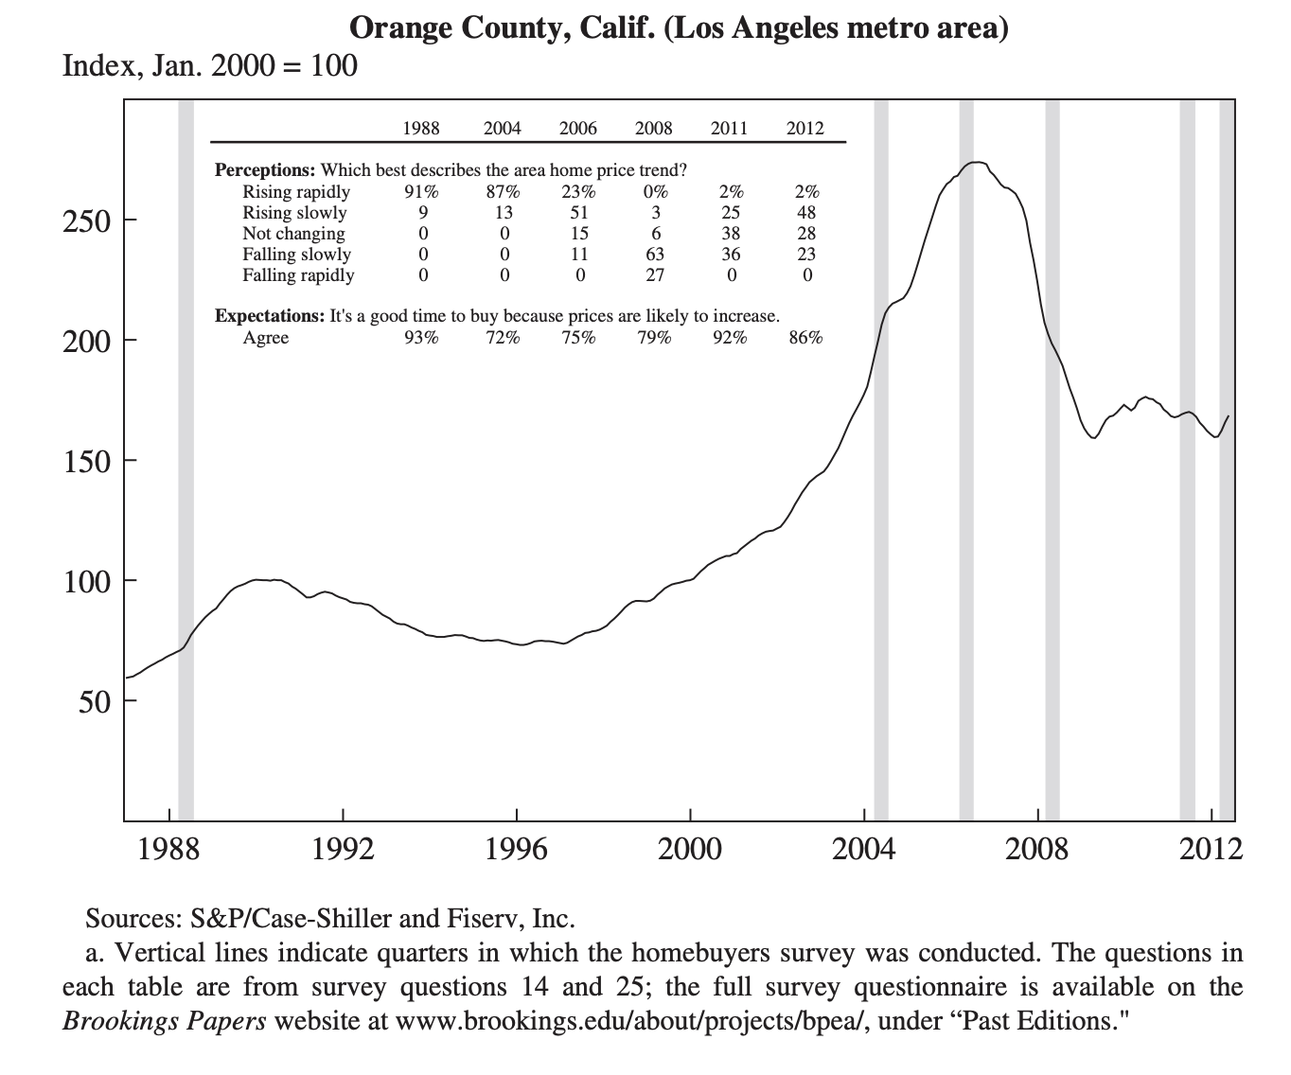
Notes:
Table 2: If buyers were well informed, one would expect to see a high positive correlation of the year-over-year price increase with the percentage saying “rising rapidly,” and a high but negative correlation with the percentage who said “falling rapidly.”

Slide 24
Housing and Sentiment
Case, Shiller, Thompson suggests that house buyer sentiment was not (particularly) inaccurate in run-up to GFC
However, housebuyer sentiment is also driving those house prices (in terms of both buyer and seller expectations)
Paper argues that growing public awareness of “bubbles” and “bubbles bursting” reverses sentiment and contributes to downward movement in prices
Robert Shiller’s second edition of “Irrational Exuberance” 2005, Princeton University Press, includes real estate alongside equities and discusses extensively processes for sentiment formation in housing markets.

Slide 25
Measuring Market Sentiment
Indirect measurement using stock market data
Baker, M. and J. Wurgler (2007). "Investor sentiment in the stock market." Journal of Economic Perspectives 21(2): 129-151.
A summary of ‘proxies’ used as sentiment measurement in the literature
Employed a sentiment index of six proxies: trading volume as measured by NYSE turnover; the dividend premium; the closed-end fund discount; the number and first-day returns on IPOs; and the equity share in new issues
1965 – 2018 index data are available at http://people.stern.nyu.edu/jwurgler/data/Investor_Sentiment_Data_20190327_POST.xlsx

Slide 26
Measuring Market Sentiment
Baker, M. and J. Wurgler (2007). "Investor sentiment in the stock market." Journal of Economic Perspectives 21(2): 129-151.
Indicators | Rational | Correlation with market sentiment
Closed-end fund discount (CEFD) | If closed-end funds are disproportionately held by retail investors, their bearish sentiment leads to higher discounts | -
Trading volume (TURN) | Irrational investors are more likely to trade when they are optimistic | +
IPO volume (NIPO) | Underlying demand for IPO is sensitive to investor sentiment | +
IPO first day return (RIPO) | A reflection of investor enthusiasm | +
Dividend premium (PDND) | Dividend-paying stocks resemble bonds in that their predictable income stream represents a salient characteristic of safety | -
Equity share in new issues (S) | Firms issue relatively more equity than debt just before periods of low market returns. | +
Notes:
Discount. Closed-end funds are investment companies who issue a fixed number of shares, which then trade on stock exchanges. The closed end fund "discount" (or occasionally premium) is the difference between the net asset value of a fund's actual security holdings and the fund's market price. Many authors, including Zweig (1973), Lee, Shleifer, and Thaler (1991), and Neal and Wheatley (1998), have argued that if closed-end funds are disproportionately held by retail investors, the average discount on closed-end equity funds may be a sentiment index, with the discount increasing when retail investors are bearish.
Trading volume: if short-selling is costlier than opening and closing long positions (as it is, in practice), irrational investors are more likely to trade, and thus add liquidity, when they are optimistic and betting on rising stocks rather than when they are pessimistic and betting on falling stocks
Dividend premium: Premium. Dividend-paying stocks resemble bonds in that their predictable income stream represents a salient characteristic of safety. The first price-based measure we mention here is therefore the "premium" for dividend-paying stocks, which may be inversely related to sentiment. In Baker and Wurgler (2004a, b), we define the dividend premium as the difference between the average market-to-book-value ratios of dividend payers and nonpayers. The dividend premium ex
Plains well the major historical trends in firms' propensity to pay dividends, such as the post-1977 decline in this propensity documented by Fama and French (2001); that is, when dividends are at a premium, firms are more likely to pay them, and are
less so when they are discounted. In other words, on the margin, firms appear to cater to prevailing sentiment for or against "safety" when deciding whether to pay dividends.

Slide 27
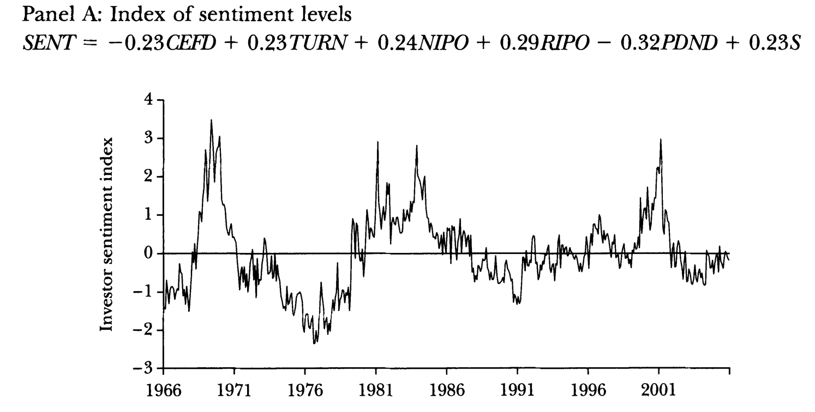
Measuring Market Sentiment
Baker, M. and J. Wurgler (2007). "Investor sentiment in the stock market." Journal of Economic Perspectives 21(2): 129-151.
Notes:
Also, some of the sentiment proxies reflect economic fundamentals to some extent. For instance, IPO volume depends, in part, on prevailing investment opportunities. To remove such influences, at least partially, we regress each proxy on a set of macroeconomic indicators-growth in industrial production, real growth in durable, nondurable, and services consumption, growth in employment, and an NBER recession indicator-and use the residuals from these regressions as our sentiment proxies.
The levels index is simply the first principal component of the six proxie.

Slide 28
Market Sentiment and Performance
Key Question: does sentiment affect market performance over and above market fundamentals?
Evidence mixed, reflecting measurement difficulty (and publication bias!)
Some evidence that positive sentiment pushes prices above “equilibrium” levels
Some evidence that positive sentiment
Some evidence that (excess) positive (and negative) sentiment precedes market corrections
Some evidence that speculative periods accompanied by more volatile sentiment measures

Slide 29
Measuring Market Sentiment
Indirect measurement using internet-based sentiment indicators
Google Trend search volume index (SVI), newspaper text analysis, social media posts, …
Online articles: Chen, H. L., et al. (2014). “Wisdom of Crowds: The Value of Stock Opinions Transmitted Through Social Media.” Review of Financial Studies 27(5): 1367-1403.
Microblog: Renault, T. (2017). “Intraday online investor sentiment and return patterns in the US stock market.” Journal of Banking & Finance 84: 25-40.
Google Trend SVI: Da, Z., et al. (2011). "In Search of Attention." Journal of Finance 66(5): 1461-1499.

Slide 30
Measuring Market Sentiment
Google Trend Search Volume Index (SVI):
Aroul, R. R., et al. (2022). "FEAR Index, city characteristics, and housing returns." Real Estate Economics 50(1): 173-205.
Dietzel, M. A. (2016). "Sentiment-based predictions of housing market turning points with Google trends." International Journal of Housing Markets and Analysis 9(1): 108-136.
Hohenstatt, R. and M. Kaesbauer (2014). "GECO's Weather Forecast for the UK Housing Market: To What Extent Can We Rely on Google Econometrics?" Journal of Real Estate Research 36(2): 253-281.
Hohenstatt, R., et al. (2011). ""Geco" and its Potential for Real Estate Research: Evidence from the U.S. Housing Market." Journal of Real Estate Research 33(4): 471-506.
van Veldhuizen, S., et al. (2016). "Internet searches and transactions on the Dutch housing market." Applied Economics Letters 23(18): 1321-1324.
Venkataraman, M., et al. (2018). "Does internet search intensity predict house prices in emerging markets? A case of India." Property Management 36(1): 103-118.
Notes:
Google Econometrics (GECO): statistics or trends maintained by Goggle.

Slide 31
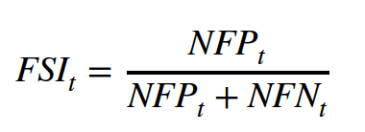
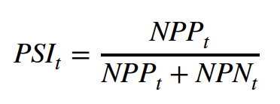
Measuring Market Sentiment
Zhu, E. W., et al. (2022). "A Sentiment Index of the Housing Market in China: Text Mining of Narratives on Social Media." Journal of Real Estate Finance and Economics: Forthcoming.
Data source: microblogs postings (Sina Weibo); based on the keyword “house price” (Fang Jia); excluding reposts.
Sampling period: January 2012 and December 2018
Sample size: 1.92 million microblogs posted by about 0.88 million users; 8.22 million sentences
Sentiment classification: Long Short-Term Memory (LSTM) model; machine learning; deep learning; neural network.
Results: 87.42% are classified as irrelevant, 1.55% as future-positive (FP), 1.14% as future negative (FN), 7.79% as past-positive (PP), and 2.10% as past-negative (PN)
Index calculation:
Notes:
future sentiment index FSI: NFP and NFN denote the numbers of future-positive and future-negative microblog sentences, respectively. If N sentences come from one microblog, they are weighted by 1/N in both the numerator and denominator of the preceding equation. By definition, the value of the index ranges between 0 and 1. The value of 0.5 may be interpreted as a neutral opinion, while a larger value refers to more positive sentiment in the market and vice versa.

Slide 32
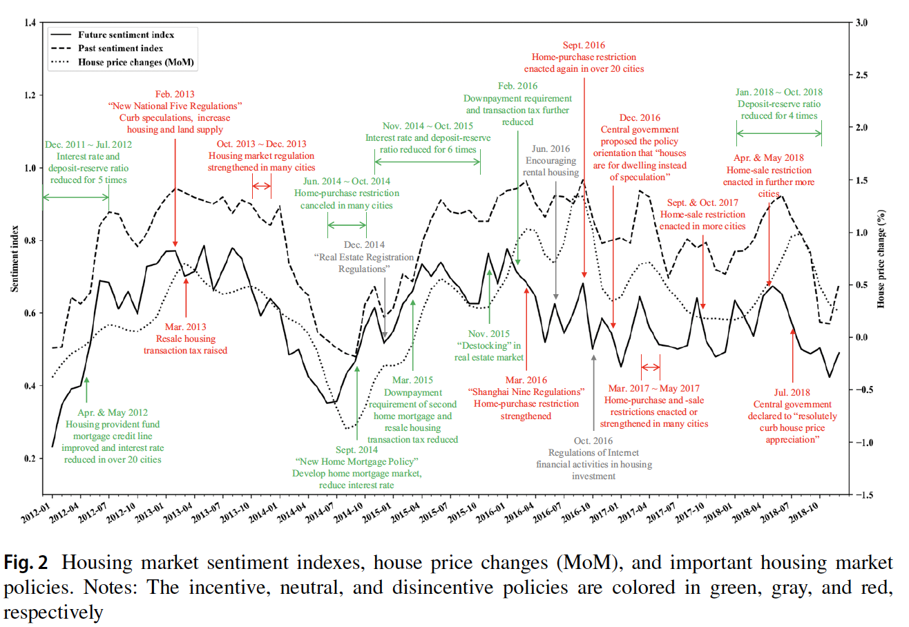
Measuring Market Sentiment
Zhu, E. W., et al. (2022). "A Sentiment Index of the Housing Market in China: Text Mining of Narratives on Social Media." Journal of Real Estate Finance and Economics: Forthcoming.

Slide 33
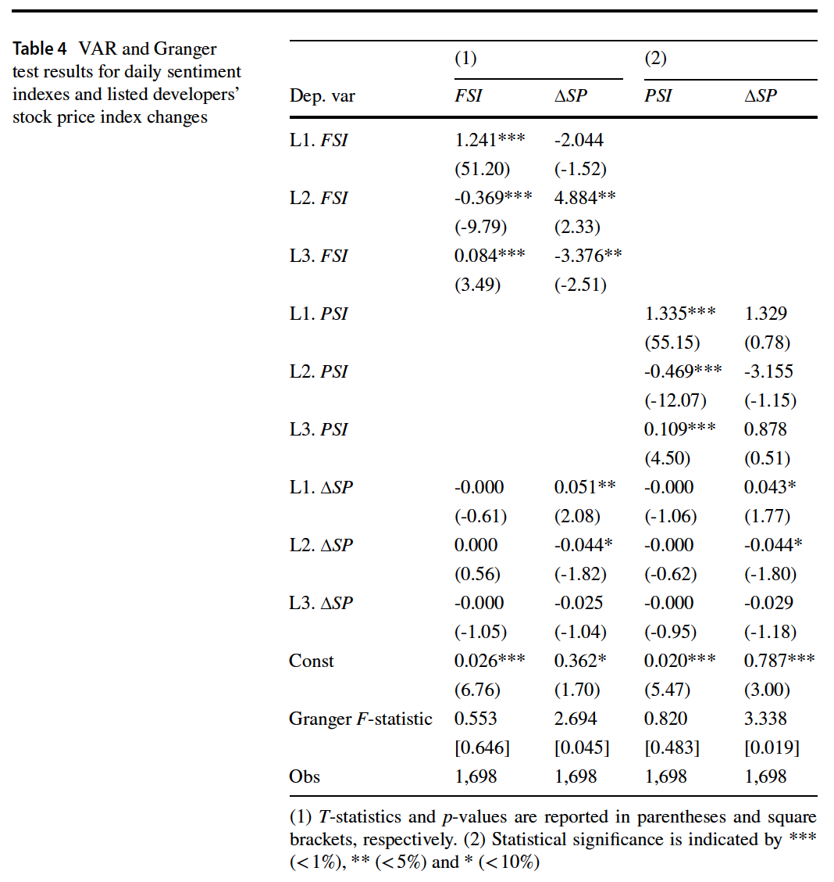
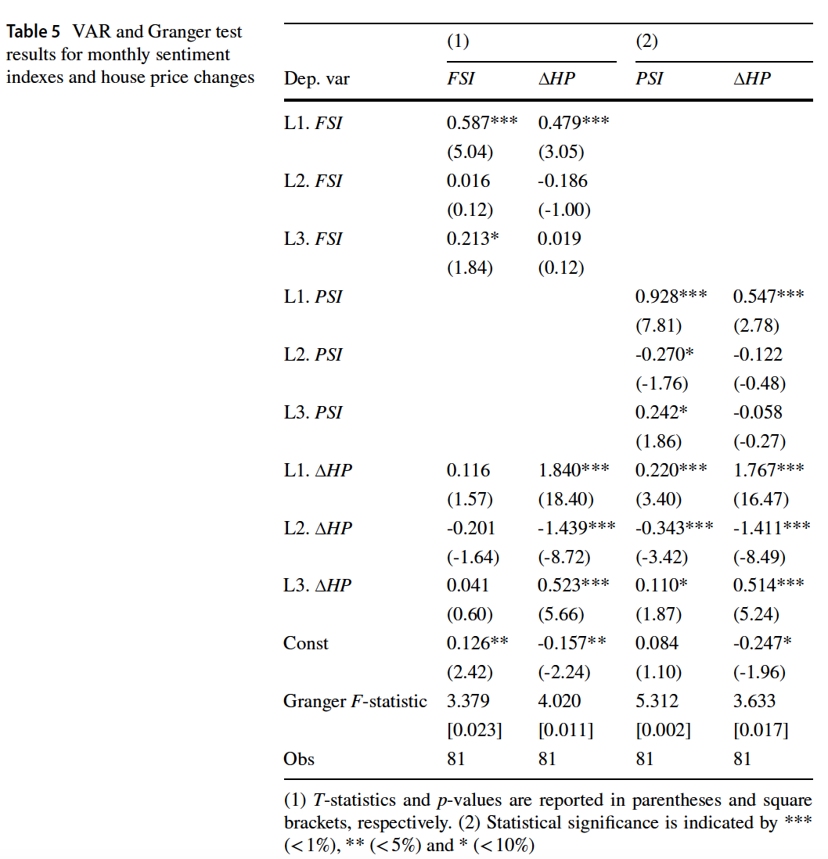
Measuring Market Sentiment
Zhu, E. W., et al. (2022). "A Sentiment Index of the Housing Market in China: Text Mining of Narratives on Social Media." Journal of Real Estate Finance and Economics: Forthcoming.

Slide 34
Measuring Market Sentiment Effects
Composite Sentiment Indices – see for example
Hui, E. C. M. and Z. Y. Wang (2014). "Market sentiment in private housing market." Habitat International 44: 375-385.
Ling, D, et al. (2014) Investor sentiment, limits to arbitrage and private market returns, Real Estate Economics, 42: 531-577
Zhou, Z. Y. (2018). "Housing market sentiment and intervention effectiveness: Evidence from China." Emerging Markets Review 35: 91-110.
Das, P., et al. (2020). "The cross-over effect of irrational sentiments in housing, commercial property, and stock markets." Journal of Banking & Finance 114.

Slide 35
Ling, Naranjo & Scheick (2014)
Observing sentiment in private commercial real estate markets in US
Direct (survey) and indirect (composite sentiment index) measures
Long-run (VAR) model relating prices and returns to market fundaments (and the sentiment indices)
Find that sentiment matters and has persistent effects
This does not hold for public real estate markets (REITs)
“We provide further long-horizon regression evidence suggesting that private commercial real estate markets are susceptible to prolonged periods of sentiment-induced mispricing as the inability to short-sell in periods of overvaluation and restricted access to credit in periods of undervaluation prevents arbitrageurs from entering the market”

Slide 36
Information, Information Sources and Sentiment
How can misinformation effects persist in markets?
Distinguish informed and less-informed markets (“noise trading”) and consider behavioural biases as discussed elsewhere in the workshop
Think about information sources: media, social media, biases and echo chambers.
Why might this apply to informed markets?
Private markets: incomplete information and information asymmetry
Key role of important individual actors and opinion formers
Reinforcement structures: rewards, career path, institutional structure.

Slide 37
Commercial Real Estate Mythologies Things Believed for Reasons Other Than “Truth”
Tenets of (say) Investment with Limited Empirical Support
Real estate is an inflation hedge …
Office rents capture economic growth, deliver real growth …
Major global cities offer better risk-adjusted returns …
Yield / cap rate is a reliable measure of risk …
Managers time leverage to enhance returns …
The best managers generate consistent alpha …
Inconsistent / “Irrational” Positions Maintained?
Valuation of over-rented properties
Valuation of break clauses
Bubble/herd pricing of sub-sectors ignoring supply adjustment

Slide 38
“Offices Deliver Real Capital and Rental Value Growth” UK office market performance over last 35 years
MSCI/IPD & ONS, author, using RPI for inflation
Annualised real value falls of 1.8% rent, 2.4% capital

Slide 39
Gurus* Agency, Information and the Role of Individuals
Decisions Relatively Infrequent, But Significant
Significant Scope for Strong Individuals to Drive Those Decisions
May override model recommendations
Evidence from hurdle rate project
Evidence from client influence studies
Dominance of heuristics in decision-making
Limited Tradition of Back-Testing
And the complexities of testing in a private market
Reinforcement Mechanisms
The market guru myth / belief
Rewards and promotion structures, funding
Recruitment and positioning
Information sources and echo chambers
* Apologies if you consider this cultural appropriation.

Slide 40
Summing Up
Individuals make decisions in face of uncertainty
Rational utility models suggest they assign utility maximising probabilities (on average)
Evidence increasingly suggests this is not the case …
Driven by incomplete and possibly biased information sources
Driven by signals from (possibly misinformed) other actors
This can lead to herd behaviour
This can lead to “excessive” role of sentiment
A question to ponder: what, if anything, might we do, knowing this?

