Slide 1
Prospect Theory - Loss Aversion
International Workshop on Behavioural Sciences and Urban-Rural Development in Developing Countries, 24 – 26 July 2023, Newnham College, University of Cambridge

Slide 2
Prospect Theory – Loss Aversion
Nature – We hate to loss more than we love to win
Neuroeconomic foundation
- gains: ventral and dorsal striatum
- losses: insula, amygdala
Empirical evidence
- effect size: > 2
- asymmetric price elasticities
- asymmetric WTA and WTP (endowment effect)
- disposition effect
V$\left(X\right)=\left\{\begin{aligned}&{\left(X−r\right)}^{α} X≥r \\ &−λ{\left(r−X\right)}^{β} X<r\end{aligned}\right.$
2
Notes:
END-OF-THE-DAY EFFECT: perfect example to show the relationship among reference point, loss aversion, and risk aversion/seeking, as well as the difference between risk preference and loss aversion.
The end-of-the-day betting effect is a cognitive bias reflected in the tendency for bettors to take gambles with higher risk and higher reward at the end of their betting session to try to make up for losses. William McGlothlin (1956) and Mukhtar Ali (1977) first discovered this effect after observing the shift in betting patterns at horserace tracks. Mcglothlin and Ali noticed that people are significantly more likely to prefer longshots to conservative bets on the last race of the day. They found that the movement towards longshots, and away from favorites, is so pronounced that some studies show that conservatively betting on the favorite to show (to finish first, second, or third) in the last race is a profitable bet despite the track’s take

Slide 3
Mental Accounting – Framing and Editing
Applications of Prospect Theory
Many transactions are complex, involving several components, simultaneous or sequential; hence:
Segregate gains (because the gain function is concave due to diminishing marginal sensitivity).
Integrate losses (because the loss function is convex, due to diminishing marginal sensitivity).
Integrate smaller losses with larger gains (to offset loss aversion).
Segregate small gains from larger losses (value of a small gain may exceed that of slightly reducing a large loss, dimin. marginal sensitivity).
3

Slide 4
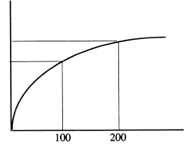
Mental Accounting – Framing and Editing
Segregate gains
Gain function is concave due to diminishing marginal sensitivity
V(2X) < 2 V(X)
Example:
V(200) < 2 V(100)
win two lotteries that pay $50 and $25 respectively, vs. win a single lottery paying $75
V(X)
V(200)
V(100)
X
4

Slide 5
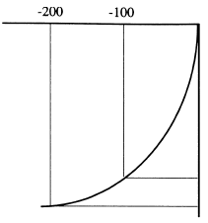
Mental Accounting – Framing and Editing
Integrate losses
Loss function is convex, due to diminishing marginal sensitivity
V(2X) > 2 V(X)
Example:
V(-200) > 2 V(-100)
A parking ticket of $200 vs. two parking tickets of $100 each
X
V(-100)
V(-200)
V(X)
5
Notes:
Plan Premium Deductible Compensation (accident) Rebate
A 1500 0 5000 0
B 1000 600 4400 0
C 1600 0 5000 600

Slide 6
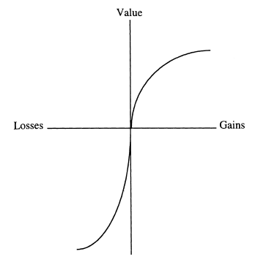
Mental Accounting – Framing and Editing
Integrate smaller losses with larger gains
to offset loss aversion
V(X) > V(X - Y) – V( - Y)
V(X – Y) > V(X) + V (– Y)
Example:
V(80) > V(100) + V(-20)
Example:
Win a $100,000 lottery and pay 20% income tax afterwards vs. Win a $80,000 lottery but tax free
Integration
Segregation
V(100)
V(80)
V(100) + V(-20)
X
V(-20)
6

Slide 7
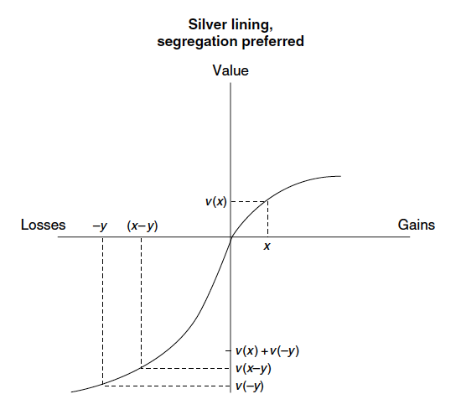
Mental Accounting – Framing and Editing
Segregate small gains from larger losses
Value of a small gain may exceed that of slightly reducing a large loss, dimin. marginal sensitivity
V(X) > V(X - Y) – V( - Y)
V(X) + V( - Y) > V (X - Y)
Example:
V(20) + V(-100) > V(-80)
Example:
A $1000 necklace with a $100 coupon
Segregation
Integration

Slide 8
Endowment effect
Definition: Endowment effect is the difference between an individual’s minimum willing-to-accept (WTA) to sell a product that he/she owns and the maximum willing-to-pay (WTP) to purchase the product. It is also called the WTA-WTP gap.
Richard Thaler coined this term in his 1980 paper: Thaler, R. (1980). "Toward a positive theory of consumer choice." Journal of Economic Behavior & Organization 1(1): 39-60.
Comprehensively tested in Kahneman, D., et al. (1990). "Experimental tests of the endowment effect and the Coase theorem." Journal of Political Economy 98(6): 1325-1348.

Slide 9
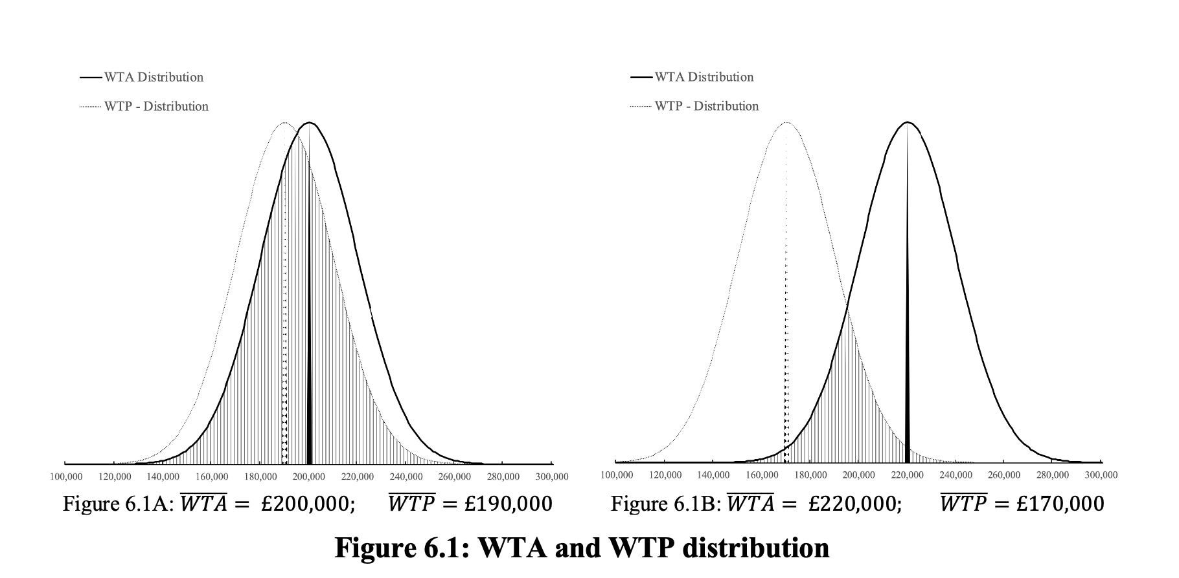
Endowment effect
Theory and models

Slide 10
Endowment effect
Kahneman, D., Knetsch, J. L., and Thaler, R. H. (1990). "Experimental tests of the endowment effect and the Coase theorem." Journal of Political Economy 98(6): 1325-1348.
Studied instant endowment effect: the value that an individual assigns to objects increase substantially as soon as ownership is established (previous studies investigated goods with much longer possessions only).
Large sample size: over 700 participants in multiple experiments.
Consumption goods: mug, pen, binoculars and chocolate bars
Introduced learning opportunity: repeated market trials, full feedback available at the end of each trial.
Conclusion: endowment effect and loss aversion are fundamental characteristics of preferences

Slide 11
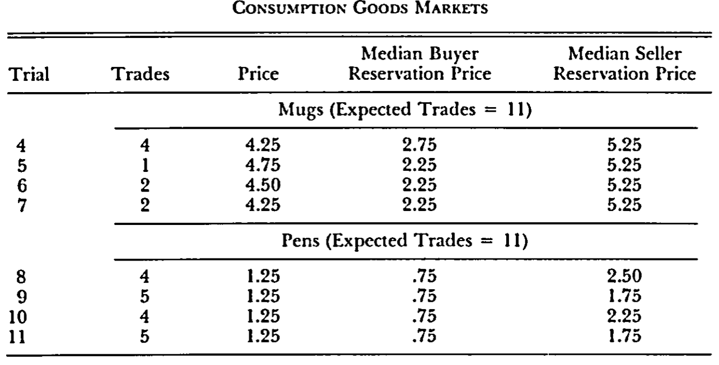
Endowment effect
Kahneman, D., Knetsch, J. L., and Thaler, R. H. (1990). "Experimental tests of the endowment effect and the Coase theorem." Journal of Political Economy 98(6): 1325-1348.
Experiment 1:
44 undergraduate students in an advanced law and economics class at Cornell University

Slide 12
Endowment effect
Field evidence:
List, J. A. (2003). "Does market experience eliminate market anomalies?" Quarterly Journal of Economics 118(1): 41-71.
List, J. A. (2004). "Substitutability, experience, and the value disparity: evidence from the marketplace." Journal of Environmental Economics and Management 47(3): 486-509.
List, J. A. (2011). "Does Market Experience Eliminate Market Anomalies? The Case of Exogenous Market Experience." American Economic Review 101(3): 313-317.
List (2003) and List (2004) treated market experience endogenously (i.e., participants decided on their own whether to trade repeatedly or not)
List (2011) introduced market experience exogenously (choose respondents with no experience in the first round, split them into two groups (NON-EXP and EXP), and ‘train’ the EXP group to be more experienced over future rounds).

Slide 13
Endowment effect
List (2003, 2004, and 2011):
Two treatments: In treatment 1 a respondent is endowed with good A and has the option to trade it for good B. In treatment 2, a different respondent is endowed with good B and has the option to trade it for good A. Respondents are assigned to the two treatments randomly.
Null hypothesis: the ratio of exchange in the two treatments is 50% (no endowment effect)
Alternative hypothesis: the ratio of exchange in the two treatments is less than 50% (endowment effect)
Field experiment: Sportscard show and Disneyland
Well-functioning marketplace: large number of active traders, transparent and updated market information, low transaction costs.
Steps: (1) give a respondent A/B, (2) complete a survey, (3) show B/A and ask if trade, and (4) conclude the transaction and exit.

Slide 14
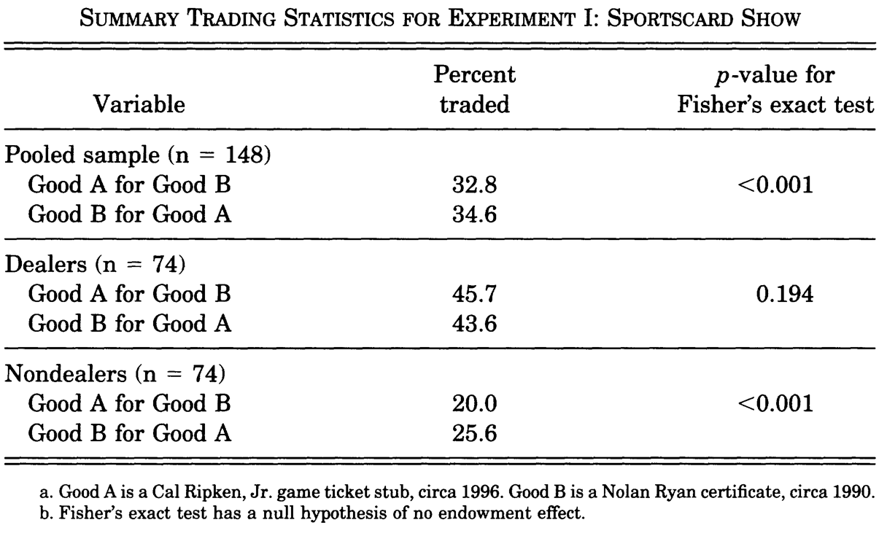
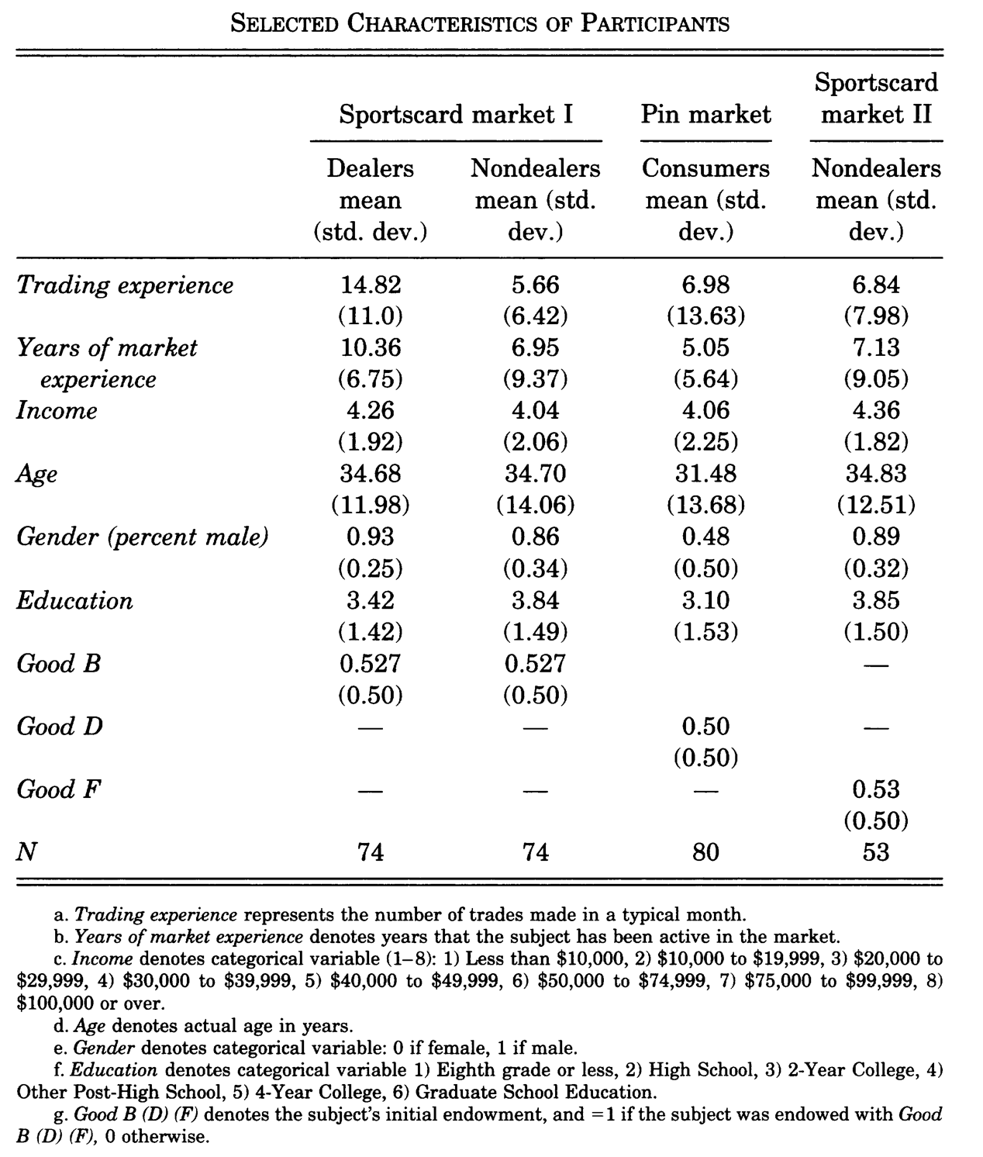
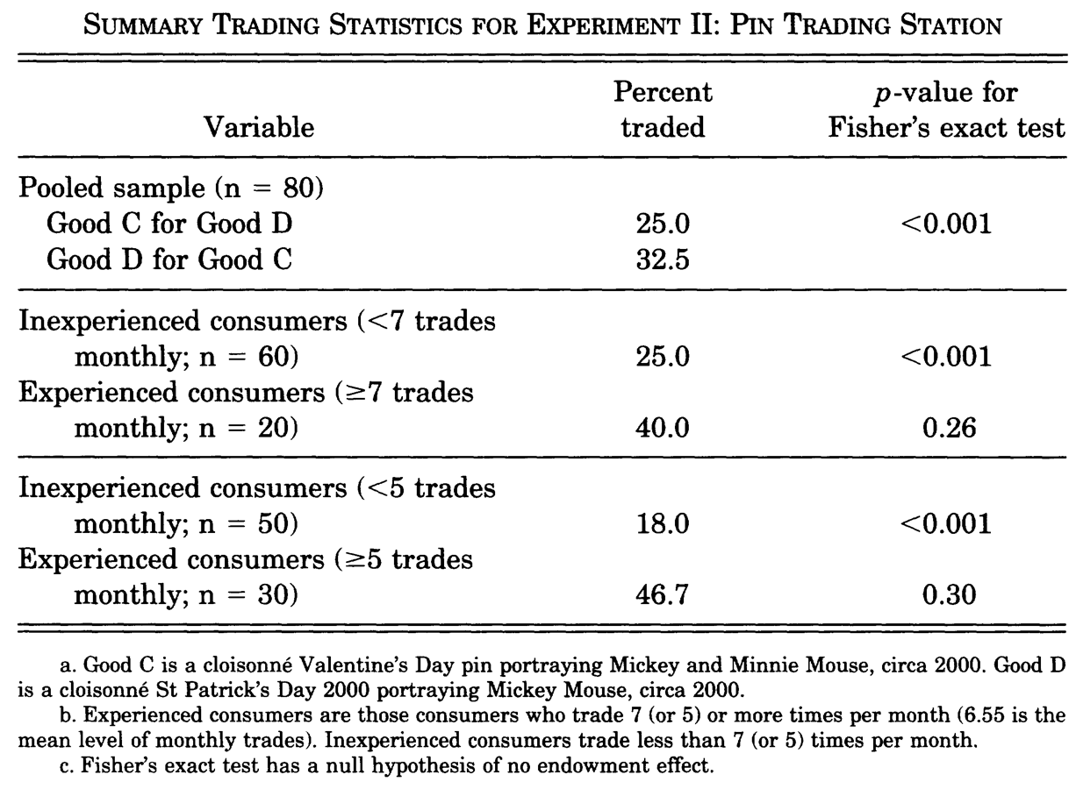

Slide 15
Endowment effect – evidence from housing markets
Bao, H. X. H. and C. M. Gong (2016). "Endowment effect and housing decisions." International Journal of Strategic Property Management 20(4): 341-353.
Field experiment
Conducted in May 2013 by the Institute of Statistical Survey (ISS) of Renmin University of China. A total of 20 interviewers were recruited and trained by ISS, and the interviews were carried out at 10 local branches of Centaline Real Estate Brokerage across the six main districts of Beijing.
Potential home sellers and buyers only
The interview lasted about 10 minutes on average
A total of 567 complete questionnaires were collected, with a response rate of 57%

Slide 16
Endowment effect – evidence from housing markets
Research design: based on three publications, buyer and seller versions are separated
Baucells, M., Weber, M., Welfens, F., (2011), Reference-Point Formation and Updating. Management Science, 57, 506-519.
Paraschiv, C., & Chenavaz, R. (2011). Sellers' and buyers' reference point dynamics in the housing market. Housing Studies, 26(3), 329–352.
Bao, H. X. H., & Gong, C. M. (2016). Endowment effect and housing decisions. International Journal of Strategic Property Management, 20(4), 341–353.
Platform: Prolific
Pre-screening filters: UK residents, home-owners, renters
Sample size: 400 (197 home-buyers and 203 home-sellers)
Time to collect the sample: 3 hours
Costs: £0.80 for the buyer questionnaire and £0.93 for the seller questionnaire

Slide 17
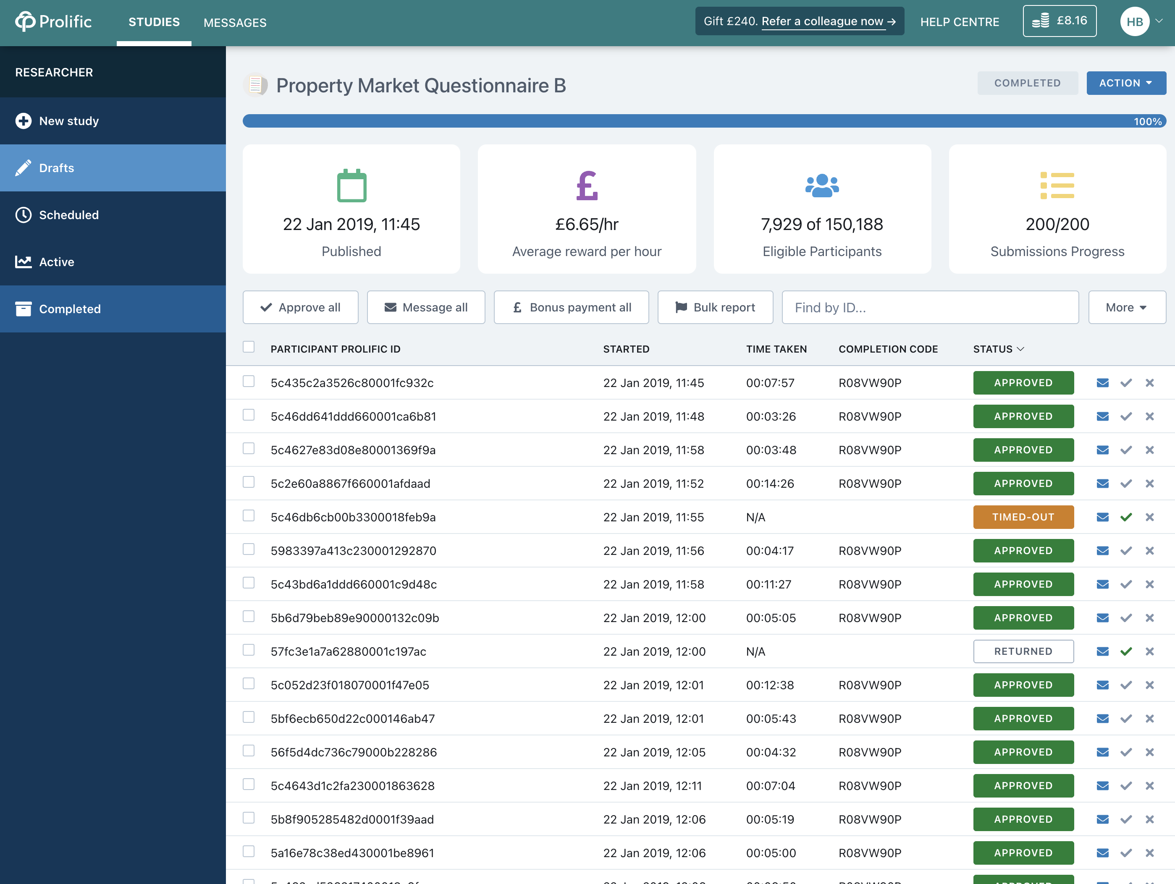
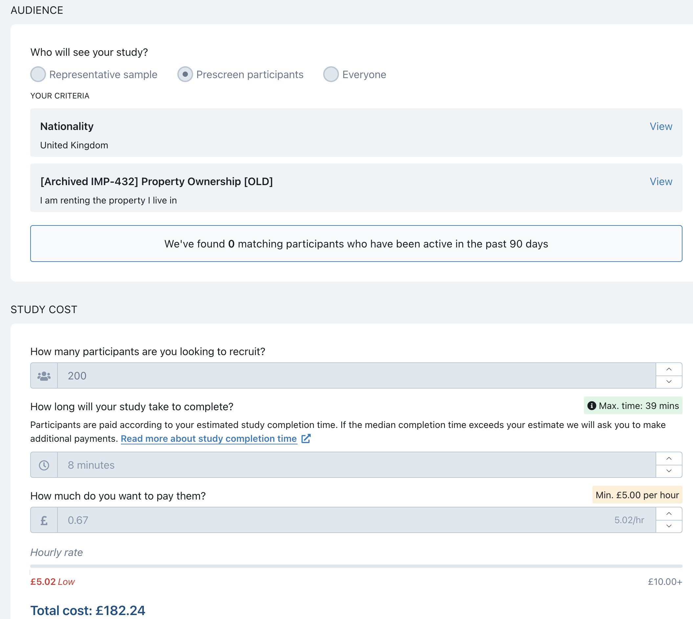

Slide 18
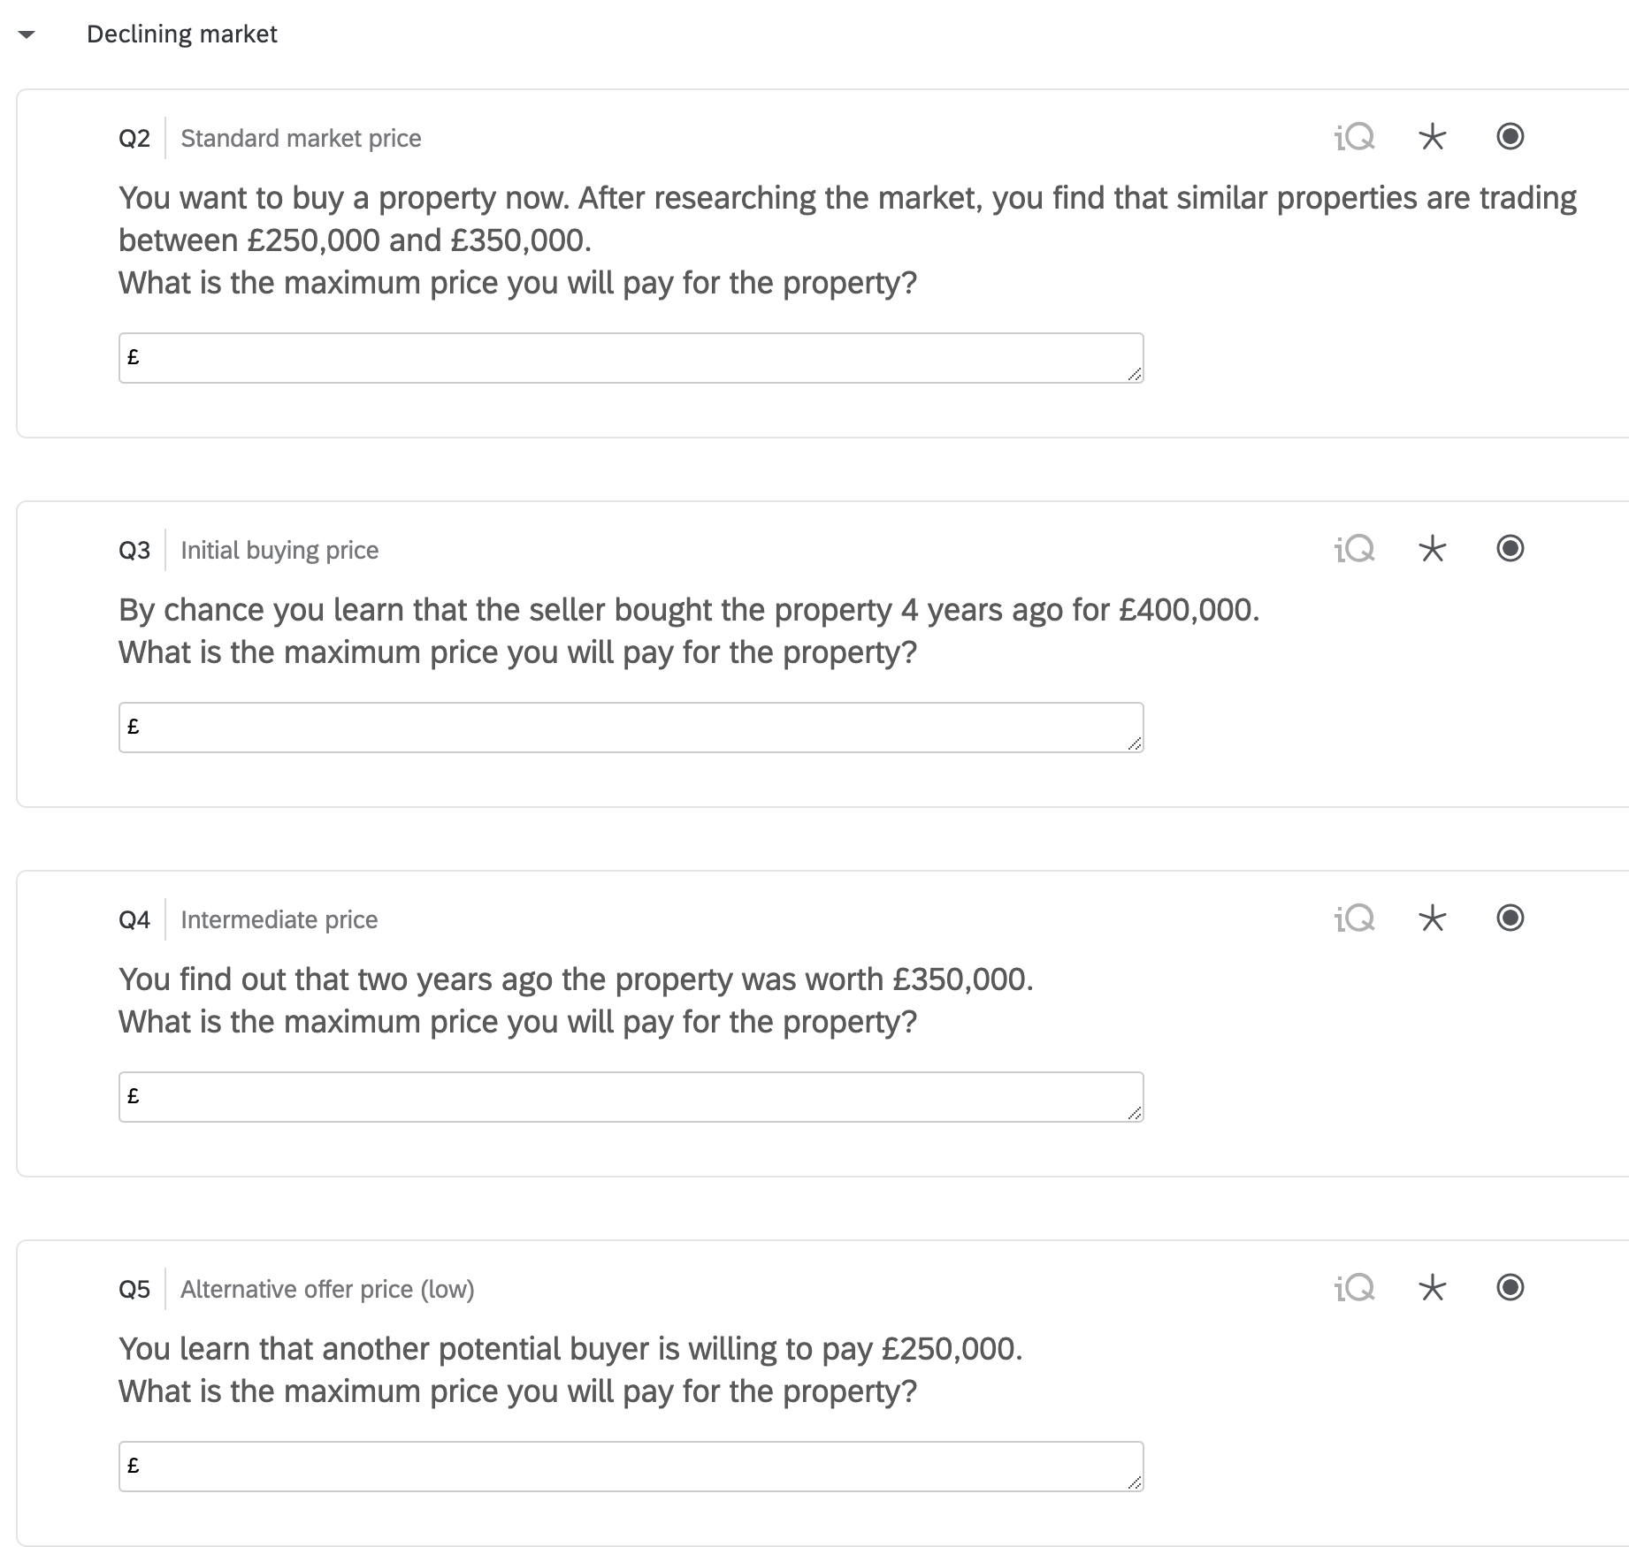
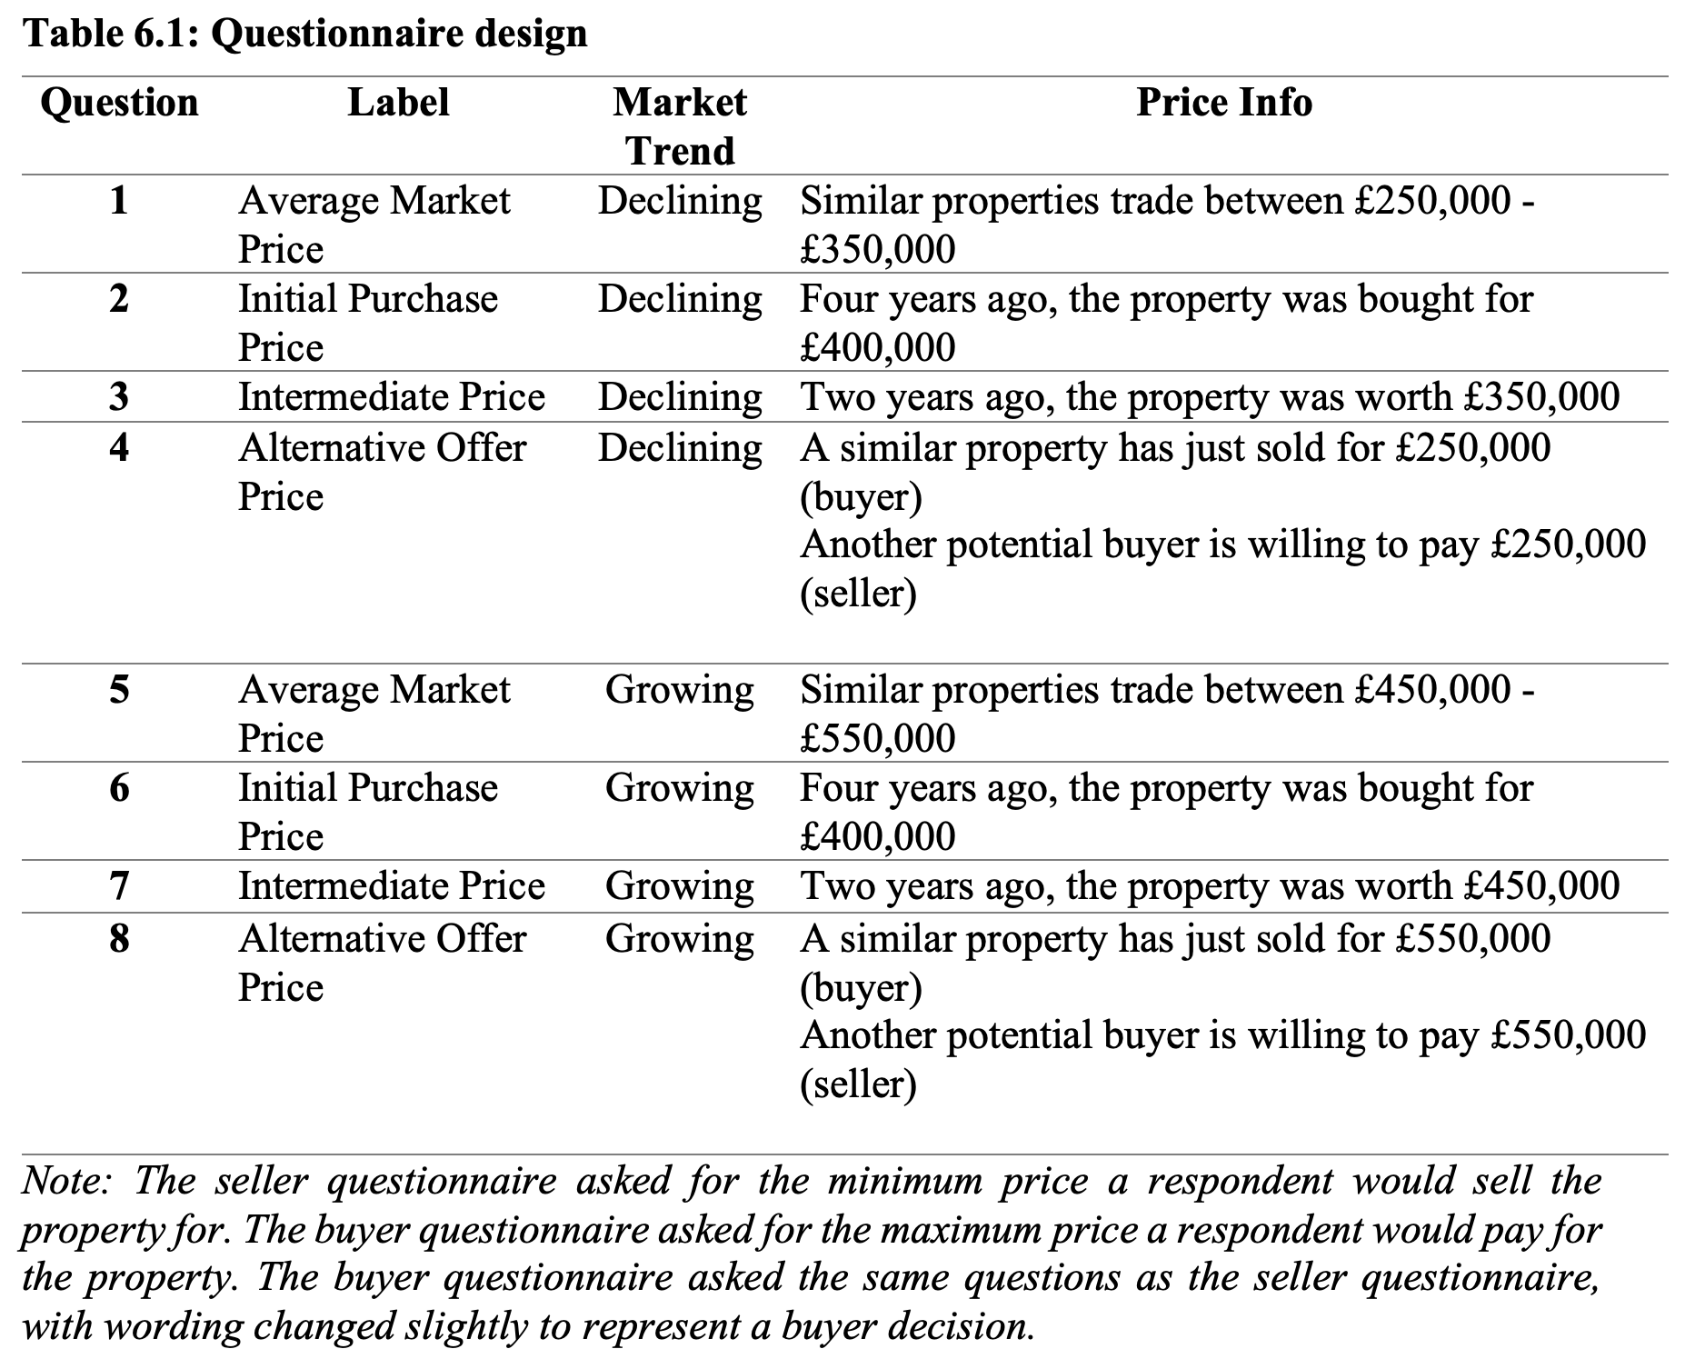

Slide 19
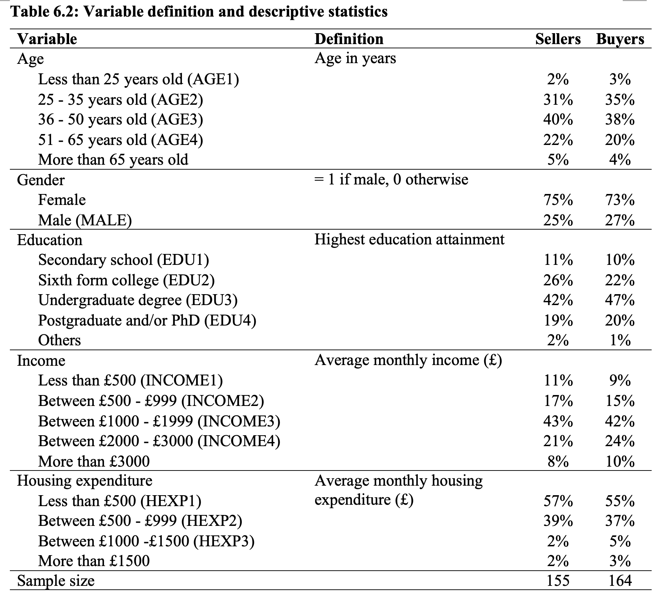

Slide 20
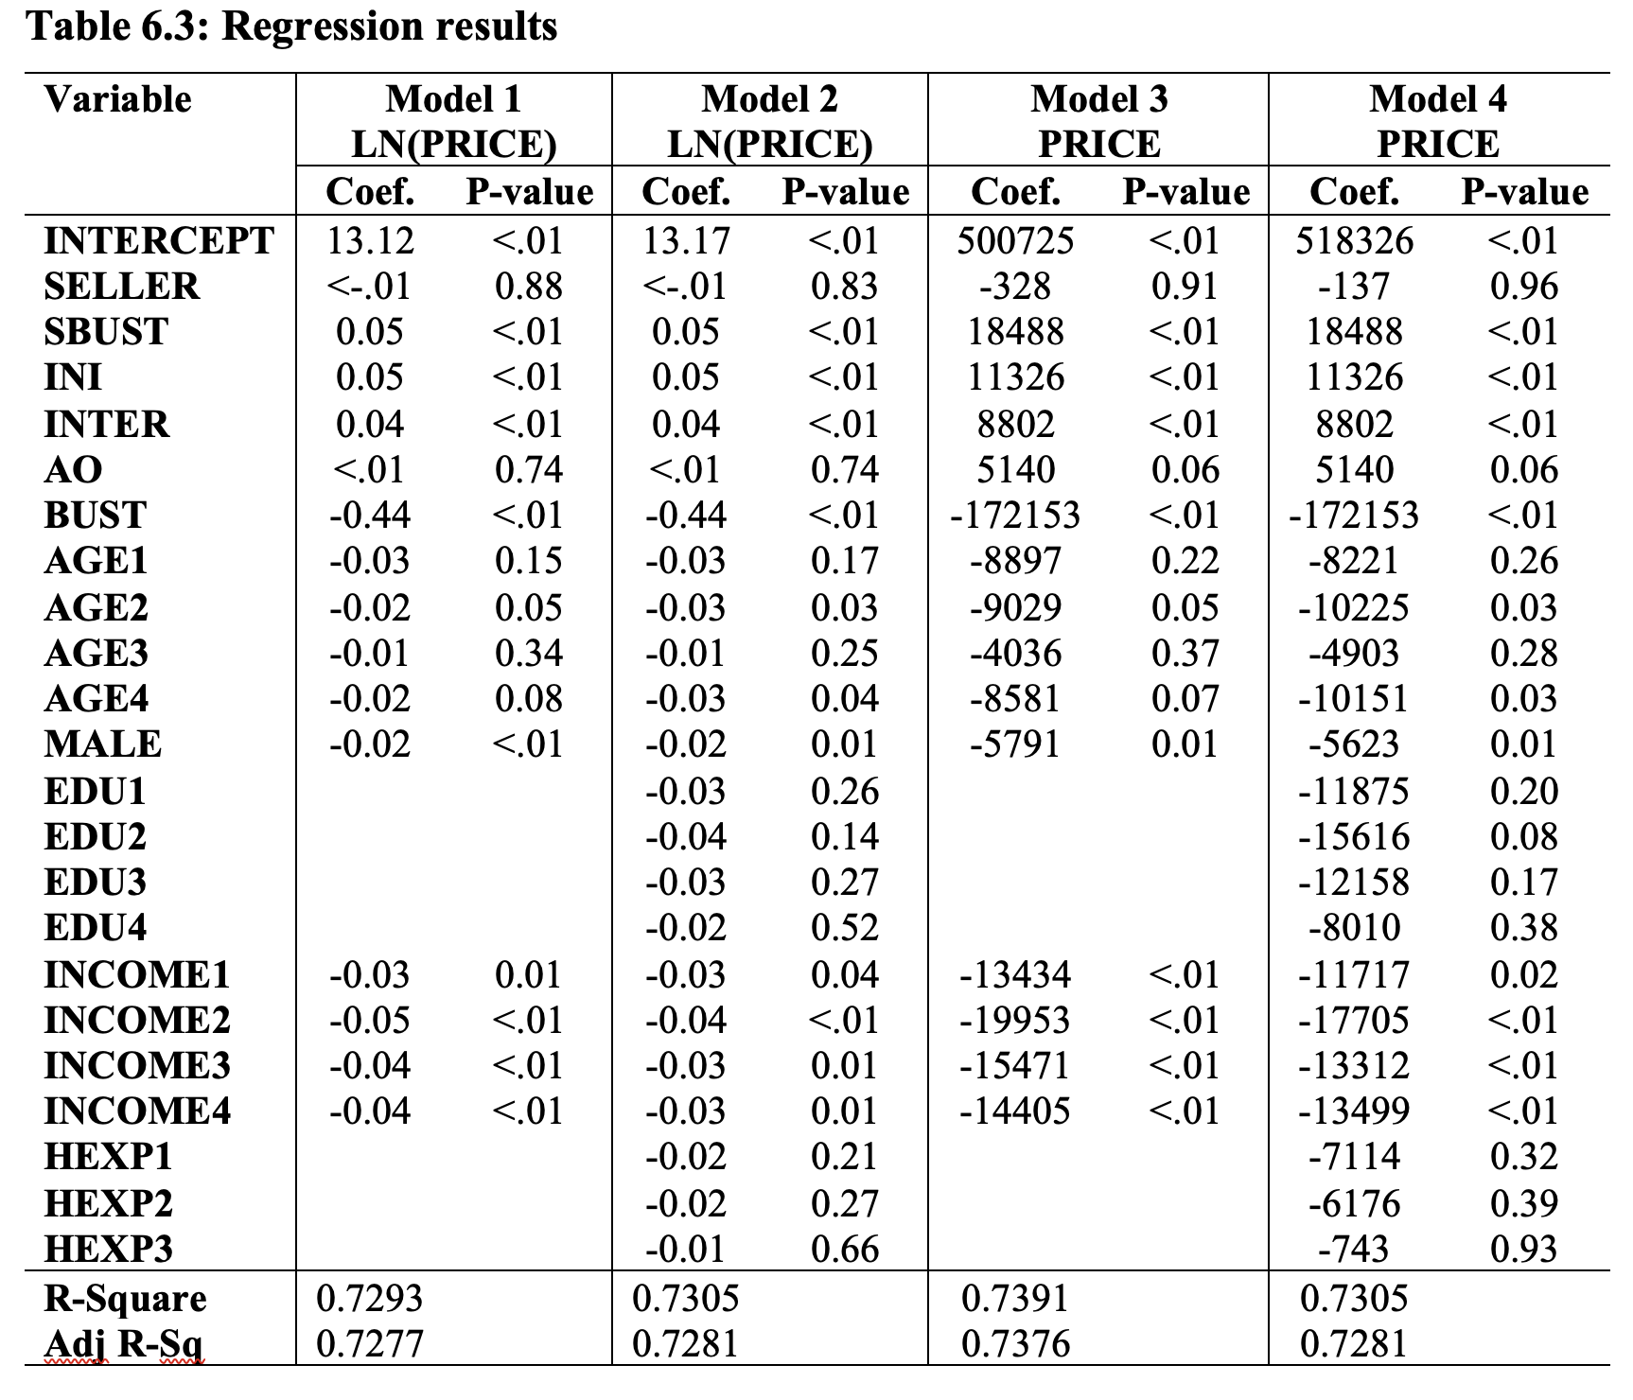
Findings and conclusions
$PRICE= β_{0}+β_{1}SELLER+β_{2}SBUST+β_{3}INI+β_{4}INTER+β_{5}AO+β_{6}BUDT$
$+β_{7}AGE1+β_{8}AGE2+β_{9}AGE3+β_{10}AGE4+β_{11}MALE+β_{12}EDU1+β_{13}EDU2$
$$+β_{14}EDU3+β_{15}EDU4+β_{15}INCOME1+β_{16}INCOME2+β_{17}INCOME3$$
$+β_{18}INCOME4+β_{19}HEXP1+β_{20}HEXP2+β_{21}HEXP3$
PRICE: Reported WTP/WTA
SELLER: = 1 if seller
BUST: = 1 if down market
SBUST = SELLER * BUST
INI: Initial purchase price
INTER: Intermediate price
AO: Alternative offer

Slide 21
Findings and conclusions
Is there endowment effect in the UK housing market?
If we look at the coefficient estimate of SELLER only, the answer is no
However, this is not the complete picture, as the coefficient estimate of SBUST is significant
Does endowment effect change with market condition?
The coefficient estimate of SBUST > 0 in all models
SBUST=1 only when both BUST= 1 and SELLER=1
Seller’s WTA is 5% or £18,488 higher than buyer’s WTP in a down market
Endowment effect is caused by loss aversion
When the market is booming, or being in the gain domain, sellers are able to overcome this psychological bias

Slide 22
Conclusions
A replication of Paraschiv, C., & Chenavaz, R. (2011)
Endowment effect is identified in down market among UK homeowners
Results are consistent with evidences collected by conventional online survey and field experiment (i.e., Baucells, M., Weber, M., Welfens, F., (2011), Paraschiv, C., & Chenavaz, R. (2011), and Bao, H. X. H., & Gong, C. M. (2016)
Prolific is a reliable and efficient platform to collect data
Helen X. H. Bao and Rufus Saunders (2021). Reference Dependence in the UK Housing Market. Housing Studies, https://doi.org/10.1080/02673037.2021.1935767.

