Slide 1
Prospect Theory – Reference Dependence
International Workshop on Behavioural Sciences and Urban-Rural Development in Developing Countries, 24 – 26 July 2023, Newnham College, University of Cambridge

Slide 2
Behavioural Theories & Models – Prospect Theory
Developed for simple prospects with monetary outcomes and stated probabilities
Two phases: an early phase of editing and a subsequent phase of evaluation
The editing phase consists of a preliminary analysis of the offered prospects, which often yields a simpler representation of these prospects.
The evaluation phase: the edited prospects are evaluated and the prospect of highest value is chosen.
Kahneman, D. and A. Tversky (1979). "Prospect Theory: An Analysis of Decision under Risk." Econometrica 47(2): 263-291.
Tversky, A. and D. Kahneman (1992). "Advances in Prospect-theory - Cumulative Representation of Uncertainty." Journal of Risk and Uncertainty 5(4): 297-323.

Slide 3
Nature of the Standard Model
The expected utility theory:
Example: Housing decision – buy or rent?
U(x)
$$\max{\sum_{t=0}^{T}{τ^{t}\sum_{i=1}^{k}{p_{i,t}U\left(x_{t} | S_{i,t}\right)}}}$$
Expected Utility when $τ$ = 0.9
Buy:
Rent:
Expected Utility when $τ$ = 0.1
Buy:
Rent:
$\sum_{t=1}^{T}{τ\sum_{i=1}^{k}{p_{i,t}U\left(x_{t} | S_{i,t}\right)}}$ = 13.2
$\sum_{t=1}^{T}{τ\sum_{i=1}^{k}{p_{i,t}U\left(x_{t} | S_{i,t}\right)}}$ = 10.6
0
x
$\sum_{t=1}^{T}{τ\sum_{i=1}^{k}{p_{i,t}U\left(x_{t} | S_{i,t}\right)}}$ = 6.8
$\sum_{t=1}^{T}{τ\sum_{i=1}^{k}{p_{i,t}U\left(x_{t} | S_{i,t}\right)}}$ = 7.4

Slide 4
Nature of Behavioural Models
The Standard Model:
$$\max{\sum_{t=0}^{T}{τ^{t}\sum_{i=1}^{k}{p_{i,t}U\left(x_{t} | S_{i,t}\right)}}}$$
Behavioural models:
Non-standard preference: $U\left(x_{t} | S_{i,t}\right)$ and $τ$
Endowment effect, loss aversion, disposition effect, social comparison …
Self-control, myopic discounting, equity premium puzzle, …
Non-standard belief: $p_{i,t}$
Overconfidence, overgeneralization, projection bias, representative bias, …
Non-standard decision-making: $\max{\sum_{t=0}^{T}{τ^{t}\sum_{i=1}^{k}{p_{i,t}U\left(x_{t} | S_{i,t}\right)}}}$
Herding, sentiment, inattention, emotion

Slide 5
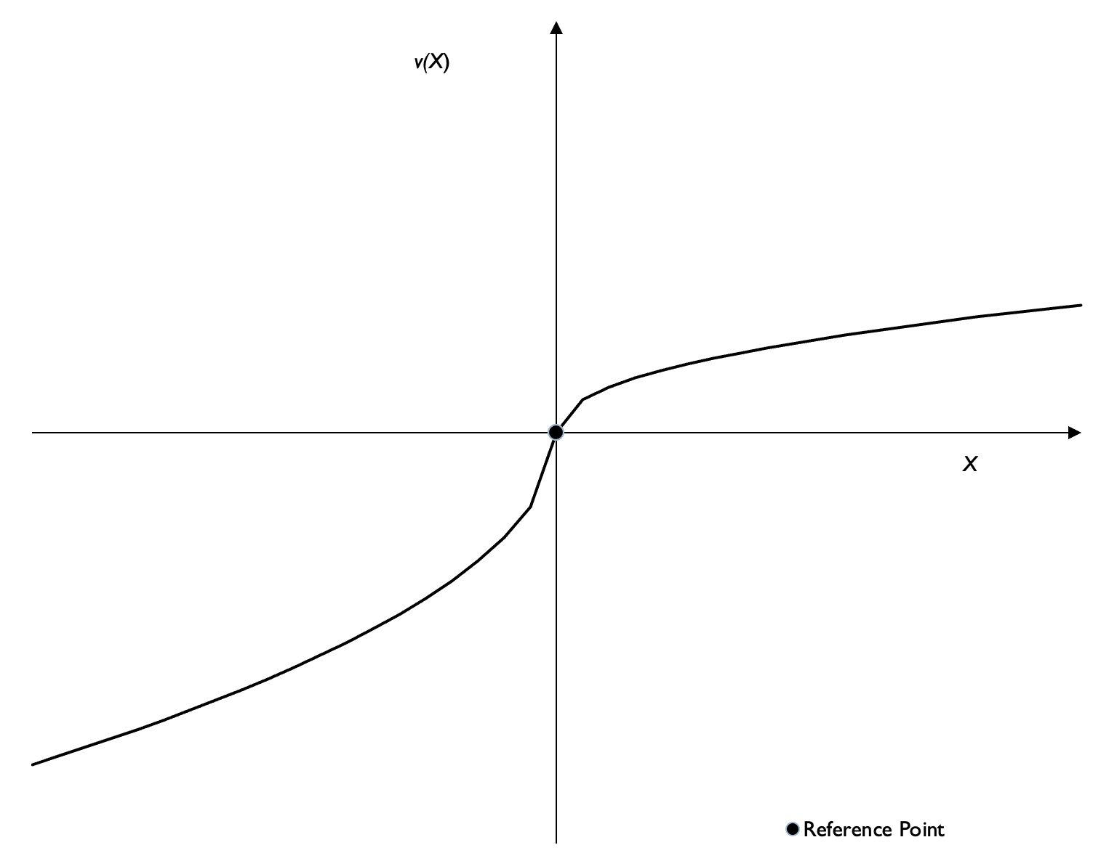
Example: Prospect Theory
The expected utility theory:
V(x)
$$\max{\sum_{t=0}^{T}{τ^{t}\sum_{i=1}^{k}{p_{i,t}U\left(x_{t} | S_{i,t}\right)}}}$$
U(x)
Prospect Theory:
$$\max{\sum_{t=0}^{T}{{f(τ)}^{t}\sum_{i=1}^{k}{w(p_{i,t})V\left(x_{t} | S_{i,t}\right)}}}$$
Gain Domain
$$r$$
x
0
x
V$\left(X\right)=\left\{\begin{aligned}&{\left(X−r\right)}^{α} X≥r \\ &−λ{\left(r−X\right)}^{β} X<r\end{aligned}\right.$
Loss Domain
$$w\left(p\right)=\frac{p^{γ}}{\frac{1}{γ}\left(p^{γ}+\left(1−p^{γ}\right)\right)}$$

Slide 6
The behavioural tool - Anchoring effect
Wheel of fortune experiment (Tversky, A. and D. Kahneman, 1974, "Judgment under Uncertainty - Heuristics and Biases." Science 185(4157): 1124-1131.)
Anchor: a starting point from which insufficient adjustment is made. It’s a broader concept than reference point (i.e., reference points are often relevant, whilst anchor points could be completely irrelevant to the decision)
What’s the percentage of African countries in the United Nations?
Respondents spun a wheel of fortune before answering the question.
The wheel was painted with numbers from 0 to 100, but rigged to show 10 or 65 only
Respondents were asked whether the number of African nations in the United Nations was greater than or less than that number, and then estimate the actual figure
The actual number is about 30% at the time
Scenarios | Outcomes
The wheel showed 65 | 45%
The wheel showed 10 | 25%

Slide 7
Anchoring effect
Ariely, D., et al. (2003). "Coherent arbitrariness": Stable demand curves without stable preferences. Quarterly Journal of Economics 118(1): 73-105.
Higher vs. lower two-digit numbers groups have huge differences in valuations
55 MBA students in a marketing research class at Carnegie Mellon University
A wide range of ordinary consumer products were considered in the lab experiment
Students were asked whether they would buy each good for a dollar figure equal to the last two digits of their social security number (Price 1)
They then state a dollar maximum willingness-to-pay (WTP) for the product (Price 2)
The incentive-compatible Becker-Degroot-Marschak procedure is used to decide whether students can buy the product (i.e., a random generated price is lower than either Price 1 or Price 2).

Slide 8
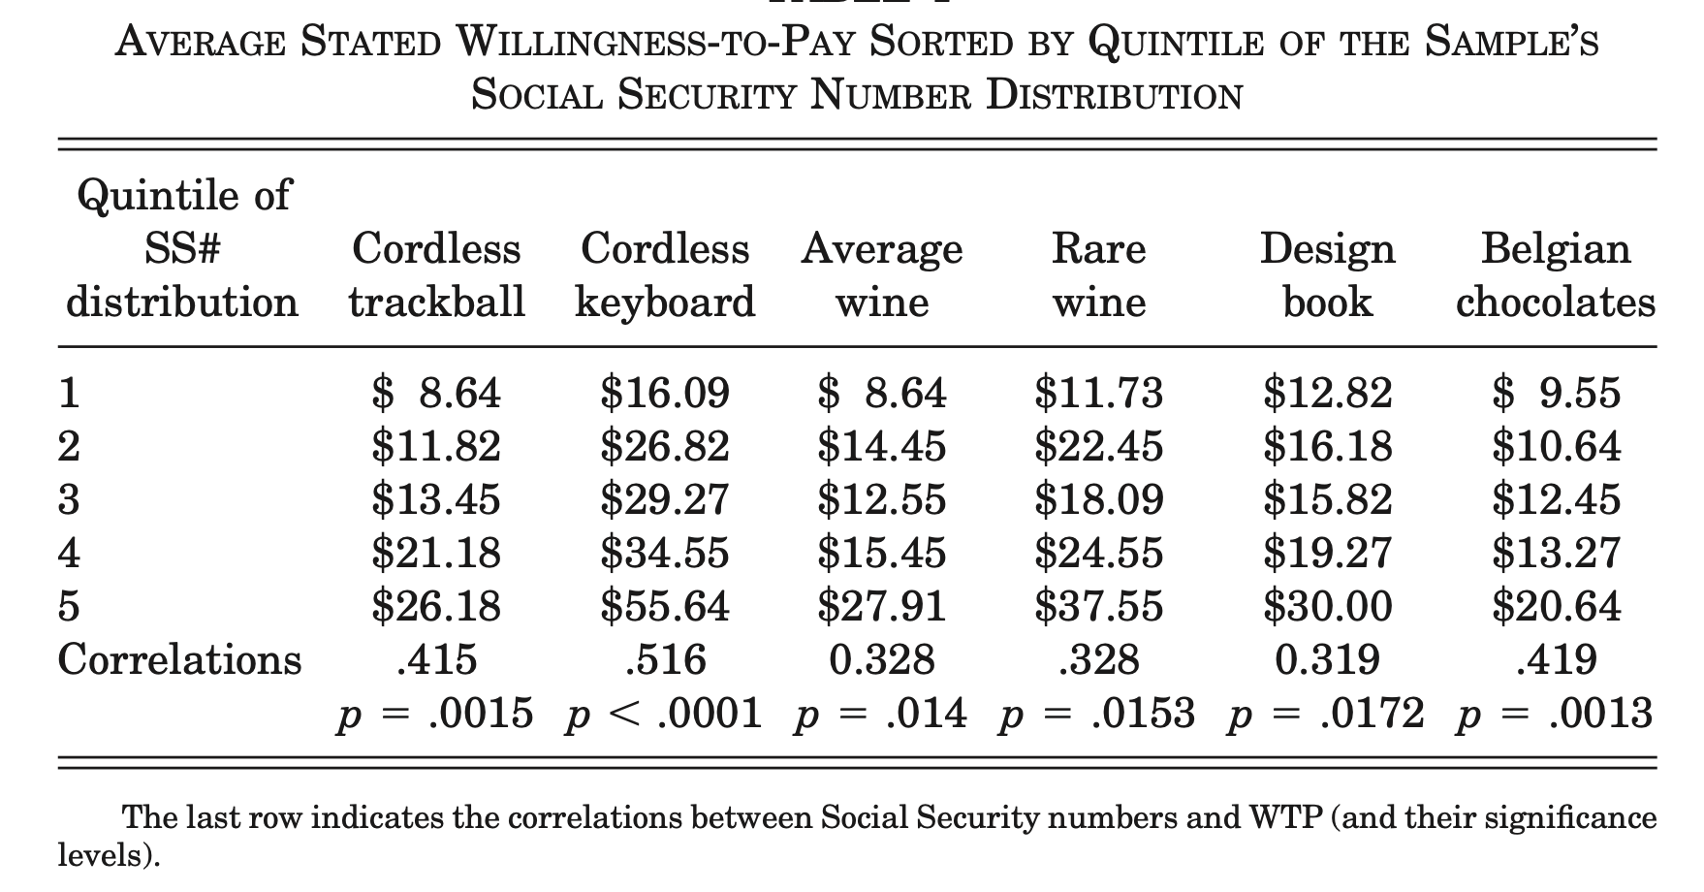
Anchoring effect
Ariely, D., et al. (2003). "Coherent arbitrariness": Stable demand curves without stable preferences. Quarterly Journal of Economics 118(1): 73-105.
See also: Ariely, D. , 2008, Predictably irrational : the hidden forces that shape our decisions. New York, Harper.

Slide 9
Source:
1. https://www.science.org/content/article/fraudulent-data-set-raise-questions-about-superstar-honesty-researcher
2. https://www.economist.com/graphic-detail/2021/08/20/a-study-on-dishonesty-was-based-on-fraudulent-data

Slide 10
Anchoring effect in housing market – lab experiment
Scott, P. J. and C. Lizieri (2012). "Consumer house price judgements: new evidence of anchoring and arbitrary coherence." Journal of Property Research 29(1): 49-68.
Experiment conducted in classroom, with 139 undergraduate students (representative of first-time homebuyers)
45 minutes long, with £5 paid for participation, and a potential reward of £10 or £20 depending on performance (incentive-based method)
The last three digits of the mobile phone number is used as an arbitrary anchor (i.e., “write down the last three digits of your mobile telephone number as a price in thousands of pounds”)
Information about four properties in Cambridge was provided next (a virtual tour including photographic and textual information)
Estimated sale prices are reported. £20 reward if estimation is within £2000 of the true sale price, and £10 for within £2000 and £10,000.

Slide 11
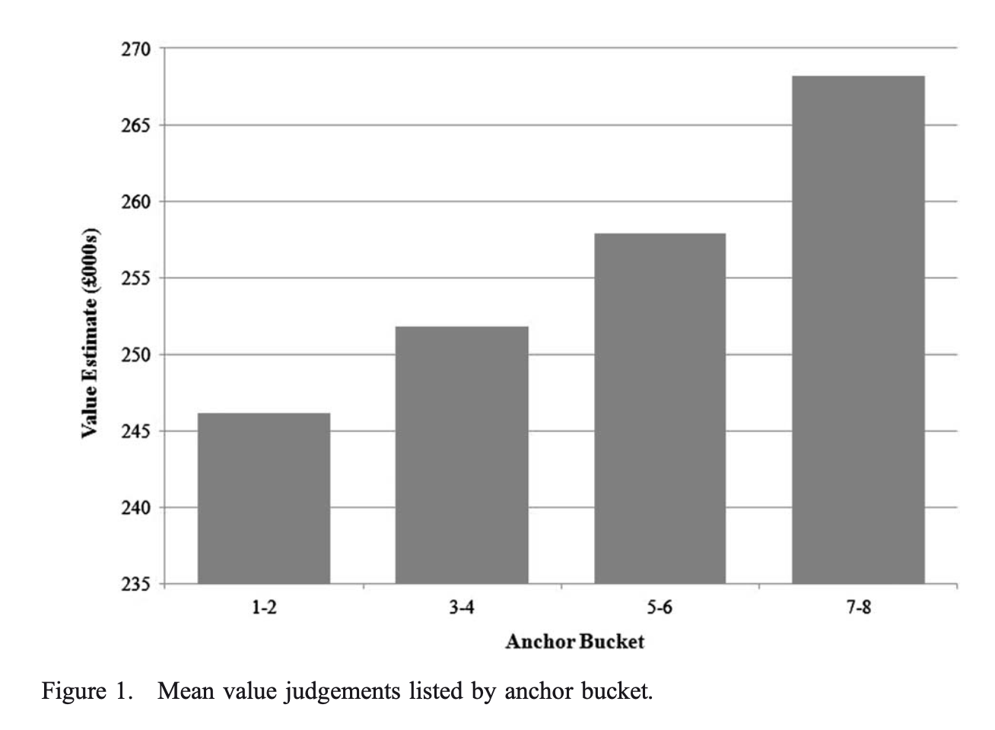
Anchoring effect in housing market – lab experiment
Scott, P. J. and C. Lizieri (2012). "Consumer house price judgements: new evidence of anchoring and arbitrary coherence." Journal of Property Research 29(1): 49-68.
£268,200
10 ‘anchor buckets’ based on the first digit of the anchor
0 and 9 are omitted because they ‘do not provide reasonable anchors’
Buckets are grouped so that the data are effectively split into quartile by anchors
Data are ‘Winsorized’ to remove extremely inaccurate answers
F = 1.142, p-value = 0.336
£246,100

Slide 12
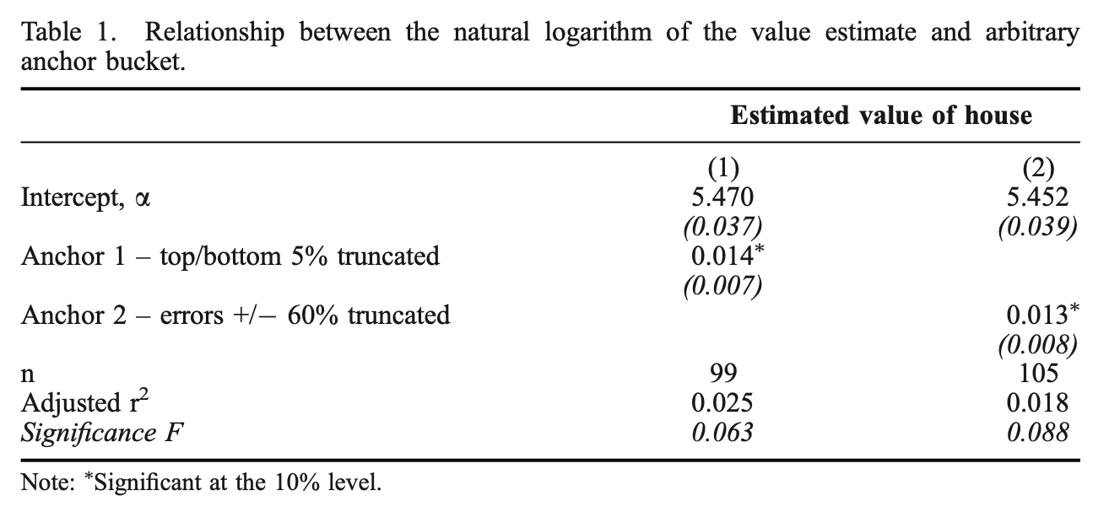
Anchoring effect in housing market – lab experiment
Scott, P. J. and C. Lizieri (2012). "Consumer house price judgements: new evidence of anchoring and arbitrary coherence." Journal of Property Research 29(1): 49-68.

Slide 13
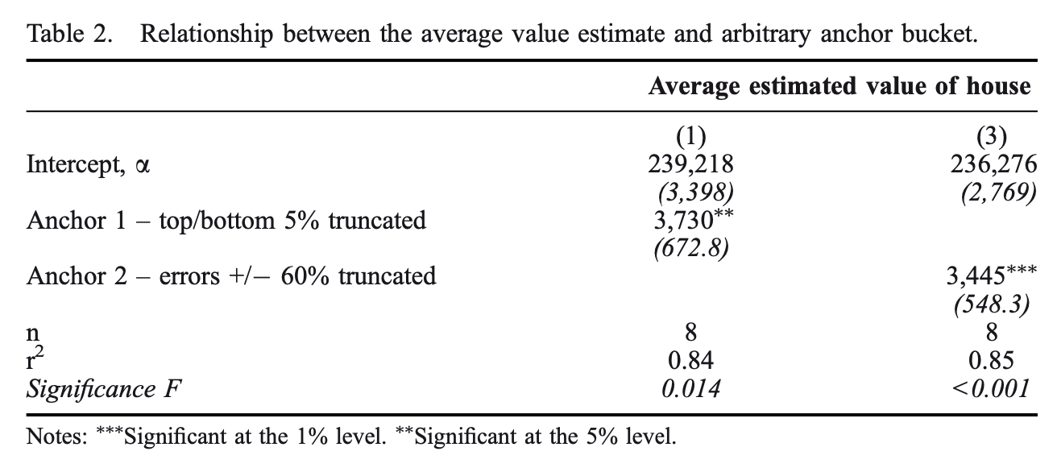
Anchoring effect in housing market – lab experiment
Scott, P. J. and C. Lizieri (2012). "Consumer house price judgements: new evidence of anchoring and arbitrary coherence." Journal of Property Research 29(1): 49-68.
Average

Slide 14
Anchoring effect in housing market – field experiment
Seiler, M. J., V. L. Seiler, et al. (2012). "Mental Accounting and False Reference Points in Real Estate Investment Decision Making." Journal of Behavioral Finance 13(1): 17-26.
Field experiment
Actual owners of investment real estate properties
Two experiments: in isolation and as part of an overall portfolio
Internet-based survey in 2009
533 usable responses
Safety check throughout the survey, 7 questions in total
Testable hypothesis:
WTS is constant in all five scenarios (no disposition effect)
WTS is the same in experiment 1 and experiment 2 (no mental accounting)

Slide 15
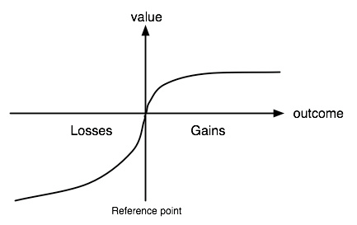
Anchoring effect in housing market – field experiment
Seiler, M. J., V. L. Seiler, et al. (2012). "Mental Accounting and False Reference Points in Real Estate Investment Decision Making." Journal of Behavioral Finance 13(1): 17-26.
Disposition effect: people are more willing to sell an investment at a gain than they are to sell investments at a loss, ceteris paribus
Willingness-to-sell curve: concave for returns above zero and convex below.
False reference point: the breaking even, or a zero return, in the willingness-to-sell curve.
Reflection point / false reference point

Slide 16
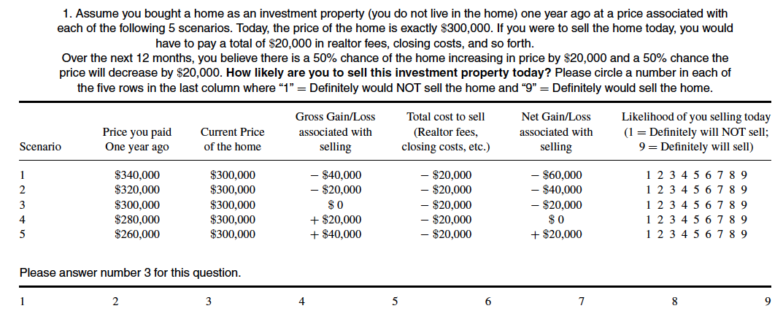
Anchoring effect in housing market – field experiment
Seiler, M. J., V. L. Seiler, et al. (2012). "Mental Accounting and False Reference Points in Real Estate Investment Decision Making." Journal of Behavioral Finance 13(1): 17-26.

Slide 17
Anchoring effect in housing market – field experiment
Seiler, M. J., V. L. Seiler, et al. (2012). "Mental Accounting and False Reference Points in Real Estate Investment Decision Making." Journal of Behavioral Finance 13(1): 17-26.

Slide 18
Anchoring effect in housing market – field experiment
Seiler, M. J., V. L. Seiler, et al. (2012). "Mental Accounting and False Reference Points in Real Estate Investment Decision Making." Journal of Behavioral Finance 13(1): 17-26.

Slide 19
Anchoring effect in housing market – field evidence
Unveren, B. and K. Baycar (2019). "Historical evidence for anchoring bias: The 1875 cadastral survey in Istanbul." Journal of Economic Psychology 73: 1-14.
Data source: cadastral survey conducted in 1875 in İstanbul by the Turkish government of the time
315 pieces of real estate from three regions (out of about 8,000 entries)
Surveyors appraised values of the real properties, and recorded their physical features
Statistically significant positive relationship between door numbers and appraised values
Rational explanations are considered, and none is found to be explanatory

Slide 20
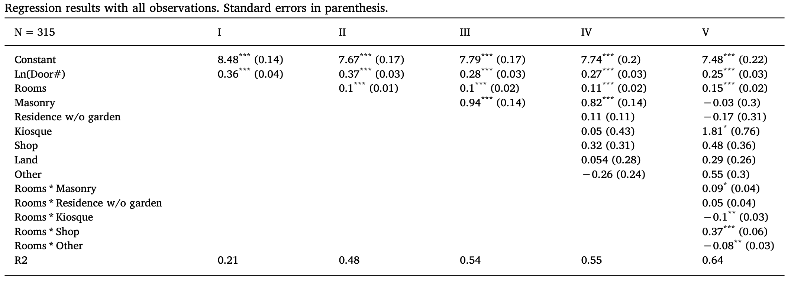
Anchoring effect in housing market – field evidence
Unveren, B. and K. Baycar (2019). "Historical evidence for anchoring bias: The 1875 cadastral survey in Istanbul." Journal of Economic Psychology 73: 1-14.
Notes:
three types of construction materials: masonry (morter), semi-masonry, and wooden
Mansion (kiosque)
Cadastral surveying is the sub-field of cadastre and surveying that specialises in the establishment and re-establishment of real property boundaries.

Slide 21
Anchoring effect in housing market – field evidence
Unveren, B. and K. Baycar (2019). "Historical evidence for anchoring bias: The 1875 cadastral survey in Istanbul." Journal of Economic Psychology 73: 1-14.
Normalized the appraised values by setting V (50) = 100
100% increase in door number, ceteris paribus, increases appraised value by 10–25%.
After conducting a similar exercise using the results of Scott and Lizieri (2012), we see that 100% increase in anchor (i.e. phone number’s last three digit) causes 3–6% increase in judgement (i.e. appraised real estate value).
N = 315 (all properties)
N = 236 (area known)
N = 94 (rent known)
N = 85 (rent and area known)
Notes:
Consider three houses with identical features but different door numbers 25, 50, and 100. Their estimated (or, average) value appraisals are denoted by V (25),V (50), andV (100). So we find a stronger but commensurate
incidental anchoring bias in terms of effect size.

Slide 22
Anchoring effect in housing market – field evidence
Unveren, B. and K. Baycar (2019). "Historical evidence for anchoring bias: The 1875 cadastral survey in Istanbul." Journal of Economic Psychology 73: 1-14.
Alternative, rational explanations considered:
Buildings with low door numbers could be close to the inner-city where real properties were maybe cheap at the time, and high door numbers could be located in the periphery where real properties were maybe expensive
Older buildings could be numbered earlier so they would have lower door numbers. In other words, door number would act as a proxy of the building age, which certainly affects value
Both locational and age variables are missing from the dataset

Slide 23
Anchoring effect in housing market – field evidence
Unveren, B. and K. Baycar (2019). "Historical evidence for anchoring bias: The 1875 cadastral survey in Istanbul." Journal of Economic Psychology 73: 1-14.

Slide 24
Anchoring effect in housing market – field evidence
Unveren, B. and K. Baycar (2019). "Historical evidence for anchoring bias: The 1875 cadastral survey in Istanbul." Journal of Economic Psychology 73: 1-14.
Strengths:
Good external validity: field evidence rather than lab experiment with students
Ruled out alternative explanations (omitted variable bias)
Estimate effect size of anchoring effect
Weaknesses:
Small sample size
Data and map are 30 years apart

Slide 25
Summary
Prospect Theory vs. Standard Economic Theory
Reference Point Dependence & Anchoring Effect
Lab Experiments and Field Evidence
An Important Step in the Studies of Loss Aversion

