Slide 1
Case Study: e-Nudge
International Workshop on Behavioural Sciences and Urban-Rural Development in Developing Countries, 24 – 26 July 2023, Newnham College, University of Cambridge

Slide 2
HSBC e-Nudge Initiative
A service to current account customers to alert them when they are approaching their overdraft limit.
The free service sent text messages to customers who reach 60%, 80% and then 95% of their limit.
A trail started in June 2011, Customers will have to request them (opt-in).
Officially rolled out on 10 November 2014 (opt-out).
Over 1M text messages were sent per month since then.
Over 50% of customers sent the alerts were able to avoid fees.
Customers saved £85m in overdraft charges within 12 months
One of the causes for the bank’s fall in revenue in 2015.

Slide 3
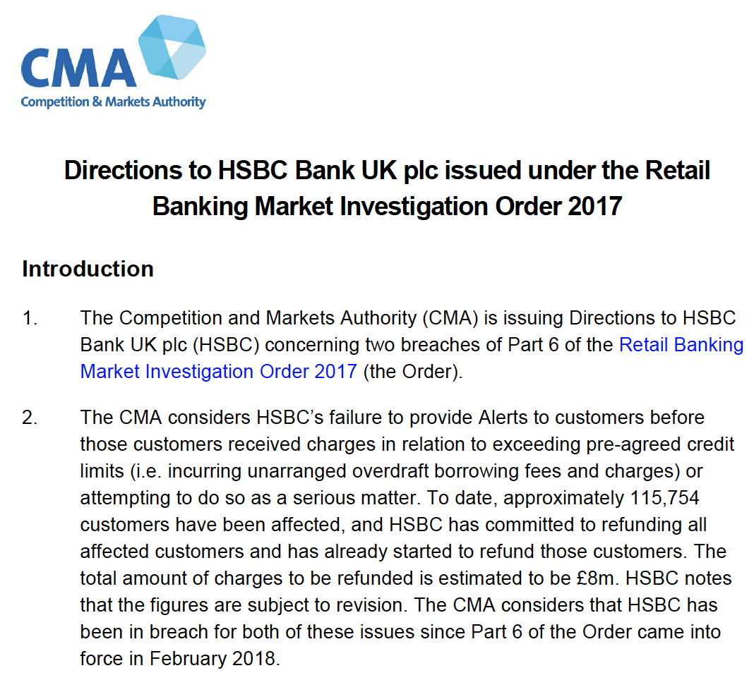
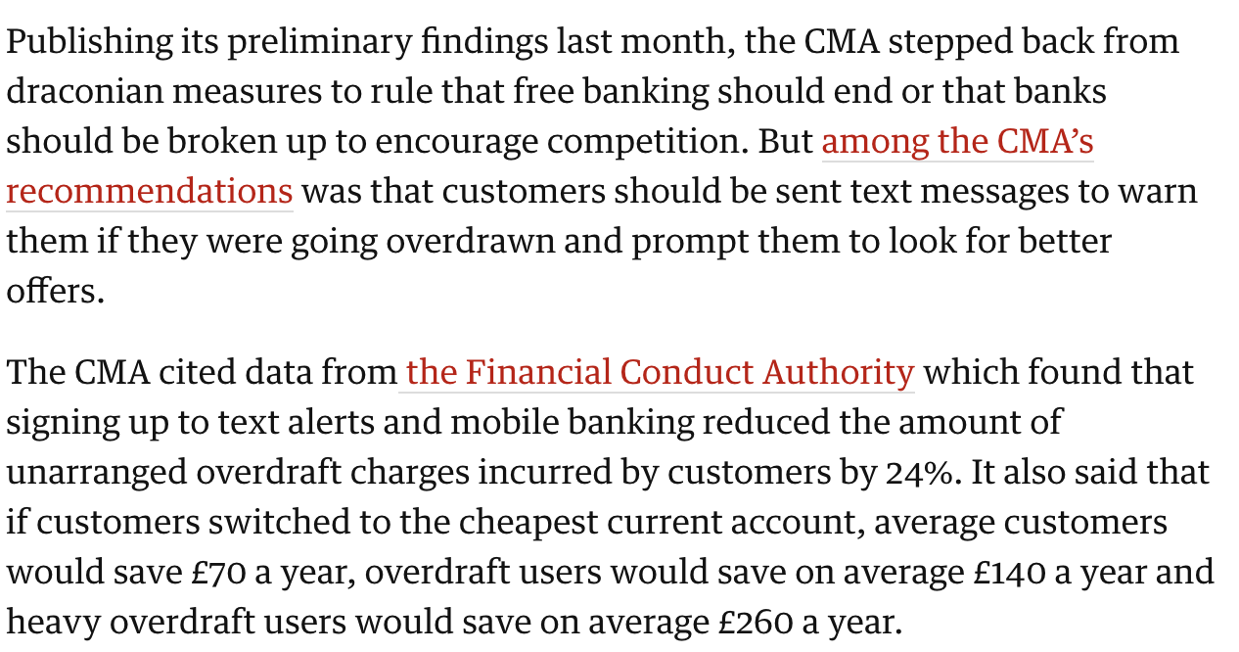
HSBC e-Nudge Initiative
Competitions and Markets Authority
Financial Conduct Authority
Source: https://www.theguardian.com/business/2015/nov/02/hsbc-first-direct-customers-saved-85m-overdraft-charges-text-warnings; and https://assets.publishing.service.gov.uk/government/uploads/system/uploads/attachment_data/file/890919/Directions_to_HSBC_UK.pdf.

Slide 4
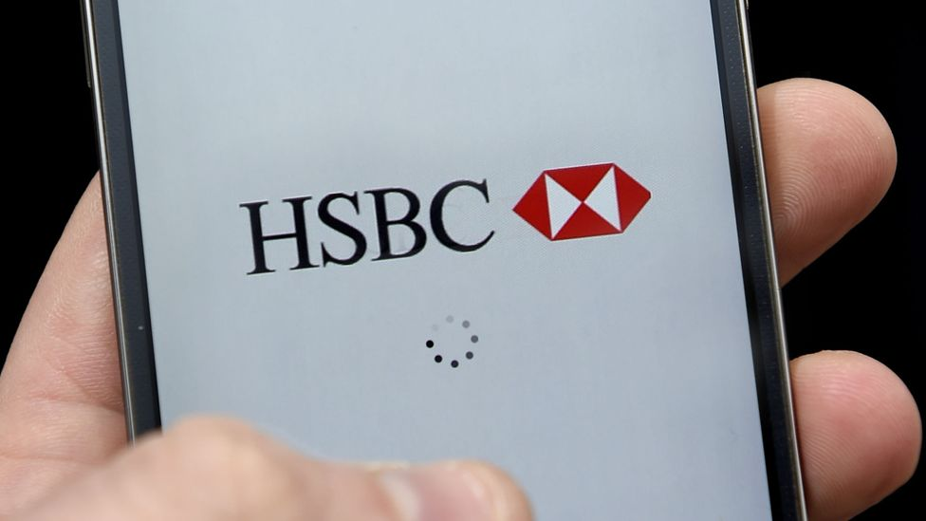
HSBC e-Nudge Initiative
HSBC Nudge, the world’s first banking app combining customer data and nudge theory.
First trial started 19 January 2016.
Backed by a commissioned study by LSE.
38 types of nudges in the trial (e.g., notifications about the amount of money spent on groceries in a week and updates on how much customers are spending or saving versus others in the same income bracket).
Around 500 HSBC customers over a three-month period.
Source: https://www.bbc.co.uk/news/technology-41429379

Slide 5
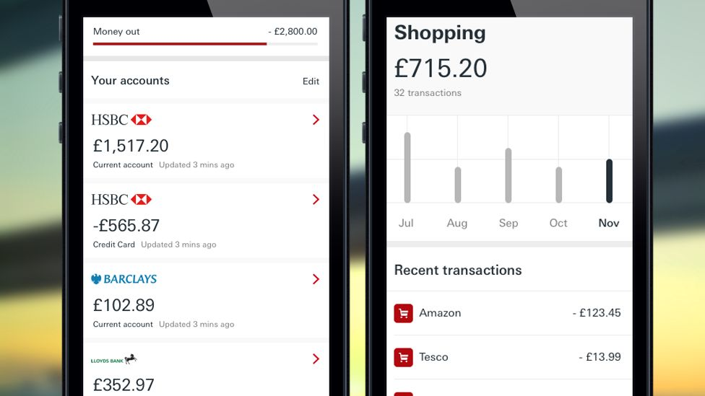
HSBC e-Nudge Initiative
HSBC Nudge, the world’s first banking app combining customer data and nudge theory.
A larger trial started in September 2017.
Customers will also be able to add accounts from 21 rivals including Lloyds and NatWest, to keep track of all their balances in one app.
Trialed with 10,000 customers
Break down spending into easily visible categories such as groceries, entertainment, coffee and utility bills.
Eventually integrated into the HSBC app
Source: https://www.bbc.co.uk/news/technology-41429379

Slide 6
HSBC e-Nudge Initiative
HSBC Nudge, the world’s first banking app combining customer data and nudge theory.
An initiative under the pressure of the regulators
The role of the ‘visible hand’
Test, test, test!
Nudge: from a novel idea to the norm.
The future of behavioural economics

Slide 7
Digital Nudges - Applications
Stieglitz S, Mirbabaie M, Deubel A, et al. (2023) The potential of digital nudging to bridge the gap between environmental attitude and behavior in the usage of smart home applications. International Journal of Information Management 72.
Study 1: Prolific experiments; 391 participants from 33 countries.
Nudges:
Social norm nudge: “The bars show the options that similar households chose.”
Self-commitment nudge: “First, please indicate which appliances you want to save energy for.”
Reminder nudge: “Remember that you want to save energy with this device"

Slide 8
Digital Nudges - Applications
Stieglitz S, Mirbabaie M, Deubel A, et al. (2023) The potential of digital nudging to bridge the gap between environmental attitude and behavior in the usage of smart home applications. International Journal of Information Management 72.
Study 1: Prolific experiments; 391 participants from 33 countries.

Slide 9
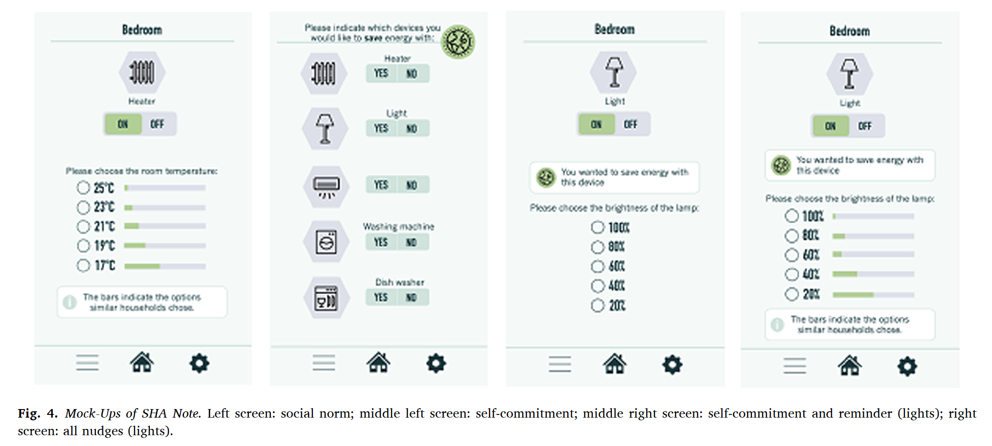
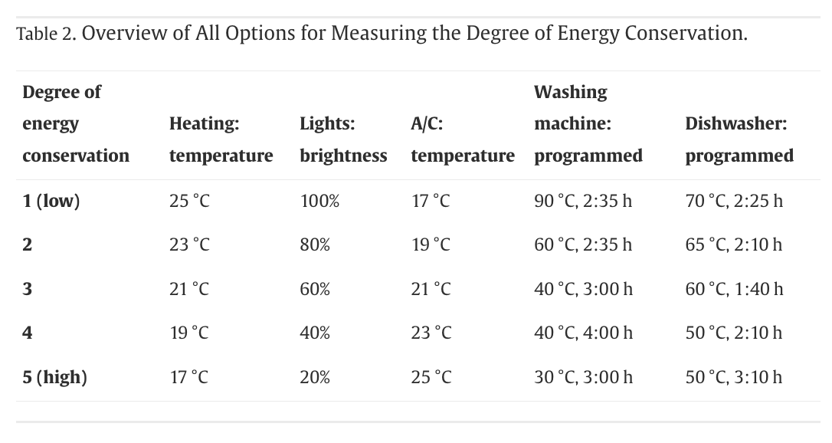
Digital Nudges - Applications
Stieglitz S, Mirbabaie M, Deubel A, et al. (2023) The potential of digital nudging to bridge the gap between environmental attitude and behavior in the usage of smart home applications. International Journal of Information Management 72.
Study 1: Prolific experiments; 391 participants from 33 countries.

Slide 10
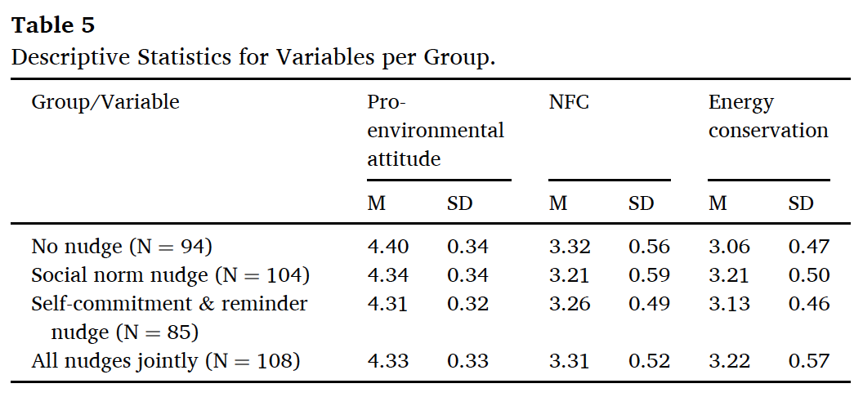
Digital Nudges - Applications
Stieglitz S, Mirbabaie M, Deubel A, et al. (2023) The potential of digital nudging to bridge the gap between environmental attitude and behavior in the usage of smart home applications. International Journal of Information Management 72.
Study 1: Prolific experiments; 391 participants from 33 countries.

Slide 11
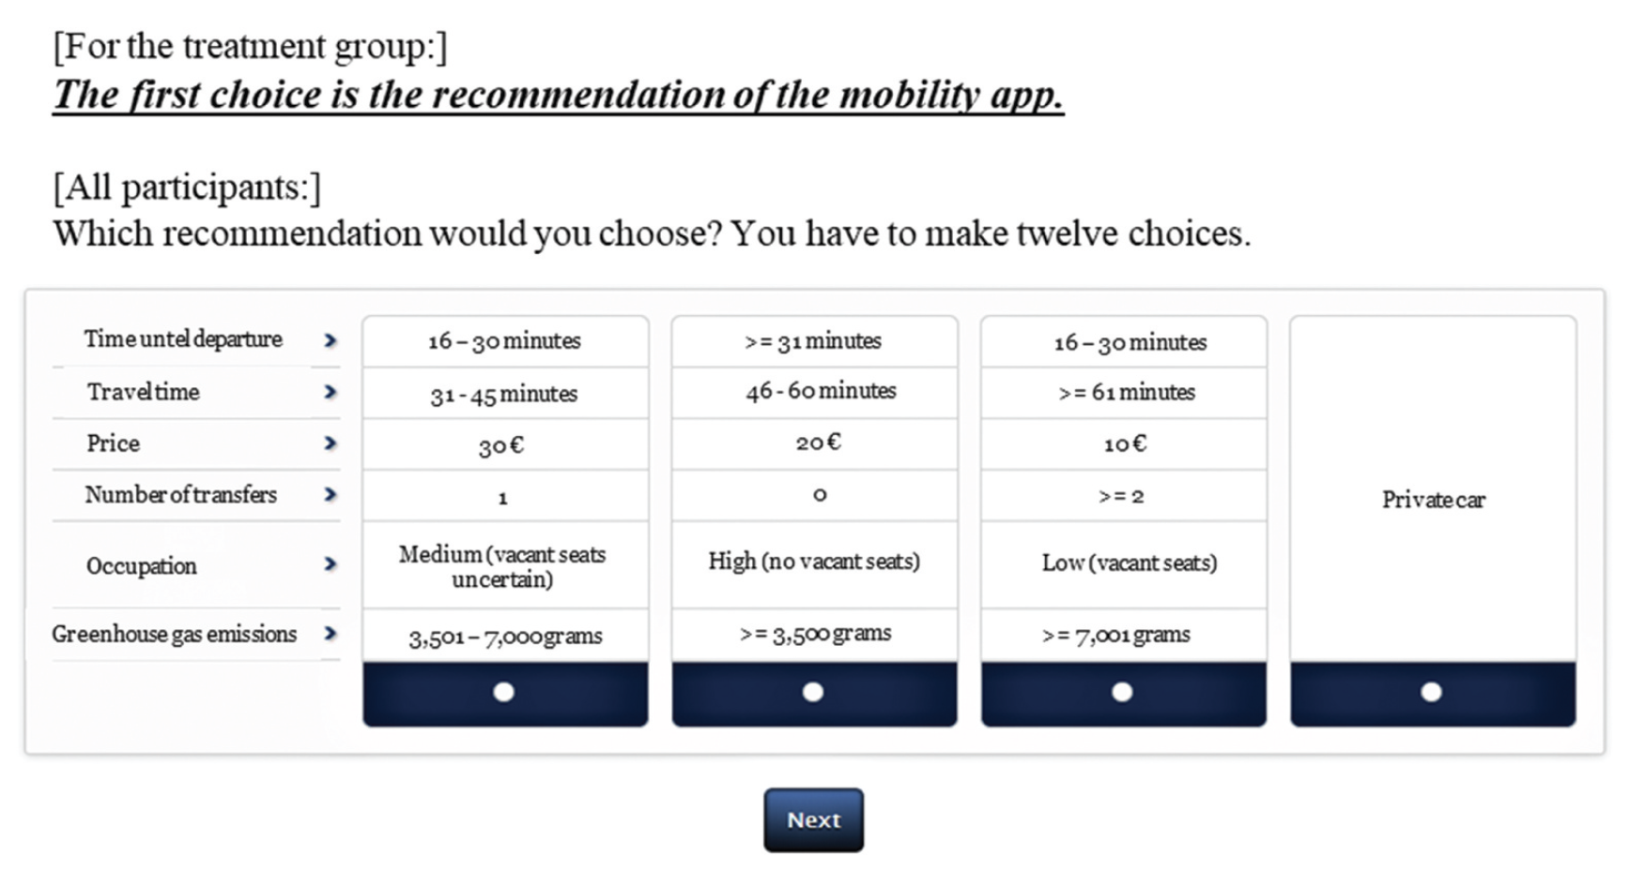
Digital Nudges - Applications
Zimmermann S, Schulz T, Hein A, et al. (2023) Motivating change in commuters' mobility behaviour: Digital nudging for public transportation use. Journal of Decision Systems.
Questionnaire survey via Facebook; Amazon gift coupons as incentives; 511 valid observations.

Slide 12
Digital Nudges - Applications
Zimmermann S, Schulz T, Hein A, et al. (2023) Motivating change in commuters' mobility behaviour: Digital nudging for public transportation use. Journal of Decision Systems.
Questionnaire survey via Facebook; Amazon gift coupons as incentives; 511 valid observations.

Slide 13
Further Readings
https://www.globalbrandsmagazine.com/hsbc-sees-increase-in-customers-avoiding-overdraft-fees/
https://money-watch.co.uk/8388/hsbc-overdraft-alerts-by-text
https://www.theguardian.com/business/2015/nov/02/hsbc-first-direct-customers-saved-85m-overdraft-charges-text-warnings
https://assets.publishing.service.gov.uk/government/uploads/system/uploads/attachment_data/file/890919/Directions_to_HSBC_UK.pdf
https://www.bbc.co.uk/news/technology-41429379
https://www.hsbc.com/insight/topics/a-personal-trainer-for-your-finances
Behavioural Insights Team (2012) Applying behavioural insights to reduce fraud, error and debt.
Dolan P, Kudrna L and Laffan K (2016) Doing as I intend to: The role of ‘implementation intentions’ in financial behaviours. Stieglitz
S, Mirbabaie M, Deubel A, et al. (2023) The potential of digital nudging to bridge the gap between environmental attitude and behavior in the usage of smart home applications. International Journal of Information Management 72.
Ytreberg NS, Alfnes F and van Oort B (2023) Mapping of the digital climate nudges in Nordic online grocery stores. Sustainable Production and Consumption 37: 202-212.
Zimmermann S, Schulz T, Hein A, et al. (2023) Motivating change in commuters' mobility behaviour: Digital nudging for public transportation use. Journal of Decision Systems. DOI: 10.1080/12460125.2023.2198056.

