Slide 1
Nudge
International Workshop on Behavioural Sciences and Urban-Rural Development in Developing Countries, 24 – 26 July 2023, Newnham College, University of Cambridge

Slide 2
Two types of behavioural interventions
Nudges (Thaler and Sunstein, 2008)
Choice architecture to induce desirable actions for both the individual and the society, such as using green electricity defaults to increase the uptake of renewable energy.
Manipulating tools. Easy and quick to implement, but the effects tend to be short-lived (Khanna, T. M., et al., 2021).
Boosts (Grune-Yanoff and Hertwig, 2016)
Focus on changing existing behavioural heuristics or establishing new ones, such as providing home energy report with personalised energy use feedback and energy conservation information to encourage energy savings (Allcott and Rogers, 2014).
Empowering tools. Require more time and resources to affect behaviours, Tend to remain effective for a longer term because ‘they have become routinised and have instilled a lasting competence in the user” (Lorenz-Spreen et al., 2020, page 1106).

Slide 3
Behavioural Theories & Models – Nudges
Nudge has two components: libertarian paternalism and choice architecture
Paternalism: to help people make the choice they would select if they were fully informed and unaffected by arousal or temptation.
Libertarian: no one is ever forced to do anything, free-will.
Choice architecture: the environment in which people make decisions
Nudges: features of the choice architecture that influence the decisions people make without changing either objective payoffs or incentives (neither the visible nor the invisible hands).
Thaler, R. H. and C. R. Sunstein (2008). Nudge : improving decisions about health, wealth, and happiness. New Haven, Yale University Press.
Thaler, R. H. (2018). "From Cashews to Nudges: The Evolution of Behavioral Economics." American Economic Review 108(6): 1265-1287.
3

Slide 4
Nudges – Applications and Impacts
Behavioural Insights Team
(UK, 2010)
Behavioural Insights unit
(NSW, Australia, 2014)
Social and Behavioral Sciences Team
(USA, 2015)
Behavioural Insight Units around the world (over 200 to date):
Countries: UK, US, Australia, Canada, Netherlands, and Germany, India, Indonesia, Peru, Singapore, …
International institutions: World Bank, UN agencies, OECD, and EU

Slide 5
Nudges – Applications and Impacts
An UK Example:
Increasing Loft Insulation Installation
Installation Only: £179
Installation + Clearance 1 (Discounted Price) : £369
Installation + Clearance 2 (Market Price) : £450
Picture source: http://wellingtoncountylistings.com
Notes:
72,480 households
Installation rate increased by more than four times in groups 2 and 3.
Make it easy!

Slide 6
The power of default
Uses ‘system 1’ instead of ‘system 2’ – doing without thinking
Saves mental power – does not require self-control
Still free will – libertarian paternalism
Example:
SMarT in the US (saving rate increased from 3.5% to 13.6%, Thaler and Benartzi, 2004)
Pension scheme in the UK (changing the default option from ‘opt-in’ to ‘opt-out’, Behavioural Insight Team)

Slide 7
Save More for Tomorrow (SMarT)
Thaler, R. H. and S. Benartzi (2004). “Save More Tomorrow™: Using behavioral economics to increase employee saving." Journal of Political Economy 112(1): S164-S187.
Field observations (close to randomized controlled trails. A field experiment).
Treatment: Save More for Tomorrow, a program to help employees who would like to save more but lack the willpower to act on this desire
Experiment setting:
The First Implementation of SMarT: Midsize Manufacturing Company in 1998
The second implementation of the program took place in May 2001 at Ispat Inland, a large midwestern steel company
The third implementation of SMarT took place at two divisions (Divisions A and O) of Philips Electronics in January 2002, with the first saving increase taking place on April 1, 2002. The remaining 28 divisions of Philips served as a control.

Slide 8
Save More for Tomorrow (SMarT)
Thaler, R. H. and S. Benartzi (2004). “Save More Tomorrow™: Using behavioral economics to increase employee saving." Journal of Political Economy 112(1): S164-S187.
Component | Description | Psychological Factor
1 | Employees are approached about increasing their contribution rates a considerable time before their scheduled pay increase | Myopic discounting
2 | If employees join, their contribution to the plan is increased beginning with the first paycheck after a raise | Loss aversion (perceived) Mental accounting
3 | The contribution rate continues to increase on each scheduled raise until the contribution rate reaches a preset maximum | Inertia and status quo bias
4 | The employee can opt out of the plan at any time | Peace of mind

Slide 9
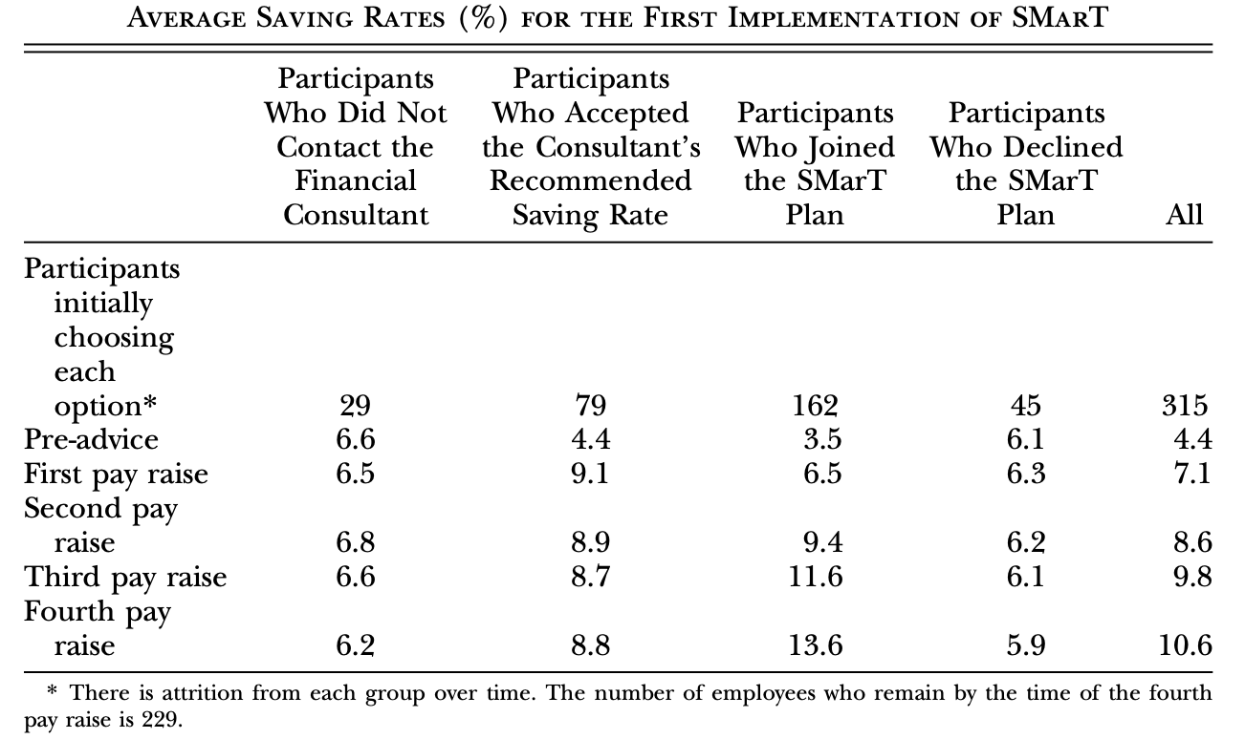
Save More for Tomorrow (SMarT)
Thaler, R. H. and S. Benartzi (2004). “Save More Tomorrow™: Using behavioral economics to increase employee saving." Journal of Political Economy 112(1): S164-S187.

Slide 10
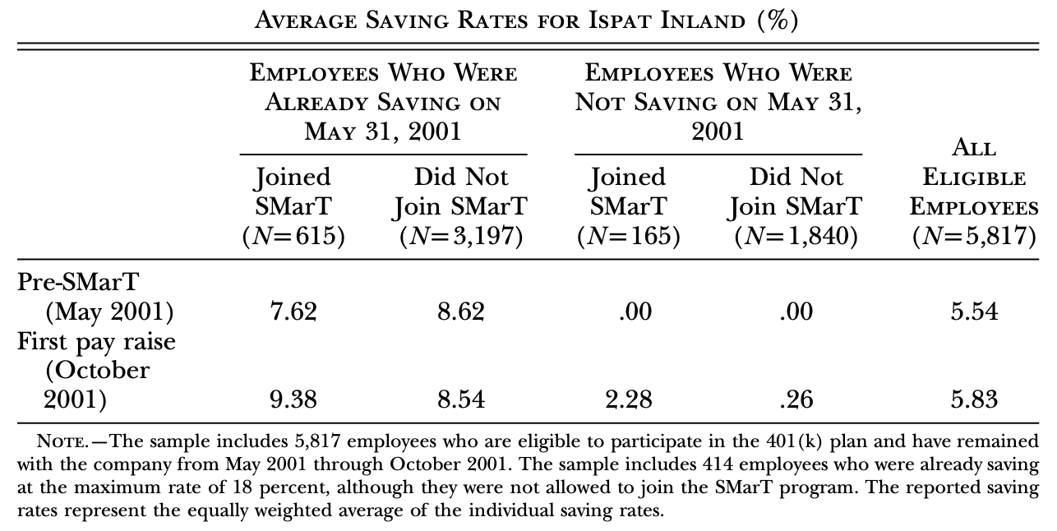
Save More for Tomorrow (SMarT)
Thaler, R. H. and S. Benartzi (2004). “Save More Tomorrow™: Using behavioral economics to increase employee saving." Journal of Political Economy 112(1): S164-S187.

Slide 11
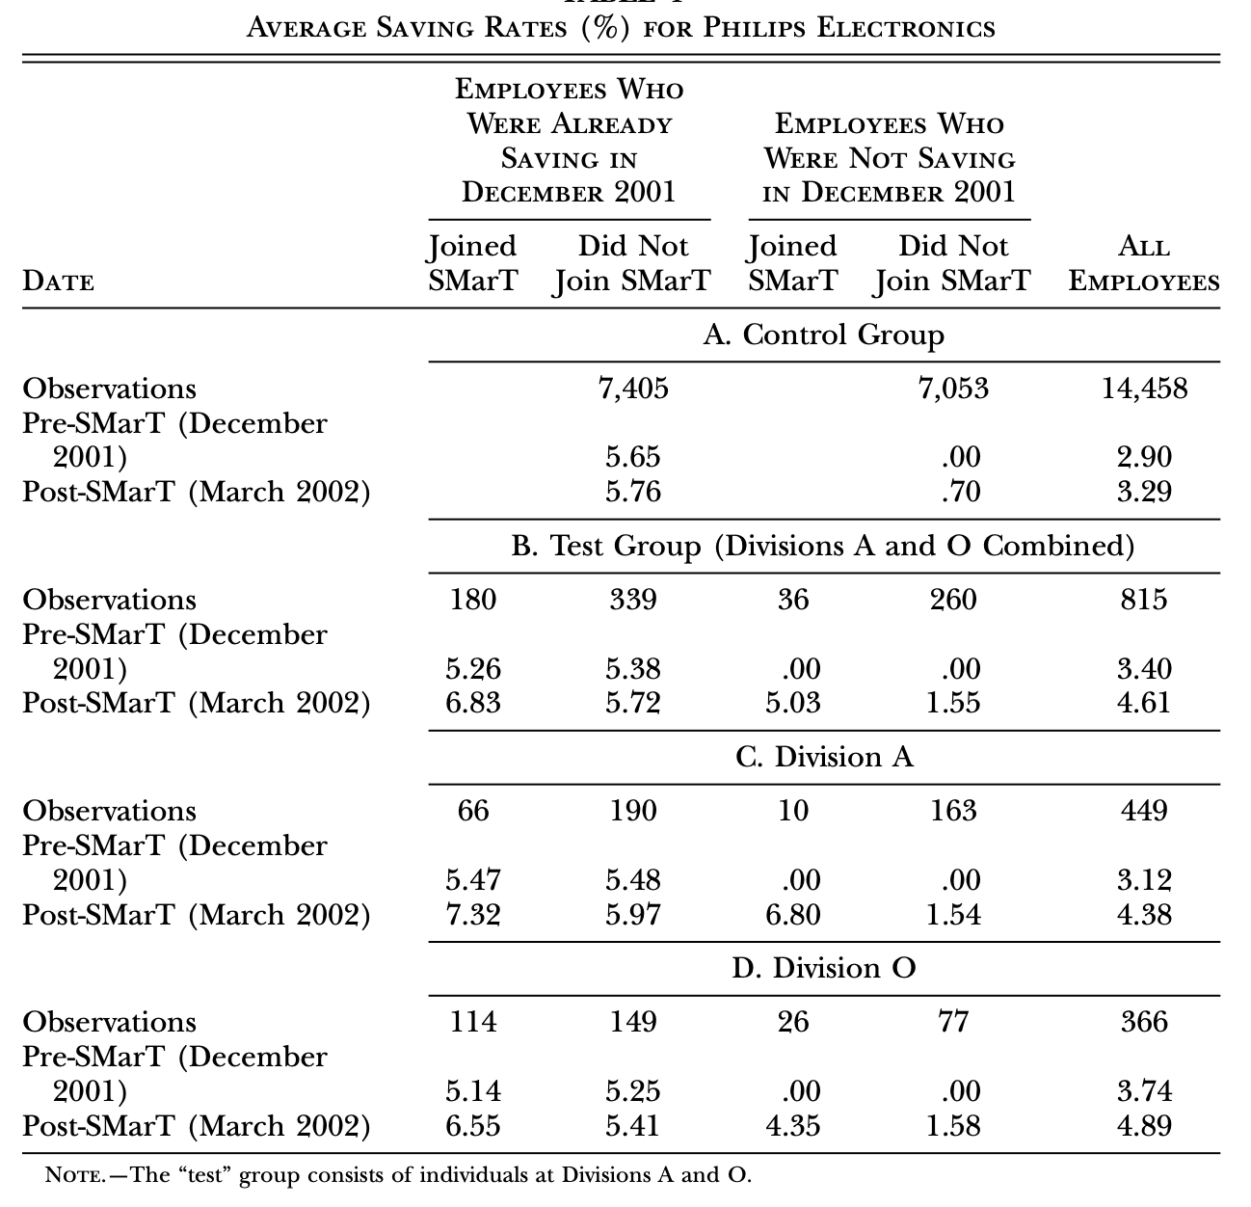
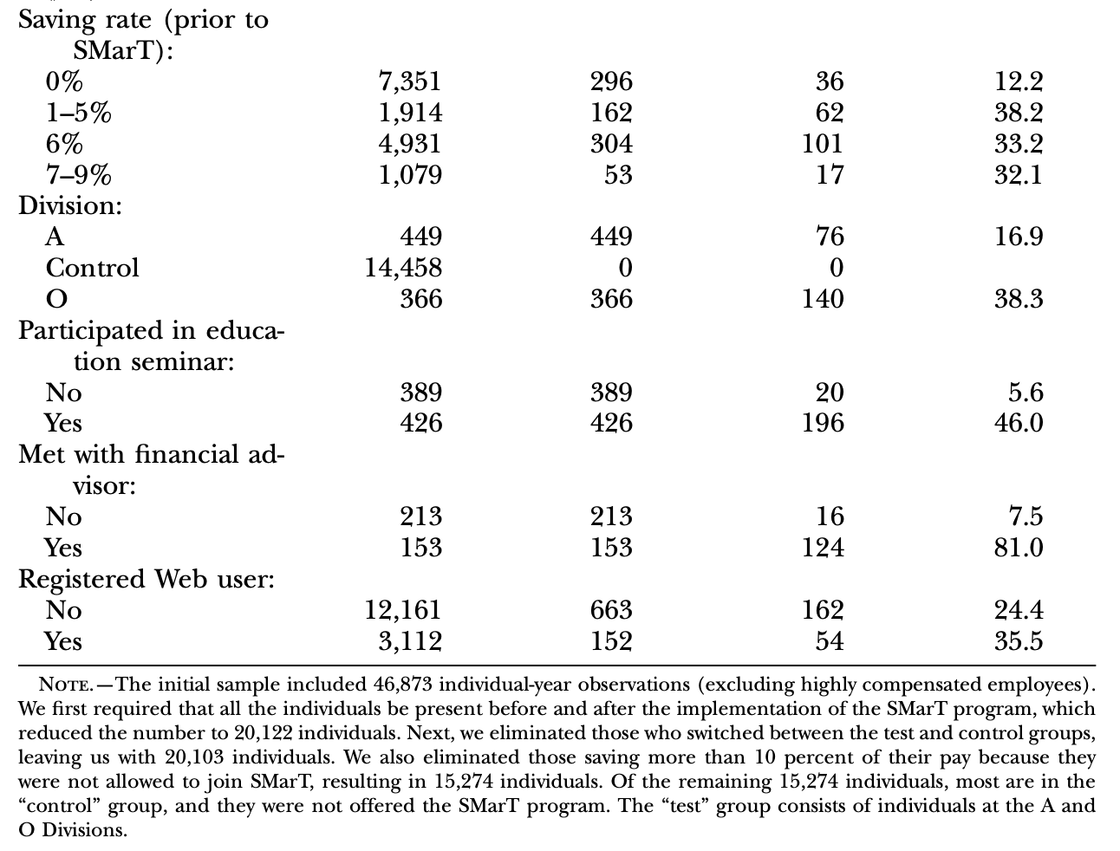
Save More for Tomorrow (SMarT)
Thaler, R. H. and S. Benartzi (2004). “Save More Tomorrow™: Using behavioral economics to increase employee saving." Journal of Political Economy 112(1): S164-S187.

Slide 12
Automatic Enrolment Pension Scheme
Department for Work and Pensions (2022). Workplace pensions participation and savings trends: 2009 to 2021.
The first nation-wide implementation of automatic enrolment pension scheme in the world
Based on experimental findings by the Behavioural Insight Team in the UK
Heavily influenced by ‘Nudges’ and Thalers’ SMarT programme
Rolled out in phases since 2012, and more than 10 million employees have participated.
Data source: Annual Survey of Hours and Earnings (ASHE)
Published by the Office for National Statistics (ONS) and is a key source of information on workplace pensions in GB as it collects information on all types of workplace pension.
Based on a 1% sample of employee jobs taken from HM Revenue & Customs (HMRC) PAYE (Pay As You Earn) records. Information is obtained from employers and treated confidentially.

Slide 13
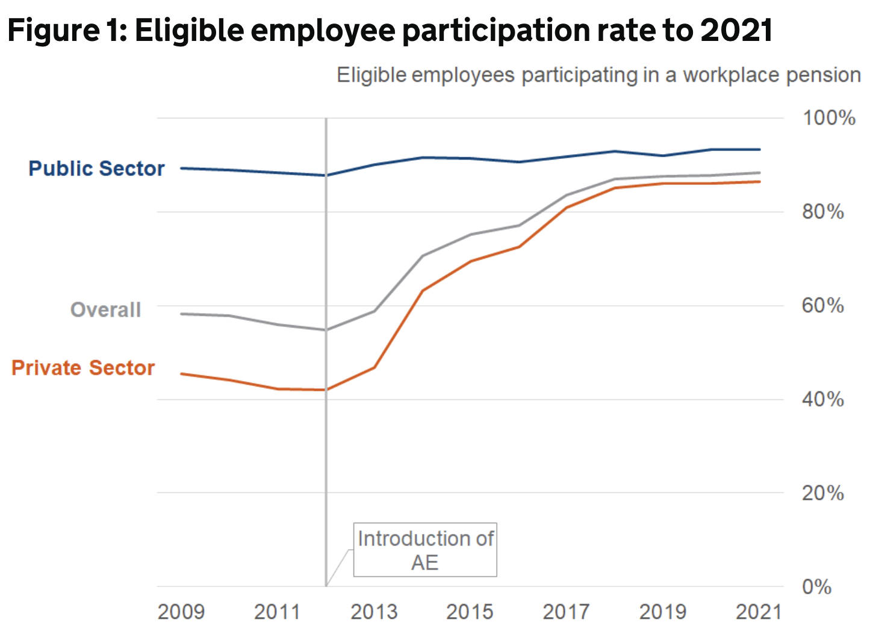
Automatic Enrolment Pension Scheme
Department for Work and Pensions (2022). Workplace pensions participation and savings trends: 2009 to 2021.
Trends across all breakdowns broadly reflect this overall picture of participation in the public and private sector
Since 2012, many gaps in participation have narrowed – the largest increases have been seen in Agriculture & Fishing and Distribution, Hotels & Restaurants industries and among small private employers (5 to 49 employees)
Most groups have seen trends in participation stabilise between 2018 and 2021
There are some gaps that remain in 2021 and there is relatively low participation of below 65% for some eligible groups including micro employers and around 66% for Pakistani and Bangladeshi employees (ethnicity is calculated using a 3-year average)

Slide 14
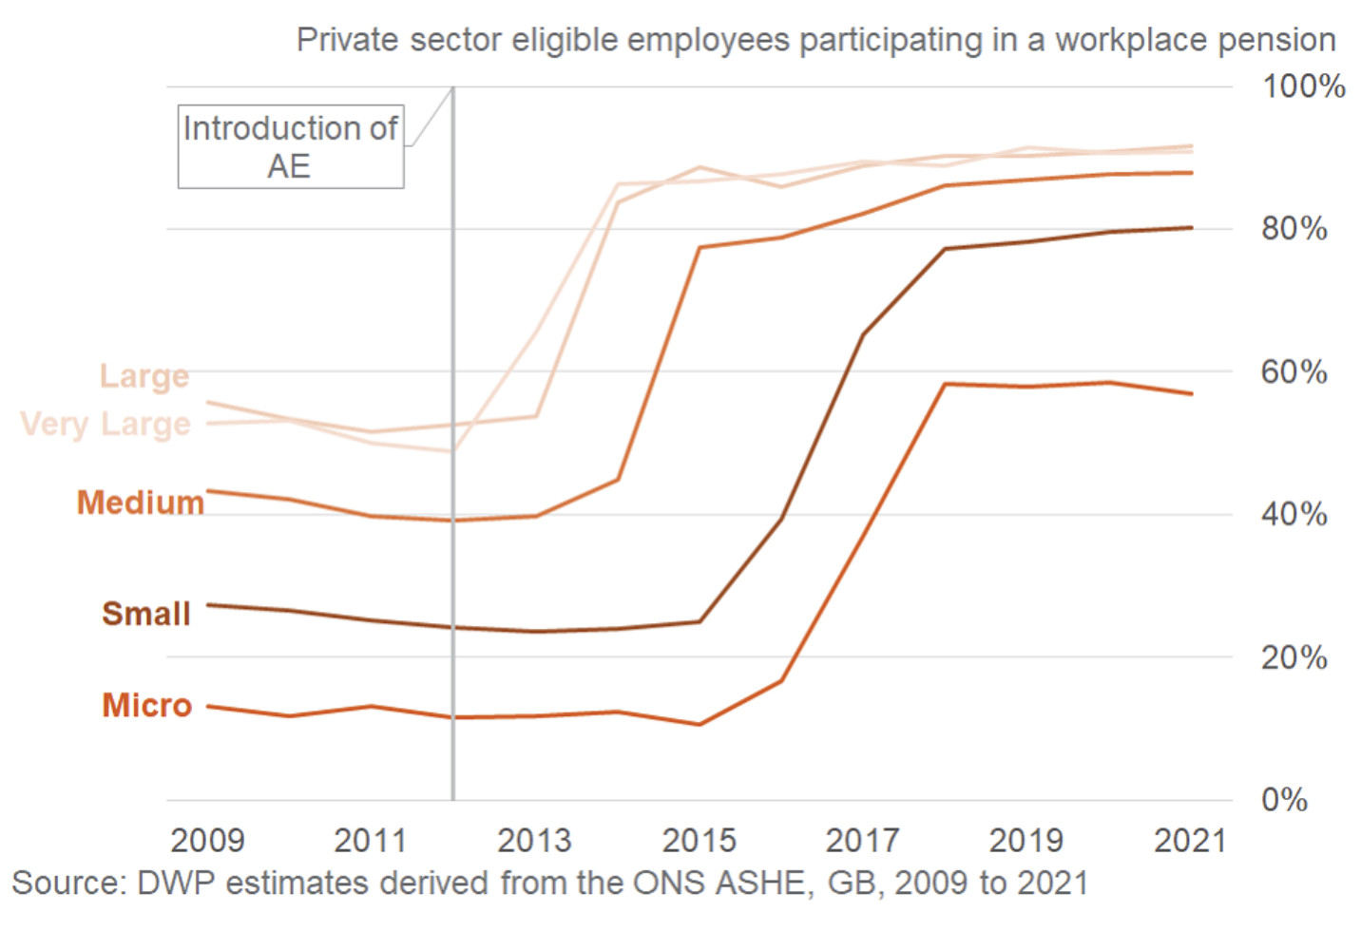
Automatic Enrolment Pension Scheme
Department for Work and Pensions (2022). Workplace pensions participation and savings trends: 2009 to 2021.
All employer sizes have seen large increases in eligible employee participation rates since the start of the relevant automatic enrolment staging date.
The highest levels of both private and public sector participation in 2021 were seen in the larger employer bands
Participation rates among micro (1 to 4 employees) and small (5 to 49 employees) employers in the private sector have increased since 2012 to their current position of 57% and 80%.
There is a persistent gap in participation rates of these groups and other sized employers.

Slide 15
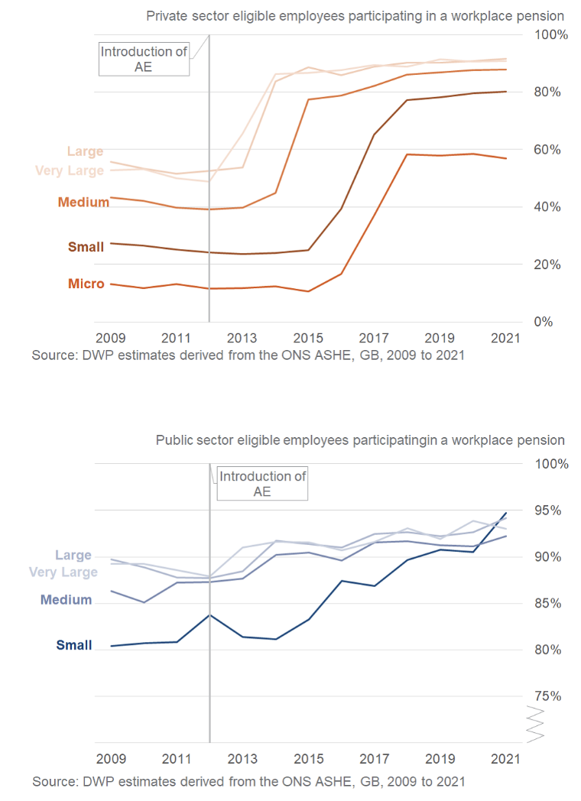
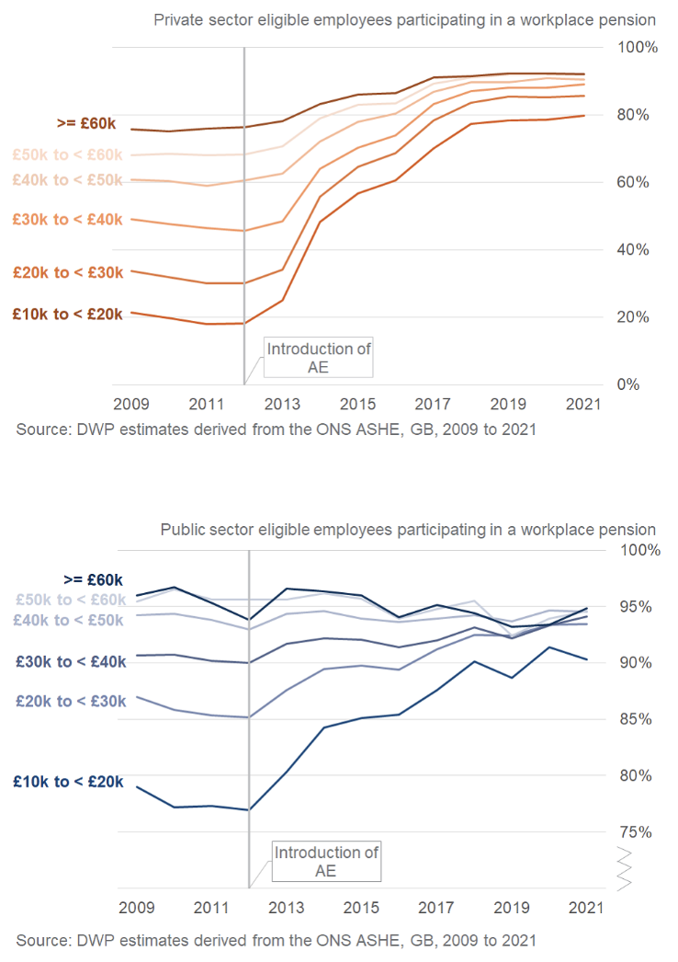
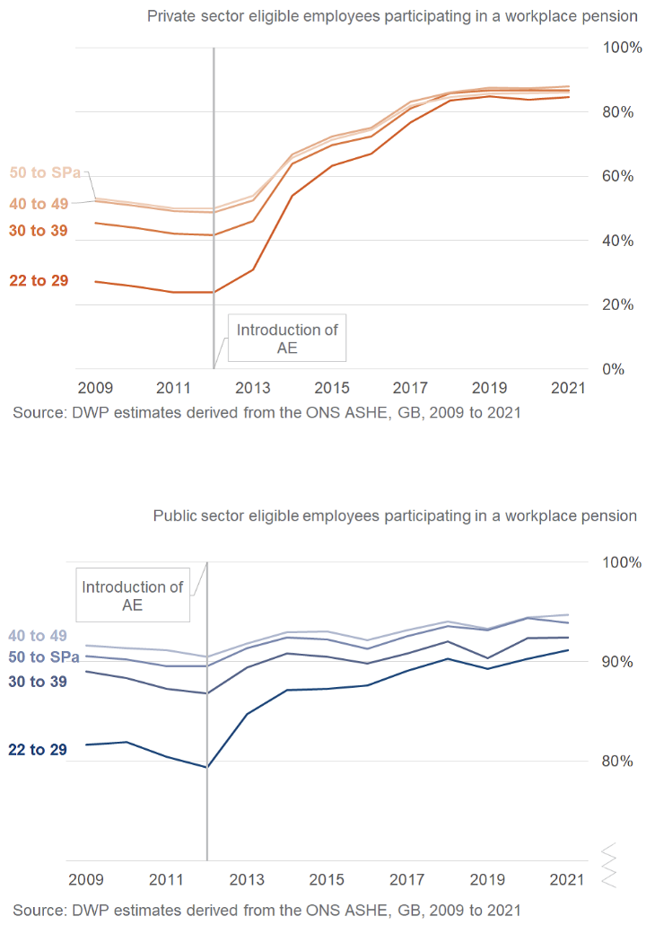
Automatic Enrolment Pension Scheme
Department for Work and Pensions (2022). Workplace pensions participation and savings trends: 2009 to 2021.

Slide 16
Automatic Enrolment Pension Scheme
Cribb, J. and C. Emmerson (2020). "What happens to workplace pension saving when employers are obliged to enrol employees automatically?" International Tax and Public Finance 27(3): 664-693.
Data source: Annual Survey of Hours and Earnings (ASHE), 1997 – 2015
Linear probability model and Probit model
Private sector only
Employers with five or more employees only
Sample size: 457,443 records and 64,849 employers.

Slide 17
Automatic Enrolment Pension Scheme
Cribb, J. and C. Emmerson (2020). "What happens to workplace pension saving when employers are obliged to enrol employees automatically?" International Tax and Public Finance 27(3): 664-693.
Dependent variable: 1) a dummy indicating whether the employee is participating in a workplace pension, and 2) contribution rates (both mean and whether below different thresholds)
Autoenrol: = 1 if automatic enrolment is in place in the employee’s employer when they are observed, and 0 otherwise
Partial_a = 1: a dummy variable for being ‘partially affected’, which varies for each year that there are people who are partially affected (2013–2015)
X: control variables including sex, age (in cubic), job tenure (three dummies), dummies for working for a non-profit institution, being in a full-time job, the job not being the individual’s ‘main’ job and the job being temporary, 10 regional dummies, 12 dummies for industry of the employer and 8 dummies for occupational category of the employee.

Slide 18
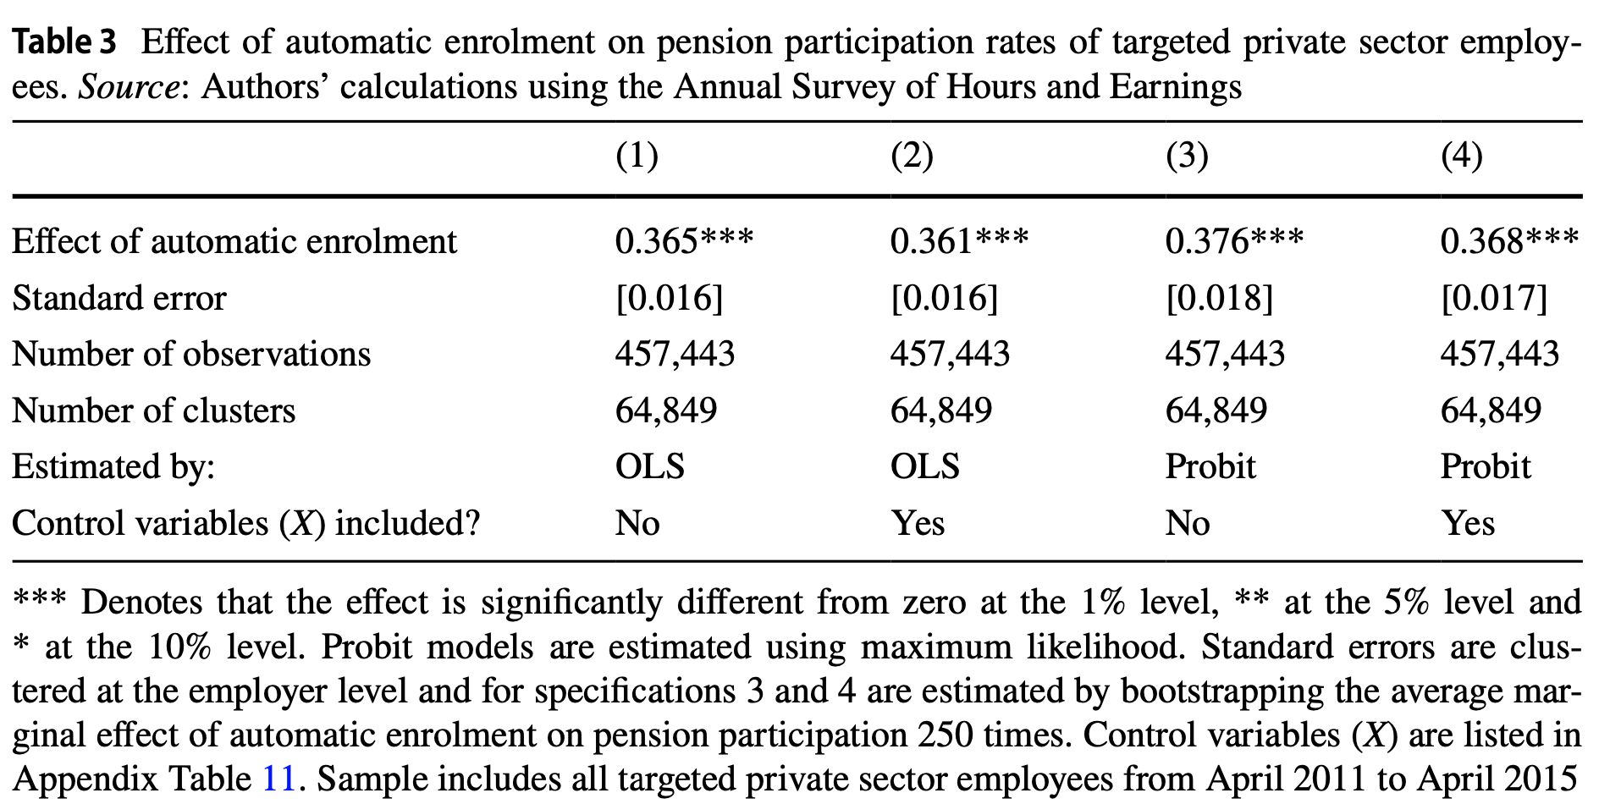
Automatic Enrolment Pension Scheme
Cribb, J. and C. Emmerson (2020). "What happens to workplace pension saving when employers are obliged to enrol employees automatically?" International Tax and Public Finance 27(3): 664-693.

Slide 19
Behavioural interventions for energy conservation
Nisa, C. F., et al. (2019). “Meta-analysis of randomised controlled trials testing behavioural interventions to promote household action on climate change.” Nature Communications 10.
A review of 83 papers, providing a total of 144 estimates
Behavioural interventions promote climate change mitigation to a very small degree while the intervention lasts, with no evidence of sustained positive effects once the intervention ends.
Behavioural interventions considered:
Information: simple messages conveying tips on how to save energy, in-home displays, energy labels or statistics about climate change
Appeals: requests, pleas and appeals to change behaviour based on values of humanity, cooperation and social responsibility
Engagement: try to change psychological processes, such as promoting goal-setting, implementation intentions, commitment or engagement, and mindfulness towards climate change mitigation
Social comparison: provide a comparative reference with respect to the mitigation behaviours of close others, such as neighbours, colleagues/friends or fellow citizens, based on principles of social influence and social comparison
Choice architecture (nudge): removing external barriers, expediting access or facilitating climate change mitigation behaviours by altering the structure of the environment in which people make choices
The intervention with the highest average effect size is choice architecture (nudges) but this strategy has been tested in a limited number of behaviours.
19

Slide 20
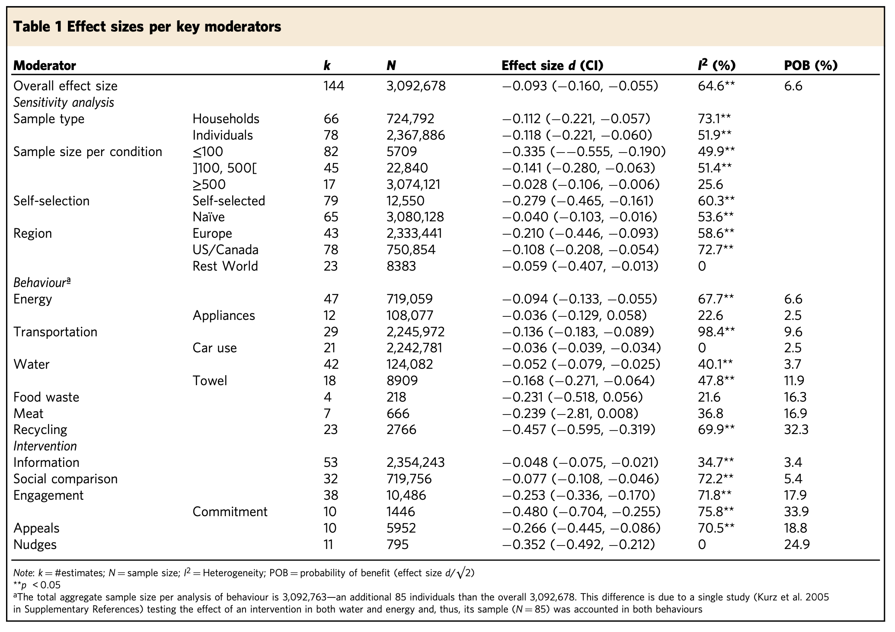
Behavioural interventions for energy conservation
Nisa, C. F., et al. (2019). “Meta-analysis of randomised controlled trials testing behavioural interventions to promote household action on climate change.” Nature Communications 10.
d | Size
< 0.1 | Very small
Around 0.2 | Small
0.3 - 0.4 | Medium-small
0.5 – 0.6 | Medium
>= 0.7 | Large
POB is the probability that the intervention will promote climate change mitigation behaviours in the experimental group, by comparison to the control no-intervention group.
20
Notes:
I2 values of 25%, 50%, and 75% have been interpreted as representing small, moderate, and high levels of heterogeneity. This is similar to standard deviation in regression analysis.

Slide 21
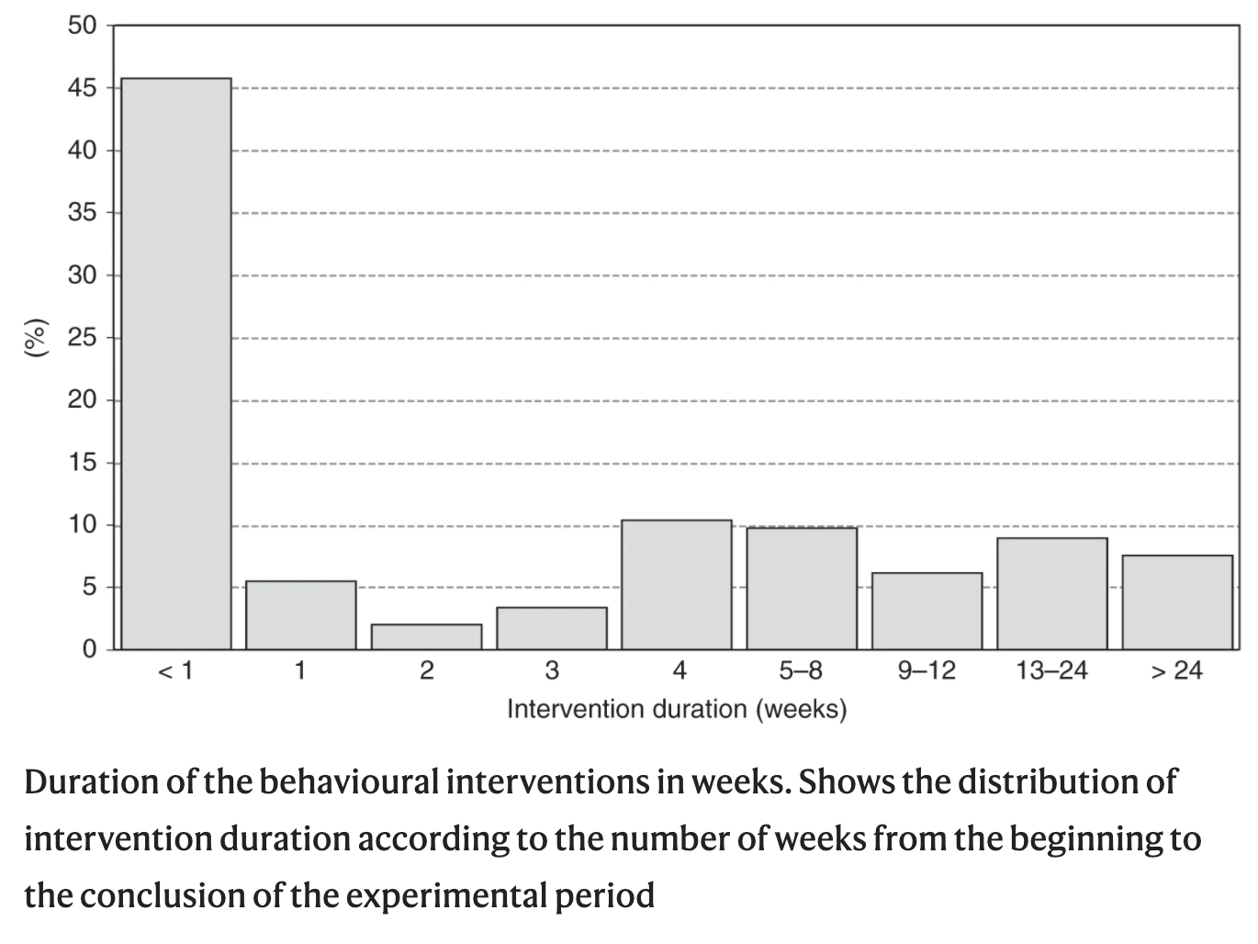
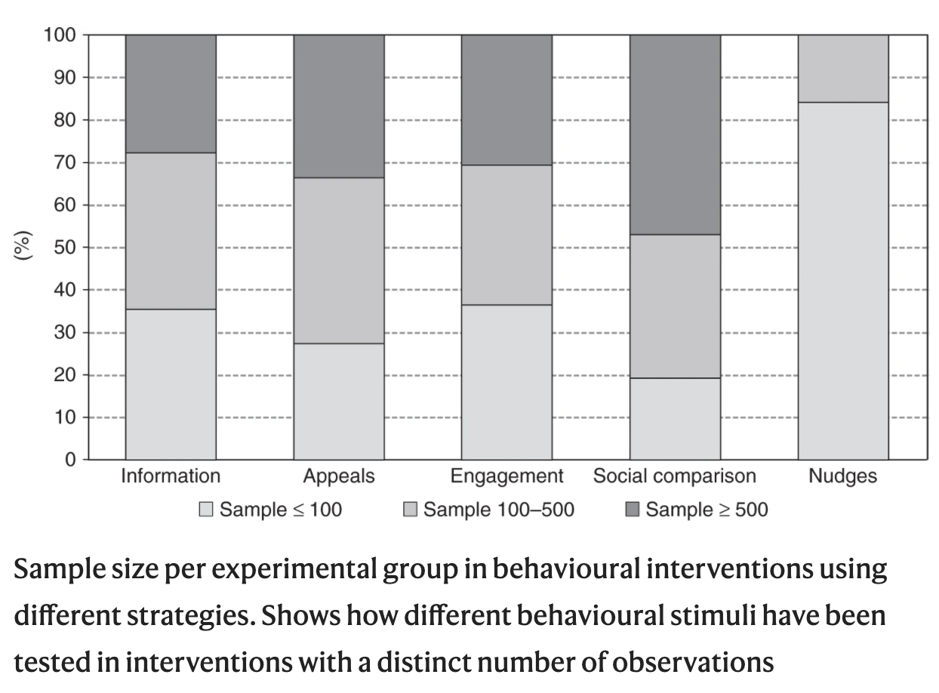
Behavioural interventions for energy conservation
Nisa, C. F., et al. (2019). “Meta-analysis of randomised controlled trials testing behavioural interventions to promote household action on climate change.” Nature Communications 10.
21

Slide 22
Further Readings
Allcott H and Rogers T (2014) The Short-Run and Long-Run Effects of Behavioral Interventions: Experimental Evidence from Energy Conservation. American Economic Review 104(10): 3003-3037.
Cribb J and Emmerson C (2020) What happens to workplace pension saving when employers are obliged to enrol employees automatically? International Tax and Public Finance 27(3): 664-693.
Department for Work and Pensions (2022) Workplace pensions participation and savings trends: 2009 to 2021. Reportno. Report Number|, Date. Place Published|: Institution|.
Grune-Yanoff T and Hertwig R (2016) Nudge Versus Boost: How Coherent are Policy and Theory? Minds and Machines 26(1-2): 149-183.
Lorenz-Spreen P, Lewandowsky S, Sunstein CR, et al. (2020) How behavioural sciences can promote truth, autonomy and democratic discourse online. Nature Human Behaviour 4(11): 1102-1109.
Thaler, RH and Benartzi S (2004). “Save More Tomorrow™: Using behavioral economics to increase employee saving." Journal of Political Economy 112(1): S164-S187.
Thaler RH (2018) From Cashews to Nudges: The Evolution of Behavioral Economics. American Economic Review 108(6): 1265-1287.
Thaler RH and Sunstein CR (2008) Nudge : improving decisions about health, wealth, and happiness. New Haven: Yale University Press.

