Slide 1
Behavioural Sciences: Past, Present, and Future
International Workshop on Behavioural Sciences and Urban-Rural Development in Developing Countries, 24 – 26 July 2023, Newnham College, University of Cambridge

Slide 2
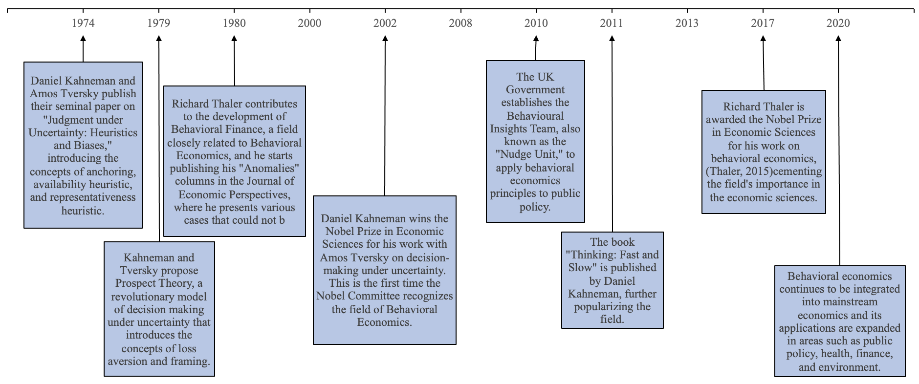
Milestones

Slide 3
Behavioural Sciences Defined
A range of inter-related academic disciplines (behavioural economics, psychology, social anthropology, neuroscience, biology, …)
Seek to understand how individuals take decisions in practice and how they are likely to respond to options
Enable us to design policies or interventions that can encourage, support and enable people to make better choices for themselves and society.
Source: http://www.behaviouralinsights.co.uk/

Slide 4
Behavioural Sciences Defined
Behavioural interventions are most useful when neither the visible hand nor the invisible hand is working
Visible hand: government regulations and laws
Invisible hand: economic incentives (financial incentives mainly)
Behavioural interventions:
the empathetic hand, targeting the psychological and/or social aspects of decision making
Inevitably context-specific and idiosyncratic

Slide 5
Behavioural Models Summary
Paper | 1 July 2014 | 25 July 2015 | 6 June 2016 | 8 July 2017 | 19 July 2018 | 29 Sept 2019 | 28 July 2021 | 11 July 2022 | 4 July 2023
Original PT | 9645 | 10889 | 12512 | 13875 | 17242 | 19196 | 23132 | 25534 | 27518
Kahneman & Tversky (1979) | (29524) | (36276) | (40407) | (45503) | (50766) | (55470) | (68613) | (73058) | (78572)
Cumulative PT | 2436 | 2815 | 3182 | 3511 | 4412 | 4898 | 6099 | 6833 | 7461
Tversky & Kahneman (1992) | (6804) | (8044) | (9026) | (10528) | (11905) | (13472) | (16660) | (18221) | (19724)
Third Generation PT | 43 | 52 | 64 | 73 | 85 | 93 | 119 | 138 | 155
Schmidt et al (2008) | (90) | (113) | (140) | (170) | (200) | (233) | (281) | (309) | (337)
Mental Accounting | -- | -- | -- | -- | -- | -- | -- | -- | --
Thaler (1985) | (3758) | (4333) | (4887) | (5661) | (6105) | (6454) | (7767) | (8386) | (8935)
Over-reaction | 919 | 1006 | 1092 | 1220 | 1562 | 1786 | 2130 | 2315 | 2471
De Bondt and Thaler (1985) | (5285) | (6175) | (6839) | (7616) | (8228) | (9001) | (10684) | (11519) | (12197)
Heteroskedasticity Test | 7888 | 7910 | 8364 | 9021 | 10481 | 10481 | 12337 | 13006 | 13562
White (1980) | (--) | (21265) | (22817) | (24666) | (26187) | (27698) | (30955) | (32274) | (33619)
Note: Web of Sciences Citation Statistics (Google Scholar in brackets)
Notes:
Kahneman, Daniel; Tversky, Amos (1979). "Prospect Theory: An Analysis of Decision under Risk" (PDF). Econometrica 47 (2): 263. doi:10.2307/1914185. ISSN 0012-9682.
Tversky, Amos; Kahneman, Daniel (1992). "Advances in prospect theory: Cumulative representation of uncertainty". Journal of Risk and Uncertainty 5 (4): 297–323. doi:10.1007/BF00122574. ISSN 0895-5646.
Third-generation prospect theory , By: Schmidt, Ulrich; Starmer, Chris; Sugden, Robert, JOURNAL OF RISK AND UNCERTAINTY Volume: 36 Issue: 3 Pages: 203-223 Published: JUN 2008
Thaler, Richard H. (1985). "Mental Accounting and Consumer Choice". Marketing Science 4 (3): 199–214. doi:10.1287/mksc.4.3.199.
DOES THE STOCK-MARKET OVERREACT , By: DEBONDT, WFM; THALER, R, JOURNAL OF FINANCE Volume: 40 Issue: 3 Pages: 793-805 Published: 1985
A HETEROSKEDASTICITY-CONSISTENT COVARIANCE-MATRIX ESTIMATOR AND A DIRECT TEST FOR HETEROSKEDASTICITY, By: WHITE, H ECONOMETRICA Volume: 48 Issue: 4 Pages: 817-838 Published: 1980

Slide 6
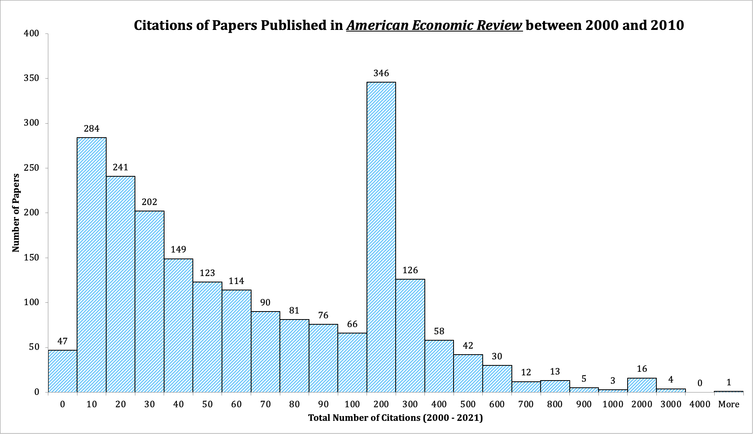
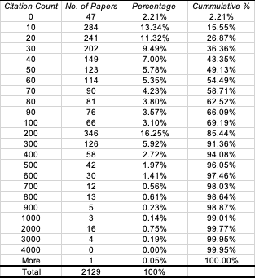

Slide 7
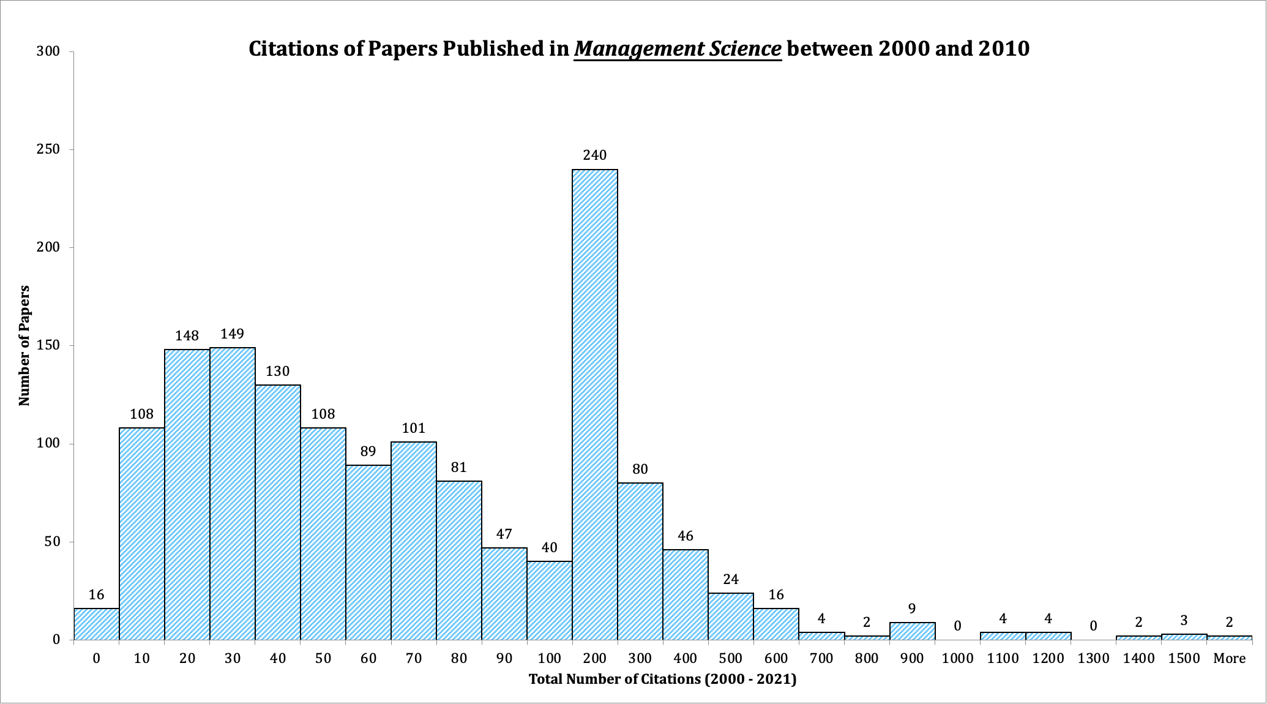
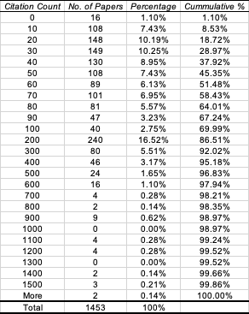

Slide 8
Behavioural Research Methods
Experiments
Testing under ceteris paribus condition
Reduces confounds
Potential design problems
Interpretation of results: ecological validity, cherry-picking
Issues: Undergraduate students, hypothetical settings, consumption goods…

Slide 9
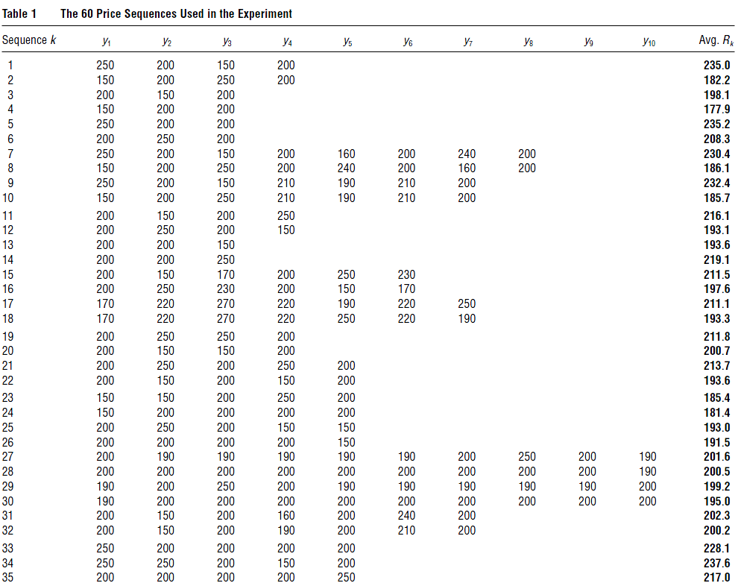
Behavioural Research Methods
Example: Baucells, M., Weber, M., Welfens, F., 2011, Reference-Point Formation and Updating. Management Sciences, 57, 506-519.
55 (20 female) undergraduate
students
8 Euros for participation
Computer lab

Slide 10
Behavioural Research Methods
Field Studies
Ecological validity vs. conceptual validity
Impact of confounds
Examples:
Barseghyan, L., F. Molinari, et al., 2013. The Nature of Risk Preferences: Evidence from Insurance Choices. American Economic Review, 103(6): 2499-2529.
DellaVigna, S., Malmendier, U., 2006. Paying not to go to the gym. American Economic Review, 96, 694-719.
List, J.A., 2011. Does Market Experience Eliminate Market Anomalies? The Case of Exogenous Market Experience. American Economic Review, 101, 313-317.
Pope, D.G., Schweitzer, M.E., 2011. Is Tiger Woods Loss Averse? Persistent Bias in the Face of Experience, Competition, and High Stakes. American Economic Review, 101, 129-157.

Slide 11
Behavioural Research Methods
Example: Pope, D.G., Schweitzer, M.E., 2011. Is Tiger Woods Loss Averse? Persistent Bias in the Face of Experience, Competition, and High Stakes. American Economic Review, 101, 129-157.
Par: a salient reference point
Putts: the final shots players take to complete a hole in PGA tours
Sample size: 2.5 million putts from 239 tournaments completed between 2004 and 2009
Quality of data:
Laser measurements of initial and final ball placement (x, y, z coordinates)
Restricted to putts attempted for eagle, birdie, par, bogey, or double bogey only
Restricted to players who had at least 1,000 putts
Included more than 300,000 fixed effects

Slide 12
Behavioural Research Methods
Simulations
Ecological validity and Conceptual validity
Computationally intensive
Simulation design is crucial
Examples:
Li, Y., Yang, L.Y., 2013. Prospect theory, the disposition effect, and asset prices. Journal of Financial Economics, 107, 715-739.

Slide 13
Behavioural Research Methods
Source: Li, Y., Yang, L.Y., 2013. Prospect theory, the disposition effect, and asset prices. Journal of Financial Economics, 107, 715-739.

Slide 14
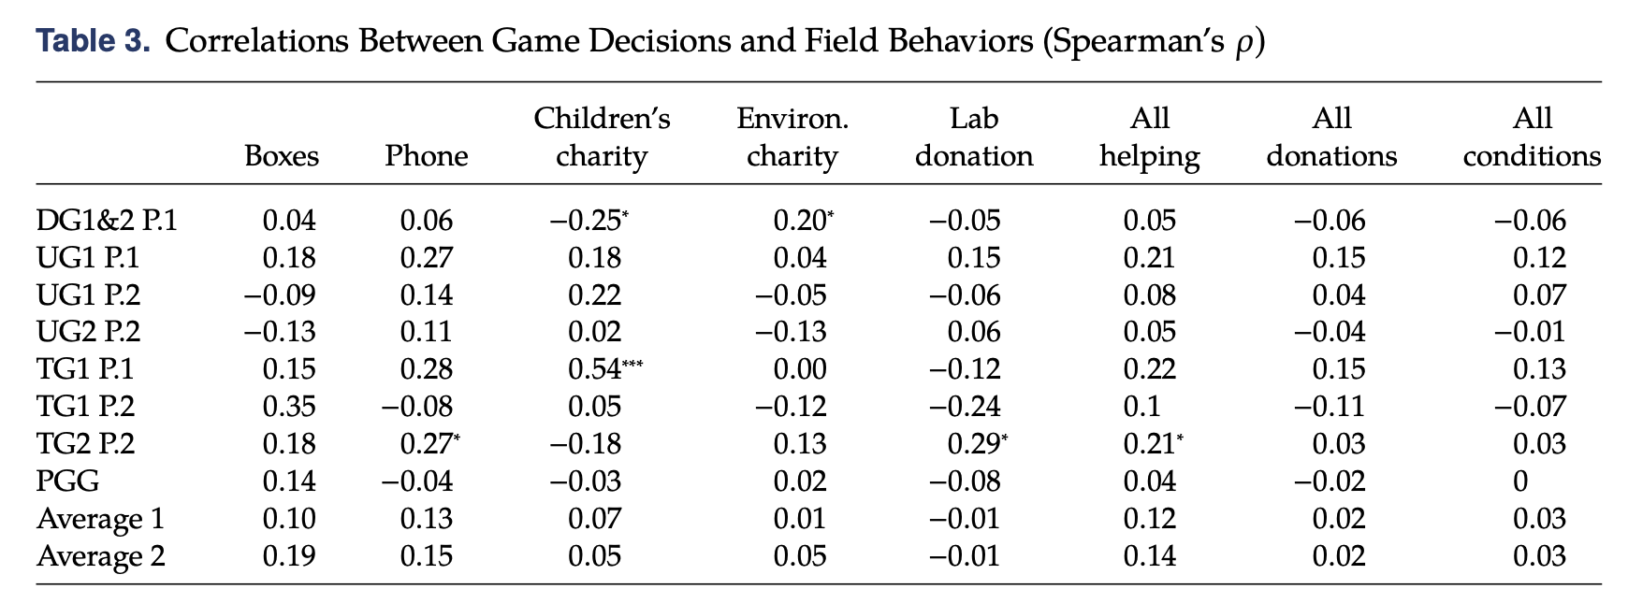
Behavioural Research Methods
Mixed methods and the focus on external validity
Combinations of multiple methods: lab experiment, survey, field experiment, simulations, games, …
Galizzi, M. M. and D. Navarro-Martinez (2019). "On the External Validity of Social Preference Games: A Systematic Lab-Field Study." Management Science 65(3): 976-1002.

Slide 15
Behavioural Research Methods
Galizzi, M. M. and D. Navarro-Martinez (2019). "On the External Validity of Social Preference Games: A Systematic Lab-Field Study." Management Science 65(3): 976-1002.
Self-reported social behaviours performed in the past, decisions in seven experimental social preference games, and behaviours in five naturalistic field situations that we created.
Survey: Self-Report Altruism (SRA) scale, 20 items (questions)
Lab experiments: dictator game (2), ultimatum game (2), trust game (2), and public good game (1)
Field experiments: help moving boxes, lend mobile phones, and donate to children’s charity, environmental charity, and lab donation.
The extent to which the games can explain the self-report measures and the field behaviours
The overarching conclusion is that the games do a poor job explaining both the self-report measures and the field behaviours

Slide 16
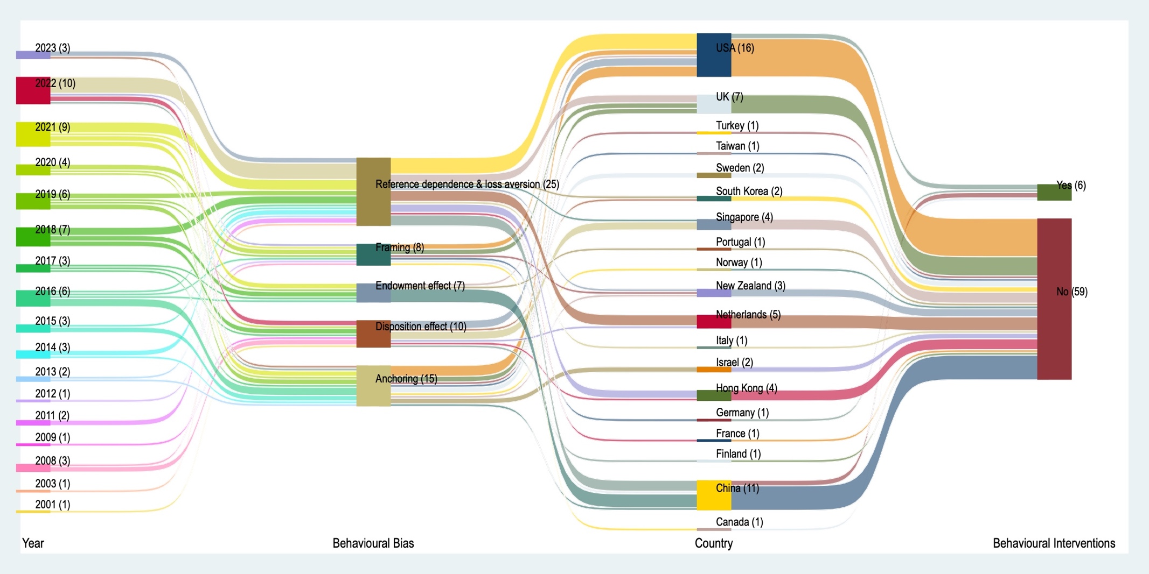
Behavioural Studies in the housing market
Source: Helen X. H. Bao (2023) Between Carrots and Sticks, from Intentions to Actions: Behavioural Interventions for Housing Decisions. Available at SSRN: https://ssrn.com/abstract=4325333 or http://dx.doi.org/10.2139/ssrn.4325333

Slide 17
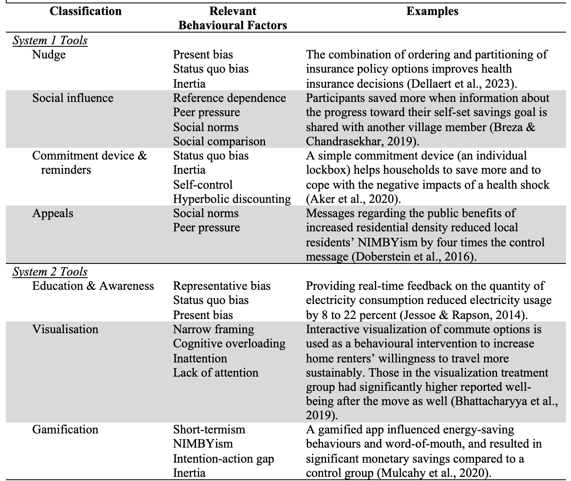
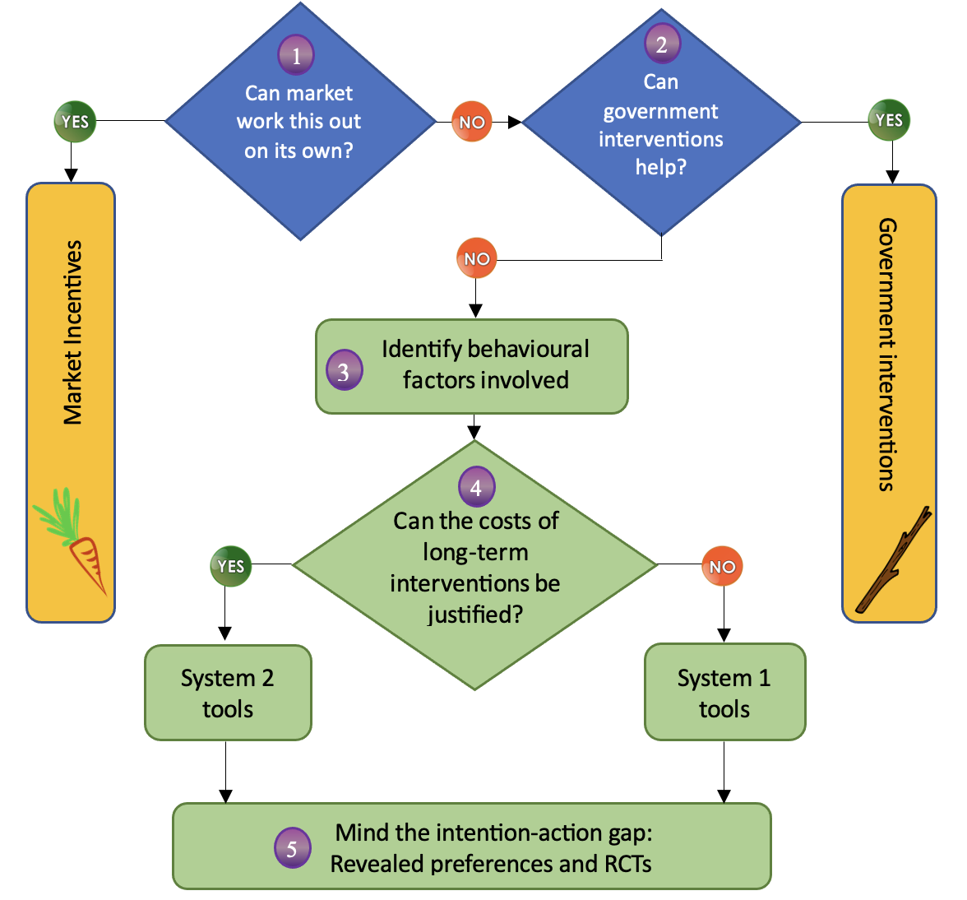
Behavioural Interventions in the housing market
Source: Helen X. H. Bao (2023) Between Carrots and Sticks, from Intentions to Actions: Behavioural Interventions for Housing Decisions. Available at SSRN: https://ssrn.com/abstract=4325333 or http://dx.doi.org/10.2139/ssrn.4325333

Slide 18
Further Readings
DellaVigna S and Linos E (2022) RCTs to Scale: Comprehensive Evidence From Two Nudge Units. Econometrica 90(1): 81-116.
Homar AR and Cvelbar LK (2021) The effects of framing on environmental decisions: A systematic literature review. Ecological Economics 183.
Kahneman D (2013) Thinking, fast and slow. New York: Farrar, Straus and Giroux.
Kahneman D and Tversky A (1979) Prospect Theory: An Analysis of Decision under Risk. Econometrica 47(2): 263-291.
Khanna TM, Baiocchi G, Callaghan M, et al. (2021) A multi-country meta-analysis on the role of behavioural change in reducing energy consumption and CO2 emissions in residential buildings. Nature Energy 6(9): 925-932.
Mertens S, Herberz M, Hahnel UJJ, et al. (2022) The effectiveness of nudging: A meta-analysis of choice architecture interventions across behavioral domains. Proceedings of the National Academy of Sciences of the United States of America 119(1).
Service O, Hallsworth M, Halpern D, et al. (2014) EAST: Four Simple Ways to Apply Behavioural Insights. Behavioural Insight Team.
Shefrin H and Statman M (2000) Behavioral Portfolio Theory. The Journal of Financial and Quantitative Analysis 35(2): 127-151.
Shiller RJ (2005) Irrational exuberance. New York: Currency/Doubleday.
Thaler RH (1992) The winner's curse: Paradoxes and anomalies of economic life. New York, NY, US: Free Press.
Thaler RH (2015) Misbehaving : the making of behavioral economics. New York: W.W. Norton & Company.
Thaler RH and Sunstein CR (2008) Nudge : improving decisions about health, wealth, and happiness. New Haven: Yale University Press.
Tversky A and Kahneman D (1974) Judgment under Uncertainty: Heuristics and Biases. Science 185(4157): 1124-1131.

