Slide 1
Nudging Towards a Better Financial Future: Applying Behavioural Insights in the Development of Financial Systems in Rural China
International Workshop on Behavioural Sciences and Urban-Rural Development in Developing Countries, 24 – 26 July 2023, Newnham College, University of Cambridge

Slide 2
Background: ESRC-NSFC funding scheme
A collaborative project between the Economic and Social Research Council (ESRC) and the National Natural Science Foundation of China (NSFC)
Contributes to the economic development and welfare of China
Focus: developing knowledge of the Chinese financial system and its future development
Total funding available: £2 Million from ESRC & 20 Million RMB from NSFC
Six to eight proposals will be funded dependent on quality, each with an ESRC budget up to £400K and an NSFC budget up to 2 Million RMB

Slide 3
Project Objectives and Work Packages (WPs)
To investigate the capabilities of Libertarian Paternalism that are known to improve the effectiveness of public policies in China’s rural financial markets and the acceptance of the approach by policy makers, financial service providers, and most importantly, rural households in China.
To conduct field experiments to identify psychological and social factors that may potentially affect the development of rural financial systems in China and to cross-validate the existing laboratory experiment results and field evidence from the UK.
WP1: to investigate whether and how confidence affects the effectiveness of rural financial policies in China and to identify nudges that can potentially improve financial policy compliance in areas with low confidence in local cadres.
WP2: to investigate the potential of combining Nudges with digital technology in rural financial systems and to identify e-Nudges that can be used to help rural households in developing healthy financial habits.
WP3: to disseminate the research findings to the community, inform policy makers and regulators about the gold standard for behavioural interventions, and raise the awareness of behavioural policy change in China and to educate the public about the nature and consequences of human limitations.

Slide 4
Behavioural Sciences Defined
A range of inter-related academic disciplines (behavioural economics, psychology, social anthropology, neuroscience, biology, …)
Seek to understand how individuals take decisions in practice and how they are likely to respond to options
Enable us to design policies or interventions that can encourage, support and enable people to make better choices for themselves and society.
Source: http://www.behaviouralinsights.co.uk/

Slide 5
Behavioural Sciences Defined
Behavioural interventions are most useful when neither the visible hand nor the invisible hand is working
Visible hand: government regulations and laws
Invisible hand: economic incentives (financial incentives mainly)
Behavioural interventions:
the empathetic hand, targeting the psychological and/or social aspects of decision making
Inevitably context-specific and idiosyncratic

Slide 6
Project Team Members
Cambridge University
PI: Professor Helen Bao
CI: Professor Colin Lizieri
PostDoc Researcher: Dr. Christina Ling Li & Dr. Scott Ziyou Wang
Renmin University of China
PI: :Professor Jinming Yan
CIs: Professor Lei Feng, Professor Zhengfeng Zhang, Professor Yanfeng Huang, Professor Weidong Qu, Professor Bo Qin, Dr. Jianhua Gang, Dr. Bo Huang, Dr. Fangzhou Xia
Researcher: Mr. Hao Chen

Slide 7
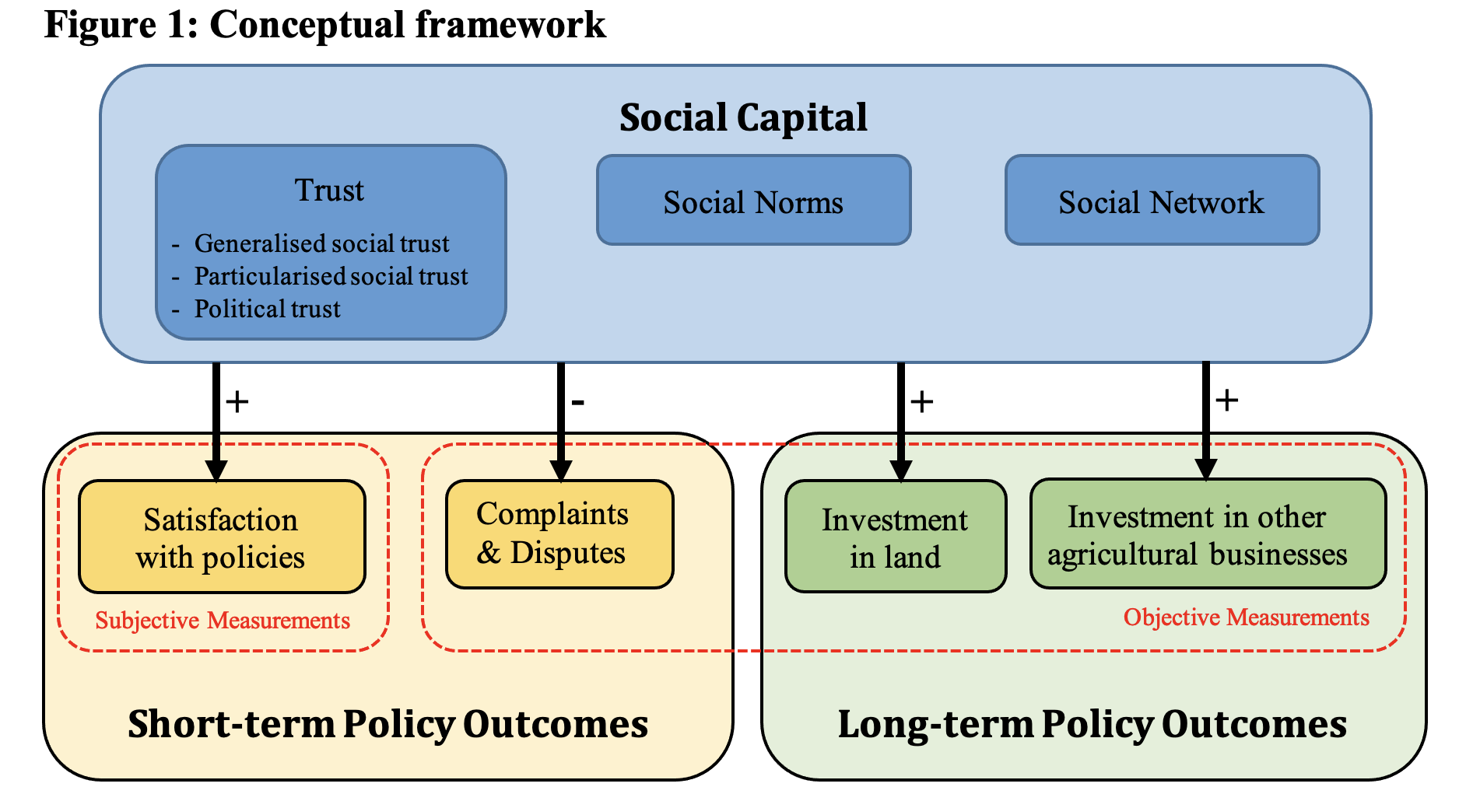
WP 1: “In government we (dis)trust: Confidence as a multiplier in China’s rural financial systems”
Pilot study in 2016 (4 provinces)
Survey (22 provinces) in February 2018
Outputs: Helen X. H. Bao, Yan Jiang, and Scott Ziyou Wang. Social Capital and the Effectiveness of Land Use Policies: Evidence from Rural China. Land Use Policy, revise and resubmitted.

Slide 8
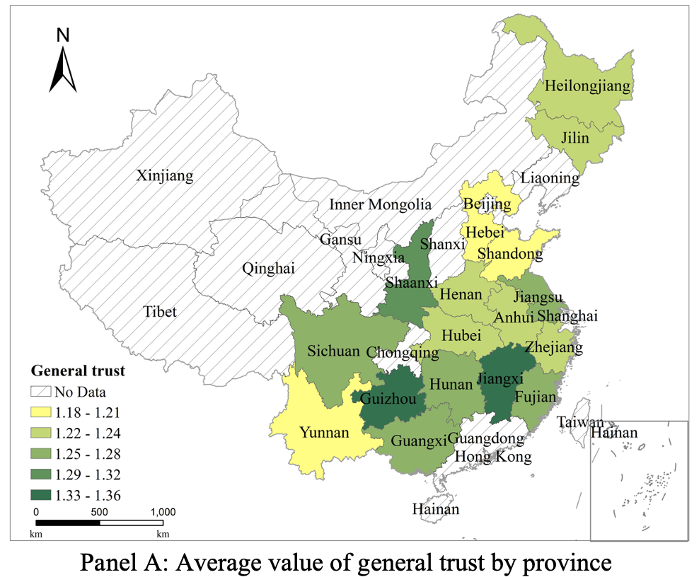
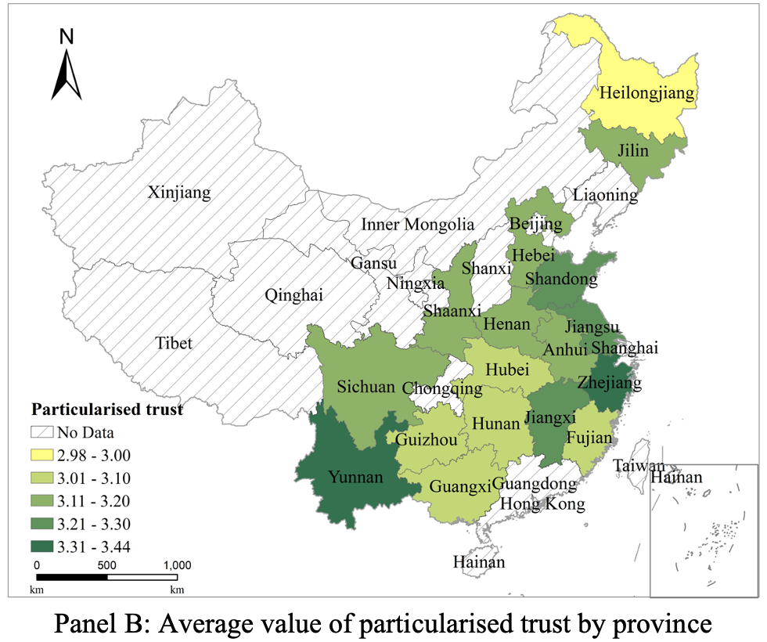
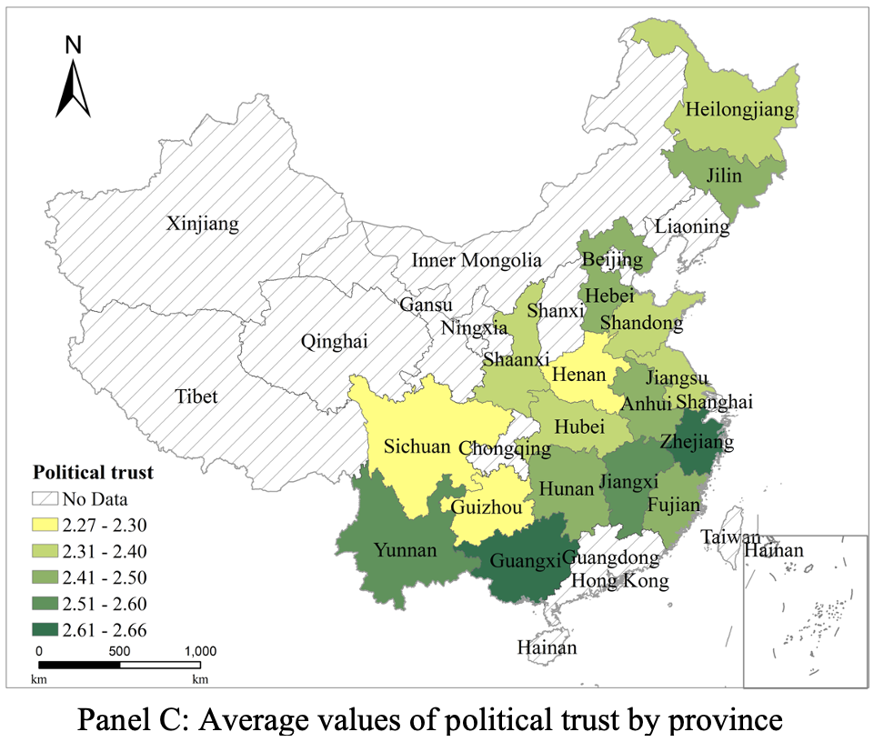
Empirical Findings - Trust

Slide 9
Empirical Findings: Short-term Land Use Policy Outcomes
Political trust, i.e., the trust towards village cadres, this the most important type of social capital determining the effectiveness of the rural land confirmation, registration, and certification scheme.
The trust towards village cadres should be separated from particularised trust, because it clearly carries special weight in the context of land use policies in China.
The effect of social network and social norm is less clear than that of political trust.

Slide 10
Empirical Findings: Long-term Land Use Policy Outcomes
Overall, social trusts do not have an impact on farmers’ decision to invest in their contract land or farming business in both categories considered.
Social network matters. But the strongest impact of social capital comes from social norms.
The social norm of conventional and risky investments in either land or subsidiary rural businesses are not complements. They are not complete substitute of each other either. Hence, there is room for improving both types of investments at the same time.

Slide 11
Conclusions
Our findings confirmed that social capital affects people’s ability and willingness to adopt sustainable practices and to comply with land use policies by reducing the costs of collecting information, mobilising financial resources, and overcoming psychological barriers.
The analytical framework has a wholistic and comprehensive design. It could effectively reduce omitted variable bias and ameliorate confounding effects, both of which are challenging issues in land use policy studies.
Our empirical approach is a significant improvement over the existing literature, because such a systematic and comprehensive empirical strategy allows the reliable identification of social capital effects.
The effects of social capital are different on short-term and long-term policy outcomes.
Policymakers should mobilise different types of social capital accordingly, such as focusing on political trust to improve the satisfaction about the policies, and provide additional support to villages with weaker social network to achieve better long-term outcomes.

Slide 12
WP2: “e-Nudges: Digital technology as an enabler to reduce fraud, error, and debt among rural households”
Established agreement with Yunnan Jinning Rural Credits Union Associations and Nantong Rural Commercial Bank for field experiment
Online banking system and rural insurance
Collection data for experiment design: Fieldwork in December 2017 (Kunming & Nantong) & Field experiments started in summer 2018 (Nantong)
Experiments were interrupted and contaminated by COVID-19
Outputs:
Helen X. H. Bao, Colin Lizieri and Christina Li. Removing Obstacles to Mobile Banking Take-up: Evidence from a Randomized Field Experiment. First draft: March 2019.

Slide 13
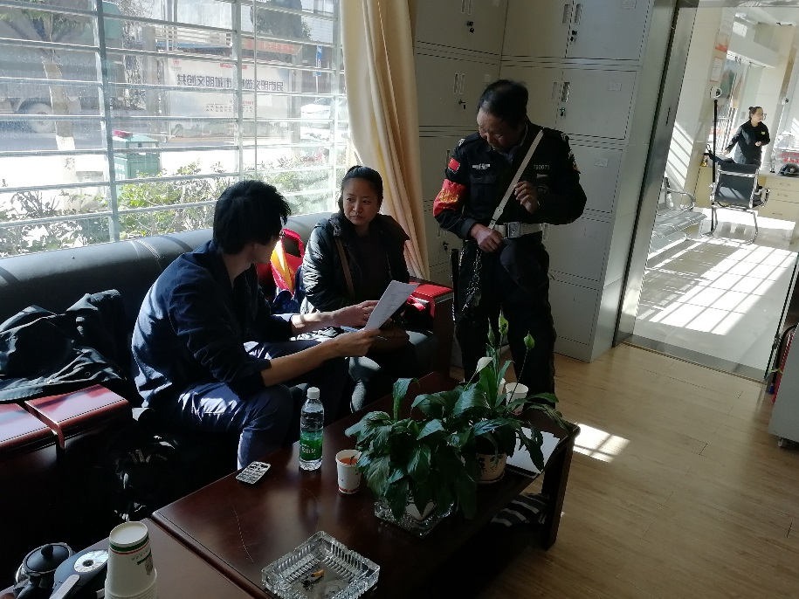
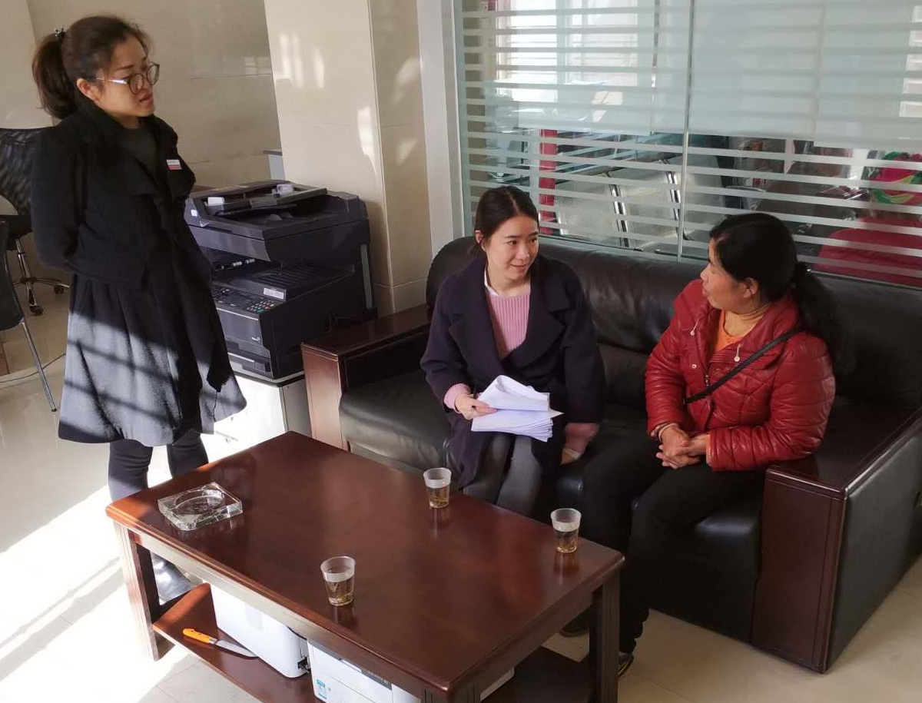
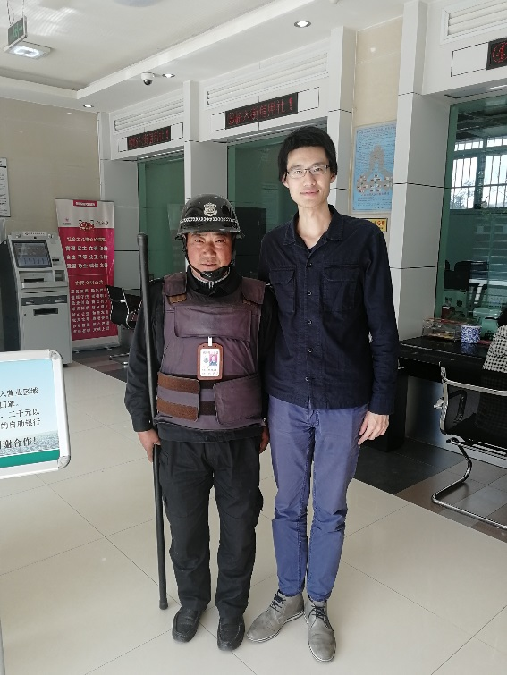
WP2: “e-Nudges: Digital technology as an enabler to reduce fraud, error, and debt among rural households”
Fieldwork in Yunnan (December 2017)

Slide 14
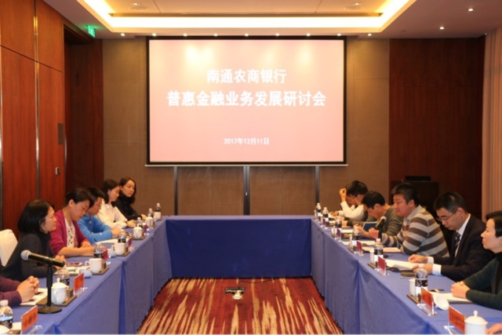
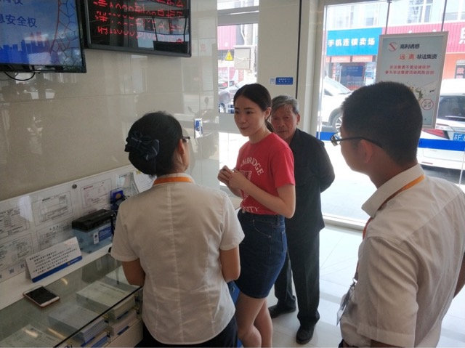
WP2: “e-Nudges: Digital technology as an enabler to reduce fraud, error, and debt among rural households”
Fieldwork in Nantong (2018)

Slide 15
WP3: “The way forward: Good nudges, and nudging for good”
Workshop and Symposium on Behavioural Sciences and Urban-Rural Development in China, 24 – 26 January 2018, Newnham College, University of Cambridge
Behavioural Sciences and Urban Rural Development Seminar Series 2018
Cities, Special Issue on “Healthy Cities, Happy Cities: Behavioural Insights” (2019 – 2020)
Land Use Policy, Special Issue on “Behavioural Land Use Policy Studies” (2019 – 2020)
Helen X. H. Bao (2020). Behavioural Science and Housing Decision Making: A Case Study Approach, London, Routledge.
Helen X. H. Bao and Colin Lizieri (forthcoming). Behavioural Housing Finance, in Ken Gibb edited, Handbooks for Housing Economics. Routledge.
International Workshop on Behavioural Sciences and Urban-Rural Development in Developing Countries, 24 – 26 July 2023, Newnham College, University of Cambridge

Slide 16
Related Publications
Helen X. H. Bao and Charlotte Chunming Meng (2023). Housing Wealth Distribution, Inequality, and Residential Satisfaction. Regional Studies, https://doi.org/10.1080/00343404.2022.2159938.
Helen X. H. Bao and Guy Robinson (2022). Behavioural Land Use Policy Studies: Past, Present, and Future. Land Use Policy, Volume 115, Article ID: 106013.
Helen X. H. Bao and Yi Lim (2022). Behavioural Interventions for Micro-mobility Adoption: Low-hanging Fruits or Hard Nuts to Crack? Transportation Research Part F: Traffic Psychology and Behaviour, Volume 84, 423 – 441.
Helen X. H. Bao and Joelle Ng (2022). Tradable Parking Permits as a Transportation Demand Management Strategy: A Behavioural Investigation. Cities, Volume 120, Article ID: 103463.
Helen X. H. Bao and Rufus Saunders (2021). Reference Dependence in the UK Housing Market. Housing Studies, forthcoming.
Helen X. H. Bao, Charlotte Chunming Meng, and Jing Wu (2021). Reference Dependence and Loss Aversion in Residential Property Development Decisions: Evidence from Beijing. Journal of Housing and the Built Environment, forthcoming.
Helen X. H. Bao, Adam Brady and Ziyou Wang (2020). Pricing Efficiency and Bounded Rationality: Evidence Based on the Responses Surrounding GICS Real Estate Category Creation. International Real Estate Review, 23(1):663 – 689.
Bao, H., Li, L. and Lizieri, C. (2019) City Profile: Chongqing (1997-2017) Cities, 94, 161-171.
Gong, C., Lizieri, C. and Bao, H. (2019) “Smarter information, smarter consumers”? Insights into the housing market, Journal of Business Research, 97, 51-64.
Yan J. and Helen X. H. Bao (2018). A Prospect Theory-Based Analysis of Housing Satisfaction with Relocations: Field Evidence from China. Cities: The International Journal of Policy and Planning, 83: 193–202.
Sally Monson, Helen X. H. Bao, and Colin Lizieri (2018). A Behavioral Interpretation of the NAV Discount Puzzle in Listed Real Estate Companies. Journal of Real Estate Portfolio Management, 24(2): 151-165.

